Slide 1


基于大模型的电子病历结构化与医学本体建设
清华大学 俞声
X-AGI 2025

Slide 2
结构化让电子病历释放应用价值
原始应用
临床流程电子化
衍生应用
临床科研数据
政府监管数据
政策制定（公共卫生政策、医保产品开发、医药市场研究等）
临床决策支持模型
Notes:
电子病历的应用价值基本上都要通过结构化来释放

Slide 3
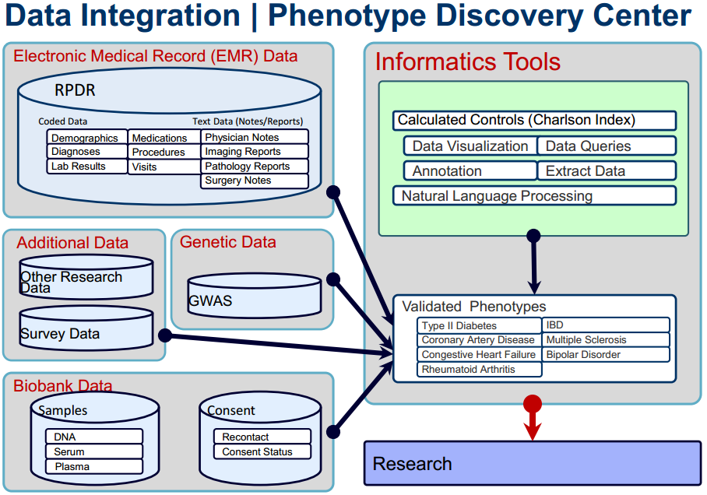
为科研服务的医疗数据集成与提取
Source: Shawn Murphy, M.D., Ph.D., Corporate Director of Research Information Systems and Computing at Partners HealthCare

Slide 4
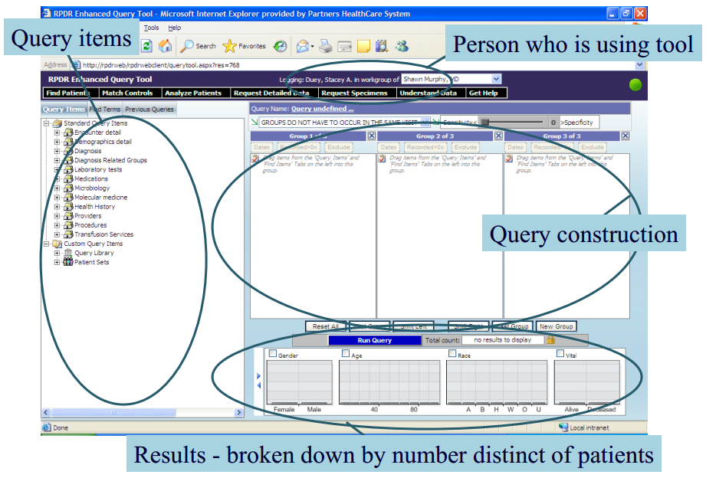
为科研服务的医疗数据集成与提取
Source: Shawn Murphy, M.D., Ph.D., Corporate Director of Research Information Systems and Computing at Partners HealthCare

Slide 5
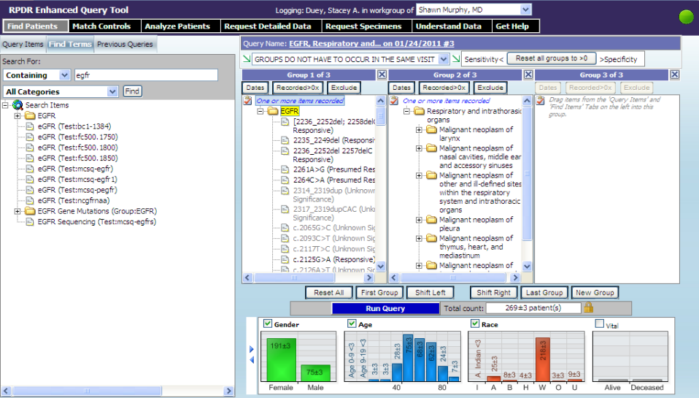
为科研服务的医疗数据集成与提取
Source: Shawn Murphy, M.D., Ph.D., Corporate Director of Research Information Systems and Computing at Partners HealthCare

Slide 6
结构化让电子病历释放应用价值
原始应用
临床流程电子化
衍生应用
临床科研数据
政府监管数据
政策制定（公共卫生政策、医保产品开发、医药市场研究等）
临床决策支持模型
多数关键信息蕴藏在自由文本中 —— 结构化是医疗信息有效利用的底层技术。
Notes:
电子病历的应用价值基本上都要通过结构化来释放

Slide 7
电子病历结构化标准化处理
病历原文
{
"术语": "慢性乙型肝炎",
"语义类型": "疾病、综合征、病理功能",
"叙述状态": "存在",
"身体部位": "无",
"数值": "NA",
"单位": "NA",
"修饰词": "无"
},
{
"术语": "肝功能异常",
"语义类型": "症状、体征、临床所见",
"叙述状态": "存在",
"身体部位": "无",
"数值": "NA",
"单位": "NA",
"修饰词": "无"
},
{
"术语": "HBsAg",
"语义类型": "化学物质、药物",
"叙述状态": "不存在",
"身体部位": "NA",
"数值": "无",
"单位": "NA",
"修饰词": "NA"
},
{
"术语": "肝脏病理",
"语义类型": "诊断操作",
"叙述状态": "存在",
"身体部位": "无",
"数值": "无",
"单位": "NA",
"修饰词": "NA"
},
{
"术语": "病毒性肝炎",
"语义类型": "疾病、综合征、病理功能",
"叙述状态": "存在",
"身体部位": "无",
"数值": "NA",
"单位": "NA",
"修饰词": "无"
},
{
"术语": "肝纤维化",
"语义类型": "疾病、综合征、病理功能",
"叙述状态": "存在",
"身体部位": "无",
"数值": "NA",
"单位": "NA",
"修饰词": "无"
},
慢性乙型肝炎病史10余年，曾有肝功能异常，中医治疗后好转；1年余前查HBsAg转阴，但肝脏病理提示病毒性肝炎伴肝纤维化（G1S3-4），予恩替卡韦0.5mg qd抗病毒治疗至今。2型糖尿病11年余，目前口服二甲双胍维格列汀850/50mg bid降糖治疗，血糖控制良好。血管性痴呆2年余，长期口服重酒石酸卡巴拉汀1.5mg bid。高血压1年余，血压最高180/80mmHg，长期口服硝苯地平控释片30mg qd，厄贝沙坦/氢氯噻嗪片150mg/12.5mg qn，血压控制在130/80mmHg。发现右侧锁骨下动脉起始部斑块形成1年余，未予特殊诊治。发现左侧肾上腺增粗、左侧肾盂输尿管连接处狭窄、继发左肾积水1年余，泌尿外科会诊不能除外肾盂旁囊肿，现定期复查。反流性食管炎2年，间断口服抑酸药物。发现甲状腺功能减退、甲状腺结节7月余，现口服左甲状腺素钠片50ug qd。发现慢性萎缩性胃炎4月余，间断护胃对症治疗。3月余前考虑抑郁状态，加用氟哌噻吨美利曲辛片*0.5mg/10mg qd至今。40余年前腹部及右前臂大面积烫伤，行植皮手术治疗，目前局部可见疤痕。20年前曾感染“梅毒”，现查TPPA阳性，TRUST阴性，考虑“梅毒转阴”，否认结核、疟疾等传染病病史及其密切接触史。无输血史。否认食物、药物过敏史。

Slide 8
结构化是医疗数据的“测序技术”
测序之于基因数据
将生物信息数据化，没有测序技术生物信息就无法获取、数字化或大规模分析，基因研究就停留在理论层面。
结构化之于医疗数据
非结构化病历数据难以直接用于分析、共享或决策，结构化的过程将这些数据转化为统一的、机器可读的格式，使其可查询、可分析。没有结构化，医疗数据就像一堆混乱的纸张，无法系统性利用。
两者
使数据从原始状态变为可操作知识的桥梁
是不可或缺的基础设施
开启了数据价值的“大门”，推动各自领域的进步

Slide 9
电子病历结构化专用大模型

Slide 10
电子病历结构化难在哪里？
病历原文
病历实际意思
Chest: Resp were unlabored, no accessory muscle use. CTAB, no
rales, wheezes or rhonchi.
Abd: Obese, Soft, NTND. No HSM or tenderness.
Ext: Large Right hip hematoma with ecchymoses extending to right
flank and down to Right calf. No c/c/edema.
Skin: stasis dermatitis, no ulcers, scars.
Neuro: Alert and oriented x 2, non- focal, CNs II-XII grossly
Intact
Pertinent Results:
CTA Chest___: Final Report
REASON FOR EXAM: Desaturation. Clinical concern for pulmonary
embolism.
Chest: Respirations unlabored, no accessory muscle use. Clear to auscultation bilaterally, no rales, wheezes or rhonchi.
Abdomen: Obese, Soft, Non-Tender, Non-Distended. No Hepatosplenomegaly or tenderness.
Extremities: Large Right hip hematoma with ecchymoses extending to right flank and down to Right calf. No clubbing, cyanosis, or edema.
Skin: stasis dermatitis, no ulcers, scars.
Neurological: Alert and oriented to person and place, non-focal, Cranial Nerves II-XII grossly intact.
Pertinent Results:
CTA Chest (Computed Tomography Angiography Chest): Final Report
REASON FOR EXAM: Desaturation. Clinical concern for pulmonary embolism.

Slide 11

电子病历结构化难在哪里？
电子病历是以高度不标准形式写的高度专业的信息
相比常规自然语言处理，更依赖上下位分析和专业背景知识
传统系统需要很多处理模块
格式清洗、命名实体识别、词义消歧、实体链接/术语标准化、叙述状态分析、身体部位分析、修饰语分析、数值与单位提取或推断、时间分析……
系统部署对技术要求高，更难以升级；
极少有医院有能力部署全套结构化系统。
基于大模型技术，GENIE以一个模型单体代替所有传统模块， 并提供更强的分析能力—— GENIE: Generative Note Information Extraction 病历精灵
https://huggingface.co/THUMedInfo/GENIE_en_8b
https://huggingface.co/THUMedInfo/GENIE_zh_7b

Slide 12
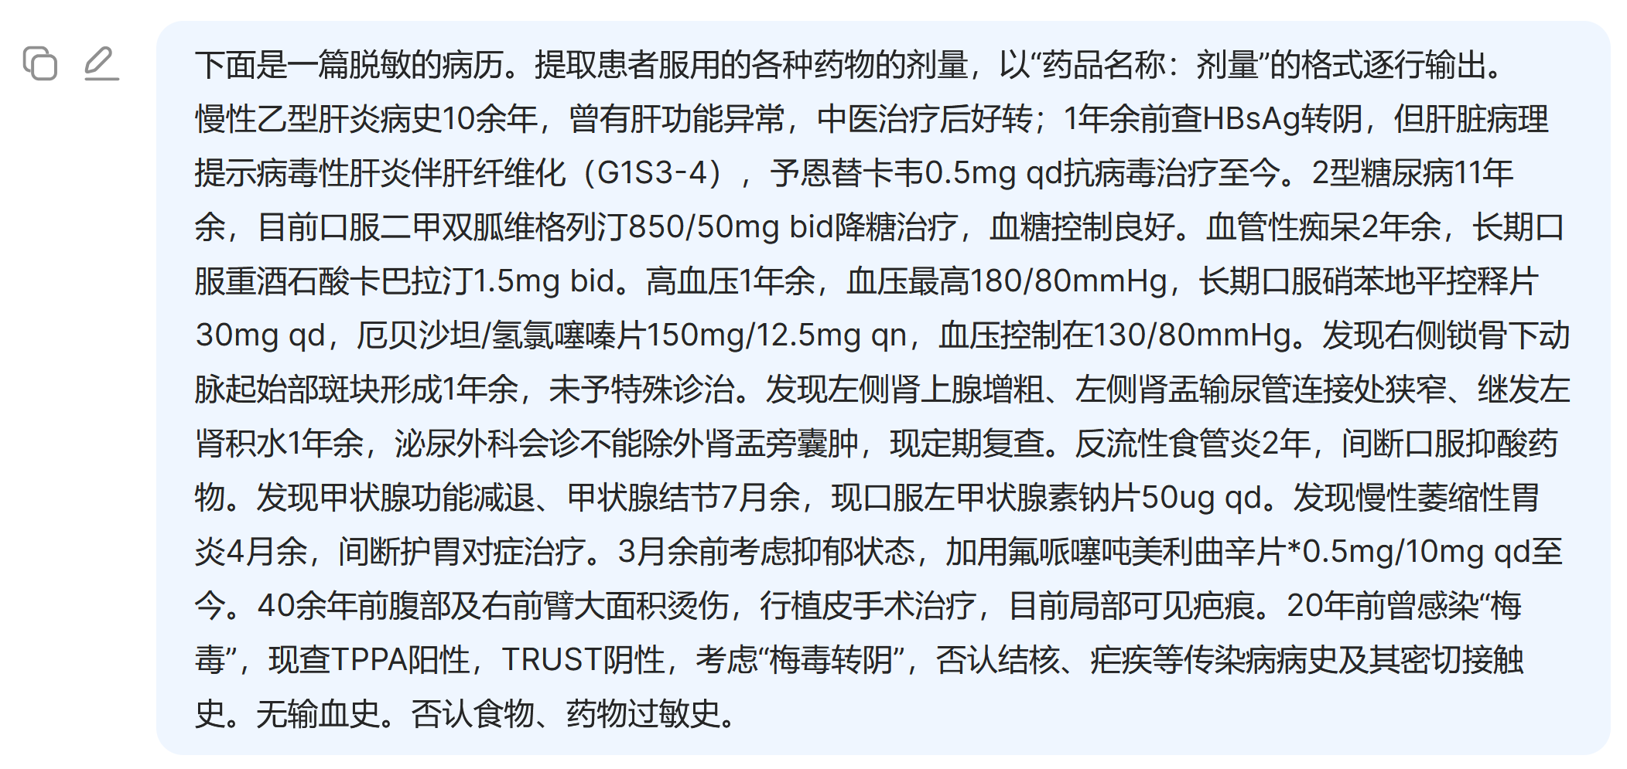
通用模型做结构化（DeepSeek r1）

Slide 13
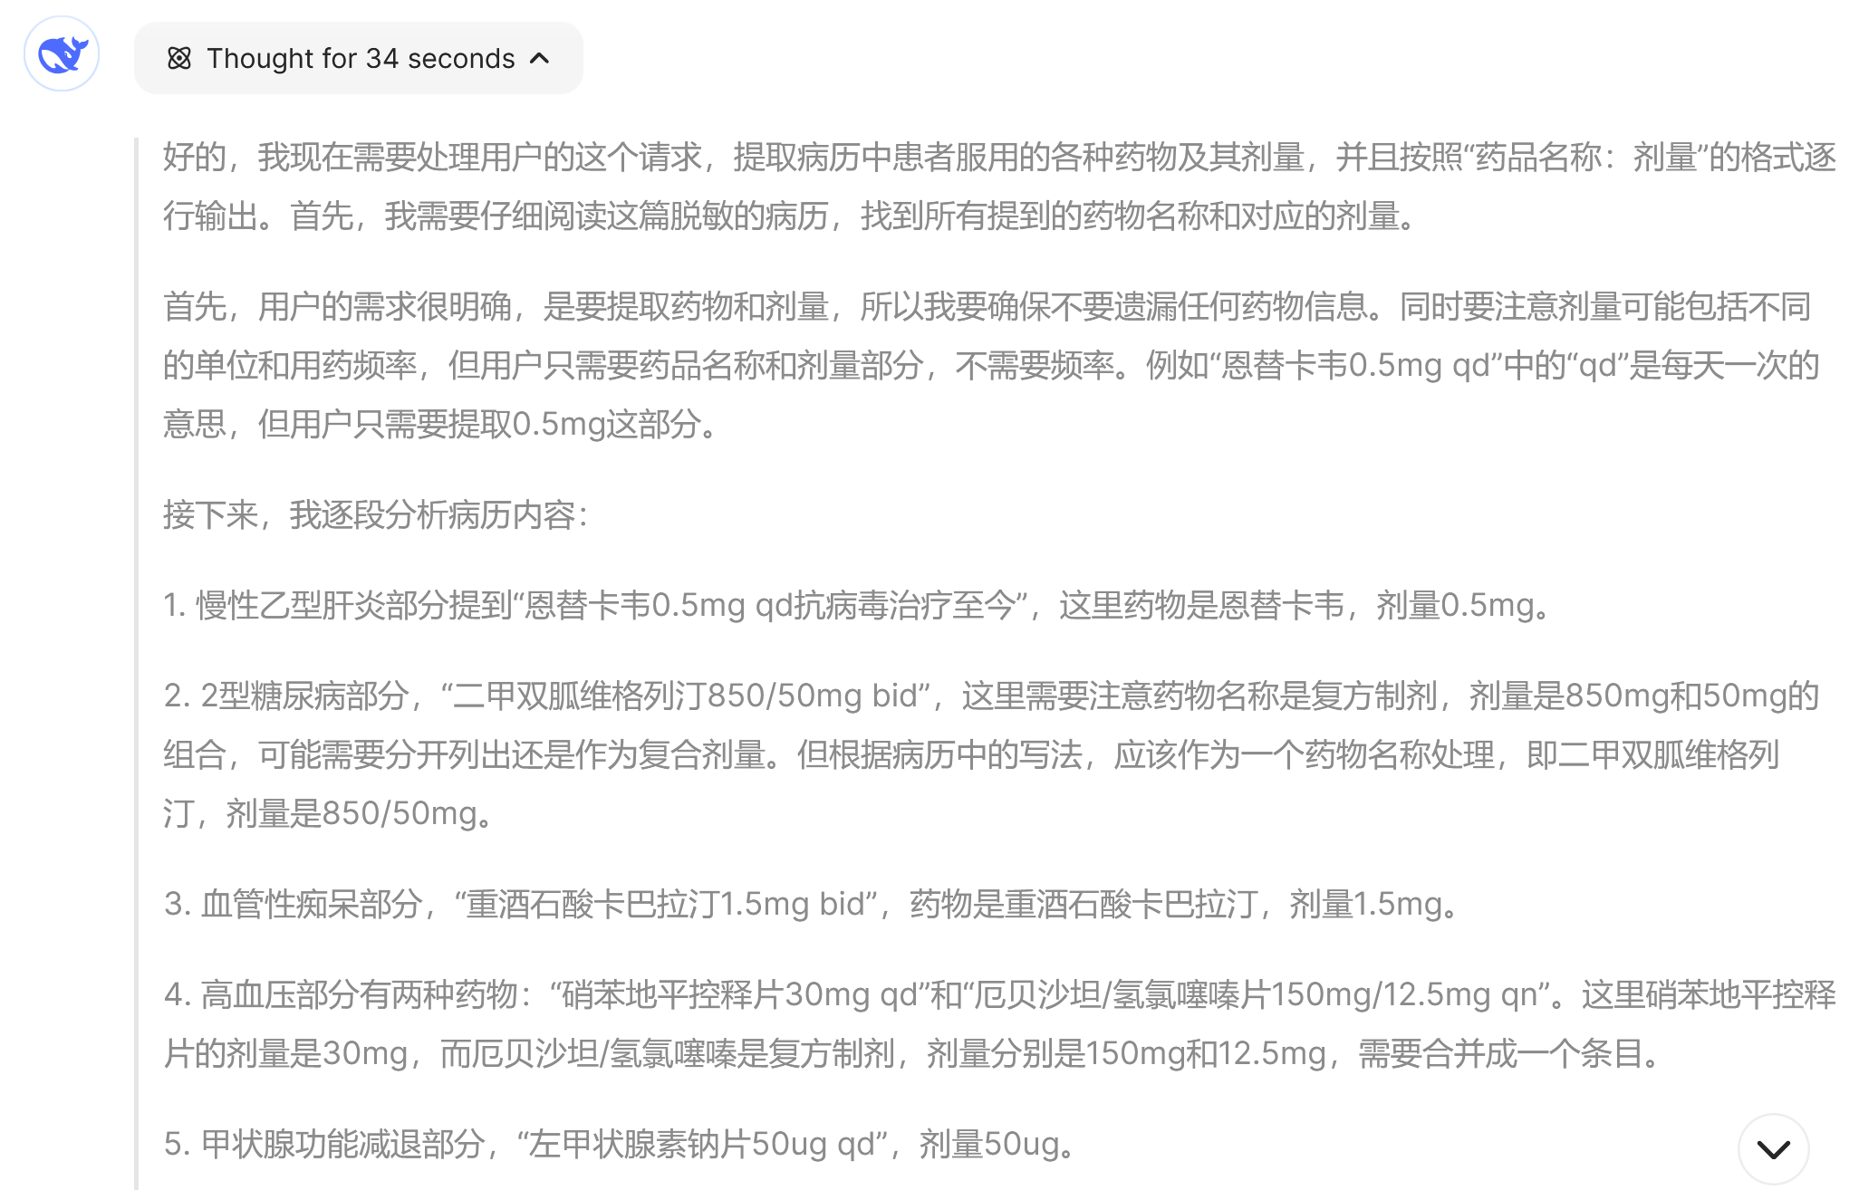
通用模型做结构化（DeepSeek r1）

Slide 14
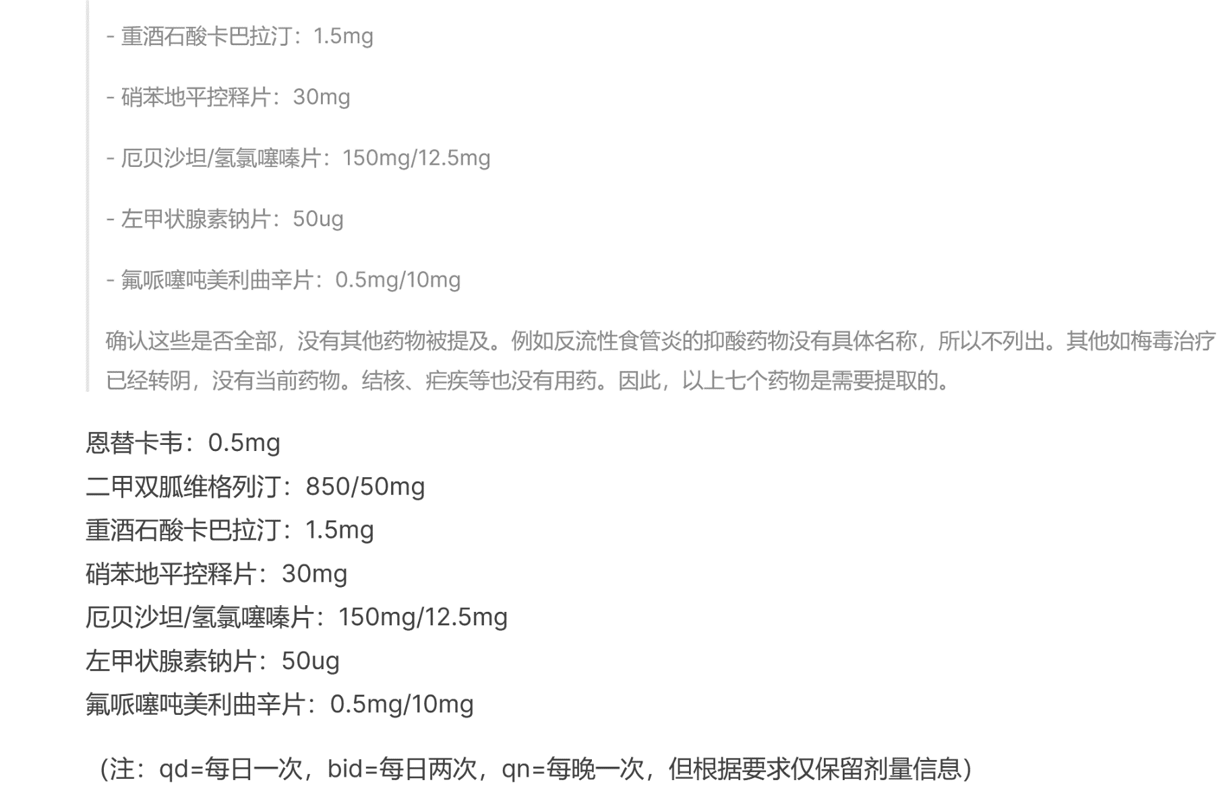
通用模型做结构化（DeepSeek r1）
每次只能提取一类信息
可能有不可预测的额外输出

Slide 15
GENIE（病历精灵）运行实例
{
"phrase": "auscultation",
"semantic_type": "Diagnostic Procedure",
"assertion_status": "present",
"body_location": "Chest",
"modifier": "not applicable",
"value": "null",
"unit": "not applicable",
"purpose": "listen to internal body sounds, such as heart and lung sounds"
},
{
"phrase": "rales",
"semantic_type": "Sign, Symptom, or Finding",
"assertion_status": "absent",
"body_location": "Chest",
"modifier": "null",
"value": "not applicable",
"unit": "not applicable",
"purpose": "not applicable"
},
{
"phrase": "wheezes",
"semantic_type": "Sign, Symptom, or Finding",
"assertion_status": "absent",
"body_location": "Chest",
"modifier": "null",
"value": "not applicable",
"unit": "not applicable",
"purpose": "not applicable"
},
病历原文
Chest: Resp were unlabored, no accessory muscle use. CTAB, no
rales, wheezes or rhonchi.
Abd: Obese, Soft, NTND. No HSM or tenderness.
Ext: Large Right hip hematoma with ecchymoses extending to right
flank and down to Right calf. No c/c/edema.
Skin: stasis dermatitis, no ulcers, scars.
Neuro: Alert and oriented x 2, non- focal, CNs II-XII grossly
Intact
Pertinent Results:
CTA Chest___: Final Report
REASON FOR EXAM: Desaturation. Clinical concern for pulmonary
embolism.

Slide 16
GENIE（病历精灵）运行实例
{
"phrase": "rhonchi",
"semantic_type": "Sign, Symptom, or Finding",
"assertion_status": "absent",
"body_location": "Chest",
"modifier": "null",
"value": "not applicable",
"unit": "not applicable",
"purpose": "not applicable"
},
{
"phrase": "hepatosplenomegaly",
"semantic_type": "Sign, Symptom, or Finding",
"assertion_status": "absent",
"body_location": "Abdomen",
"modifier": "null",
"value": "not applicable",
"unit": "not applicable",
"purpose": "not applicable"
},
{
"phrase": "tenderness",
"semantic_type": "Sign, Symptom, or Finding",
"assertion_status": "absent",
"body_location": "Abdomen",
"modifier": "null",
"value": "not applicable",
"unit": "not applicable",
"purpose": "not applicable"
},
病历原文
Chest: Resp were unlabored, no accessory muscle use. CTAB, no
rales, wheezes or rhonchi.
Abd: Obese, Soft, NTND. No HSM or tenderness.
Ext: Large Right hip hematoma with ecchymoses extending to right
flank and down to Right calf. No c/c/edema.
Skin: stasis dermatitis, no ulcers, scars.
Neuro: Alert and oriented x 2, non- focal, CNs II-XII grossly
Intact
Pertinent Results:
CTA Chest___: Final Report
REASON FOR EXAM: Desaturation. Clinical concern for pulmonary
embolism.

Slide 17
GENIE（病历精灵）运行实例
病历原文
{
"phrase": "hip hematoma",
"semantic_type": "Disease, Syndrome or Pathologic Function",
"assertion_status": "present",
"body_location": "Large Right",
"modifier": "Large right",
"value": "not applicable",
"unit": "not applicable",
"purpose": "not applicable"
},
{
"phrase": "ecchymoses",
"semantic_type": "Disease, Syndrome or Pathologic Function",
"assertion_status": "present",
"body_location": "right flank and down to Right calf",
"modifier": "null",
"value": "not applicable",
"unit": "not applicable",
"purpose": "not applicable"
},
{
"phrase": "clubbing",
"semantic_type": "Anatomical Abnormality",
"assertion_status": "absent",
"body_location": "Extremities",
"modifier": "null",
"value": "not applicable",
"unit": "not applicable",
"purpose": "not applicable"
},
Chest: Resp were unlabored, no accessory muscle use. CTAB, no
rales, wheezes or rhonchi.
Abd: Obese, Soft, NTND. No HSM or tenderness.
Ext: Large Right hip hematoma with ecchymoses extending to right
flank and down to Right calf. No c/c/edema.
Skin: stasis dermatitis, no ulcers, scars.
Neuro: Alert and oriented x 2, non- focal, CNs II-XII grossly
Intact
Pertinent Results:
CTA Chest___: Final Report
REASON FOR EXAM: Desaturation. Clinical concern for pulmonary
embolism.

Slide 18
GENIE（病历精灵）运行实例
病历原文
{
"phrase": "cyanosis",
"semantic_type": "Sign, Symptom, or Finding",
"assertion_status": "absent",
"body_location": "Extremities",
"modifier": "null",
"value": "not applicable",
"unit": "not applicable",
"purpose": "not applicable"
},
{
"phrase": "edema",
"semantic_type": "Disease, Syndrome or Pathologic Function",
"assertion_status": "absent",
"body_location": "Extremities",
"modifier": "null",
"value": "not applicable",
"unit": "not applicable",
"purpose": "not applicable"
},
{
"phrase": "stasis dermatitis",
"semantic_type": "Disease, Syndrome or Pathologic Function",
"assertion_status": "present",
"body_location": "Skin",
"modifier": "null",
"value": "not applicable",
"unit": "not applicable",
"purpose": "not applicable"
},
Chest: Resp were unlabored, no accessory muscle use. CTAB, no
rales, wheezes or rhonchi.
Abd: Obese, Soft, NTND. No HSM or tenderness.
Ext: Large Right hip hematoma with ecchymoses extending to right
flank and down to Right calf. No c/c/edema.
Skin: stasis dermatitis, no ulcers, scars.
Neuro: Alert and oriented x 2, non- focal, CNs II-XII grossly
Intact
Pertinent Results:
CTA Chest___: Final Report
REASON FOR EXAM: Desaturation. Clinical concern for pulmonary
embolism.

Slide 19
GENIE（病历精灵）运行实例
{
"phrase": "meds",
"semantic_type": "Chemical or Drug",
"assertion_status": "title",
"body_location": "not applicable",
"modifier": "not applicable",
"value": "null",
"unit": "not applicable",
"purpose": "null"
},
{
"phrase": "plavix",
"semantic_type": "Chemical or Drug",
"assertion_status": "present",
"body_location": "not applicable",
"modifier": "not applicable",
"value": "75",
"unit": "mg",
"purpose": "prevent blood clots"
},
{
"phrase": "clopidogrel",
"semantic_type": "Chemical or Drug",
"assertion_status": "present",
"body_location": "not applicable",
"modifier": "not applicable",
"value": "null",
"unit": "not applicable",
"purpose": "prevent blood clots"
},
病历原文
Medications on Admission: Meds: plavix 75mg daily, isosorbide mononitrate ER 60mg daily,
toprol XL 200mg___, cellcept 1000mg___, nitro 0.4mg prn,
nystatin s/s, prilosec 40mg daily, ranitidine 300mg qhs,
hydralazine 75mg tid, kayexalate prn, tacro 9mg___, trazodone
50-100mg qhs, valcyte 450mg daily, aspirin 325mg daily

Slide 20
GENIE（病历精灵）运行实例
病历原文
{
"phrase": "isosorbide mononitrate",
"semantic_type": "Chemical or Drug",
"assertion_status": "present",
"body_location": "not applicable",
"modifier": "not applicable",
"value": "60",
"unit": "mg",
"purpose": "treat angina"
},
{
"phrase": "toprol xl",
"semantic_type": "Chemical or Drug",
"assertion_status": "present",
"body_location": "not applicable",
"modifier": "not applicable",
"value": "200",
"unit": "mg",
"purpose": "treat high blood pressure and heart problems"
},
{
"phrase": "metoprolol succinate",
"semantic_type": "Chemical or Drug",
"assertion_status": "present",
"body_location": "not applicable",
"modifier": "not applicable",
"value": "null",
"unit": "not applicable",
"purpose": "treat high blood pressure and heart problems"
},
Medications on Admission: Meds: plavix 75mg daily, isosorbide mononitrate ER 60mg daily,
toprol XL 200mg___, cellcept 1000mg___, nitro 0.4mg prn,
nystatin s/s, prilosec 40mg daily, ranitidine 300mg qhs,
hydralazine 75mg tid, kayexalate prn, tacro 9mg___, trazodone
50-100mg qhs, valcyte 450mg daily, aspirin 325mg daily

Slide 21
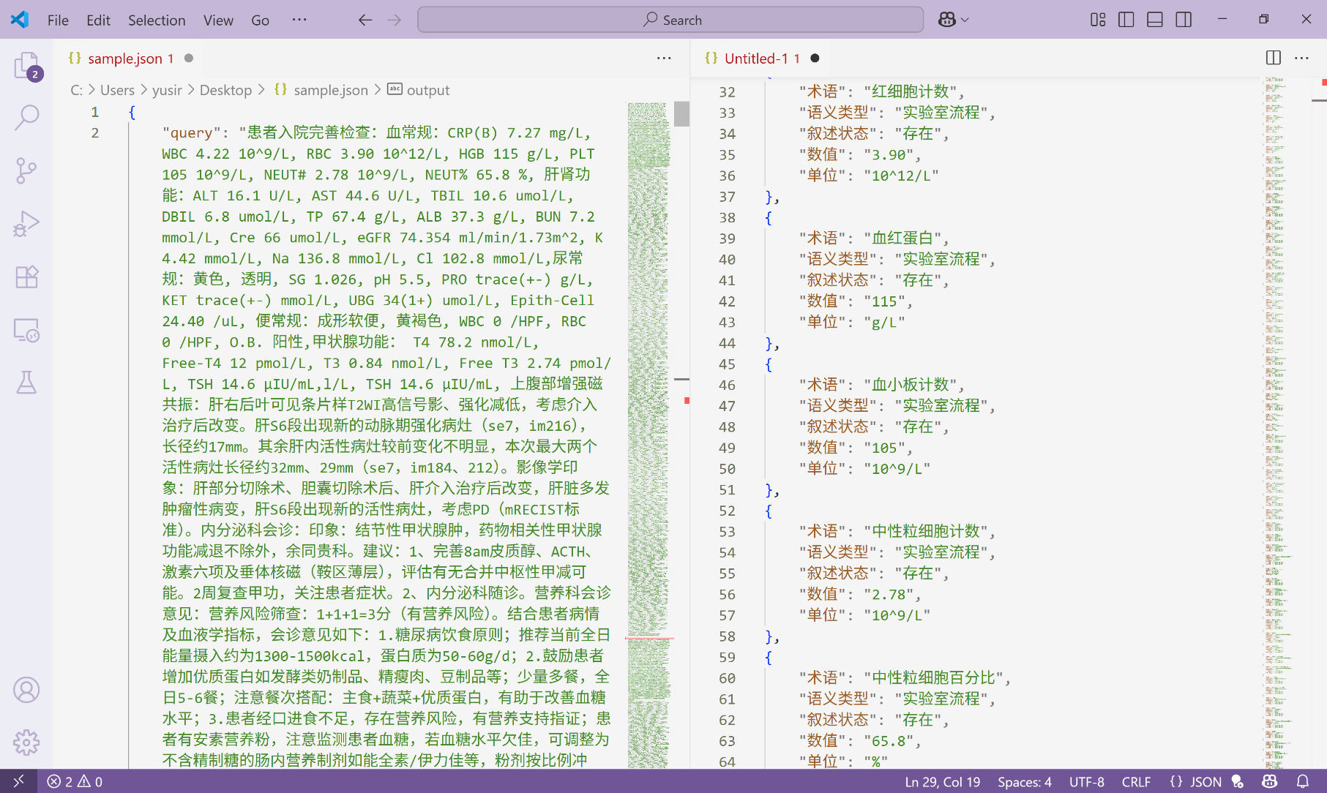
GENIE（病历精灵）运行实例

Slide 22
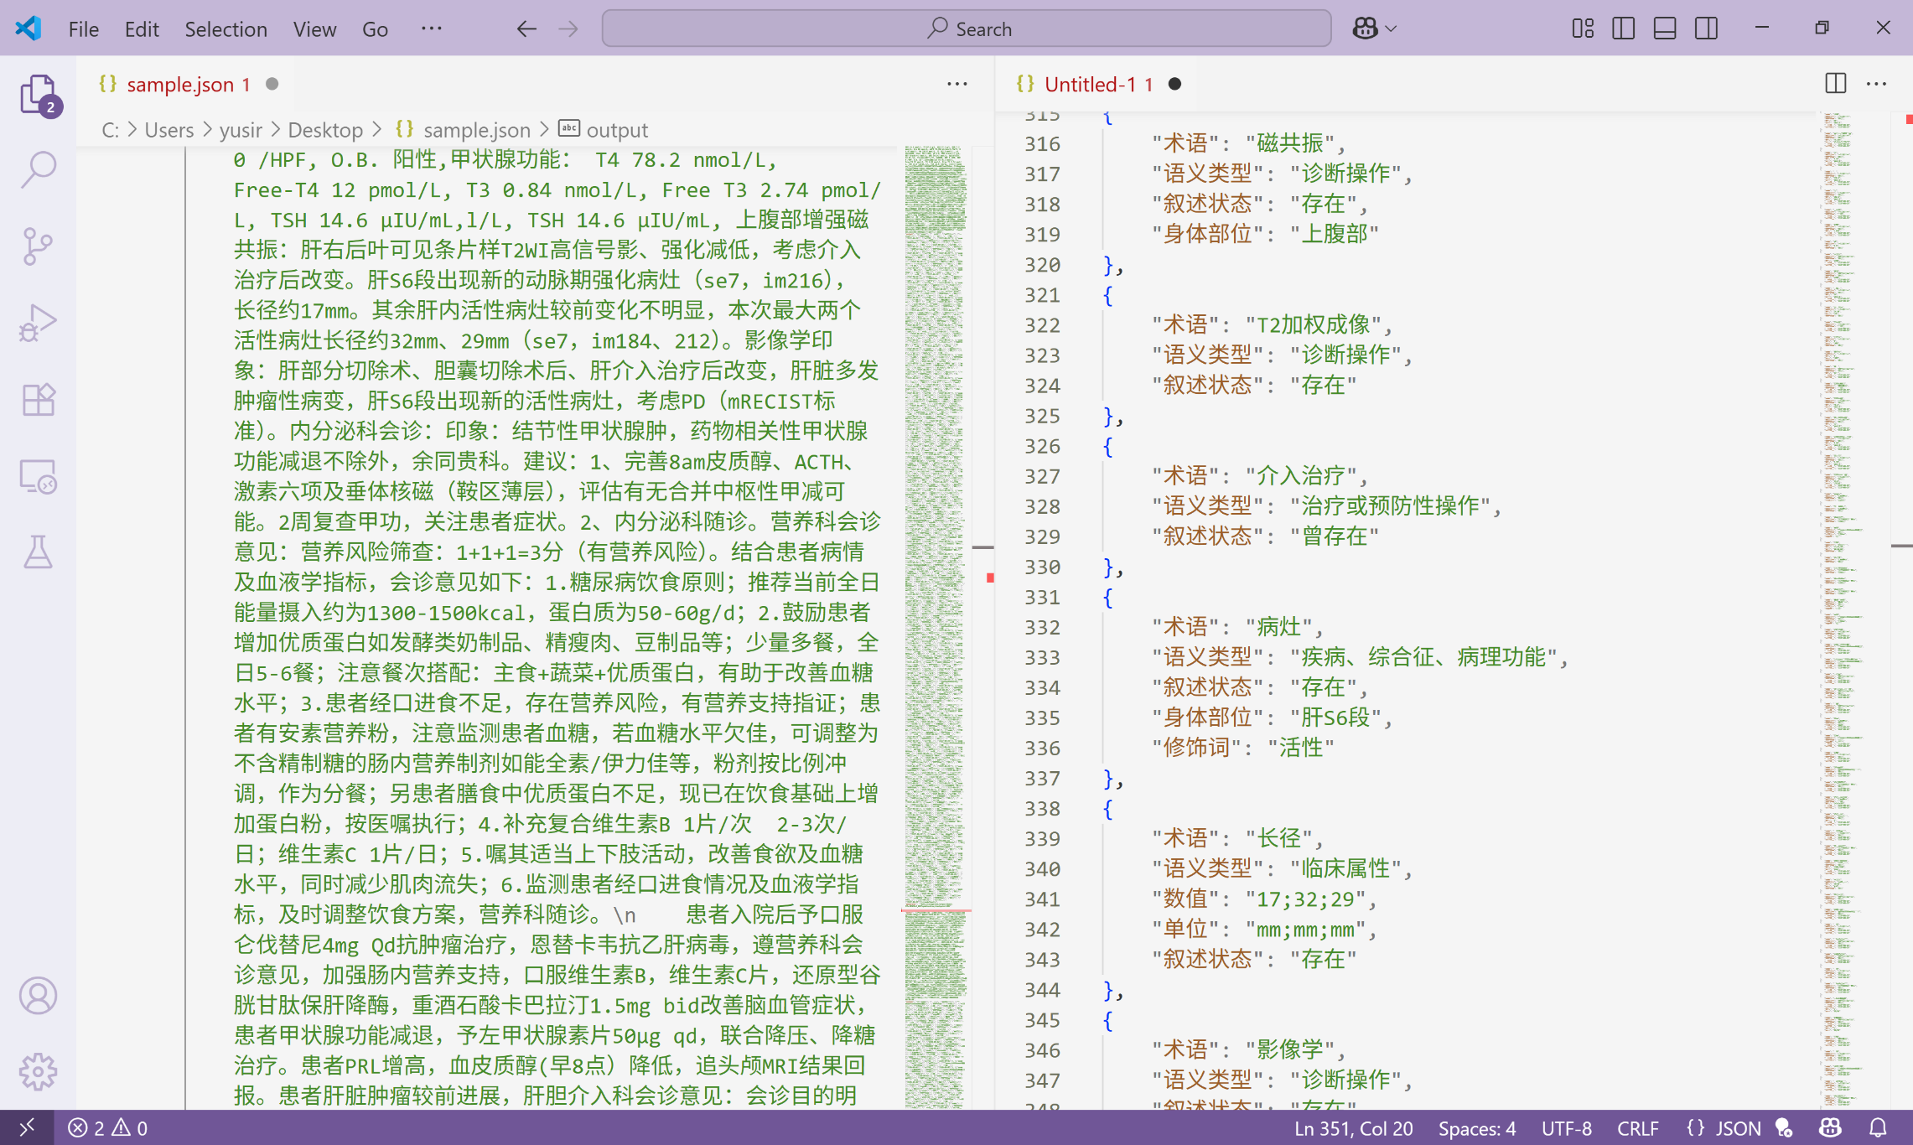
GENIE（病历精灵）运行实例

Slide 23
对比通用大模型的优势
 | GENIE | GPT-4o | DeepSeek r1
易用性 | 直接使用，准确性较好。 | 大量提示词工程和样例增加难度、成本和时间。输出需要后处理对齐拼接。术语识别不符合行业习惯。 | 类似GPT-4o
效率 | 一次输出全部属性结果（千字病历约1秒） | 对各属性逐次运行，成本高、速度慢（超过1分钟） | 比GPT-4o更慢
医院是否可用 | 开源、断网运行 | 极少数医院有私有云GPT-4o | 开源、断网运行
硬件需求 与成本 | 可在消费级硬件运行 | DGX集群，无法承担在百万、千万篇病历上运行GPT-4o | 蒸馏版可在消费级硬件运行

Slide 24
医学本体建设进展

Slide 25
医学本体（知识图谱）是医疗AI的基石
医学本体以医学概念为单位，并至少包含以下内容：
概念的语义类型
概念的各种名称（术语）
概念间的关系
概念的ID
医学本体为医学信息、大数据与人工智能行业提供：
医学文本大数据分析的基础（NLP）
服务医学信息化、智能化
行业信息交换的公共标准

Slide 26
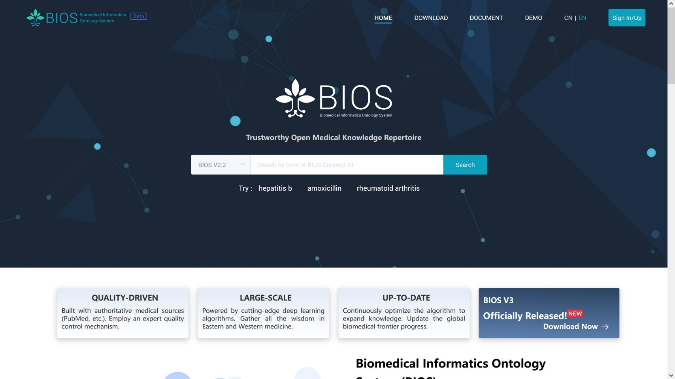
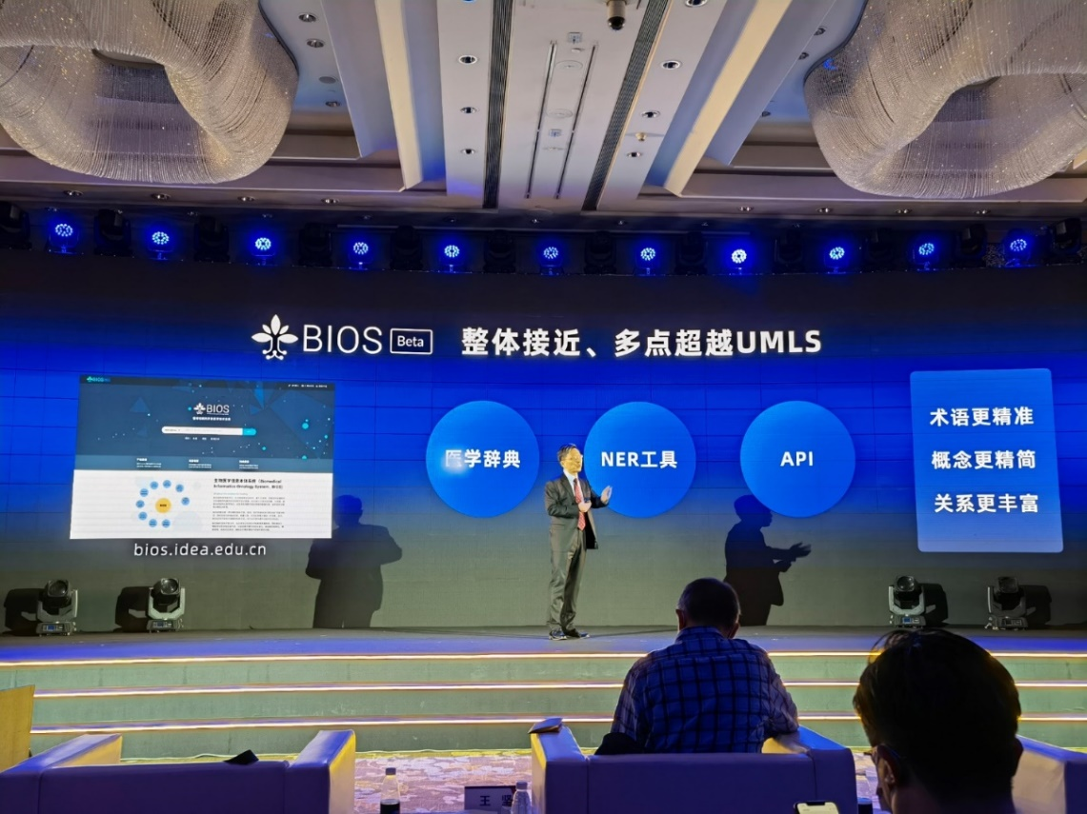
目前最大的单体生物医学本体系统
http://bios.org.cn/
2021年11月沈向洋院士发布初版BIOS

Slide 27
BIOS和UMLS对比
 | Unified Medical Language System (UMLS) | Biomedical Informatics Ontology System (BIOS)
开发者 | 美国国家医学图书馆 | 清华大学 + 粤港澳数字经济研究院
历史 | 1986年启动，当前版本2025AA | 2021年启动，当前版本V3
体量 | 345万概念 1416万术语 (1040万英文) | 2210万概念 4600万术语 (3580万英文，1020万中文)
方法 | 集成190个术语系统 | 单体系统，完全由算法生成
下载 | https://www.nlm.nih.gov/research/umls/index.html | https://huggingface.co/datasets/THUMedInfo/BIOS_v3

Slide 28
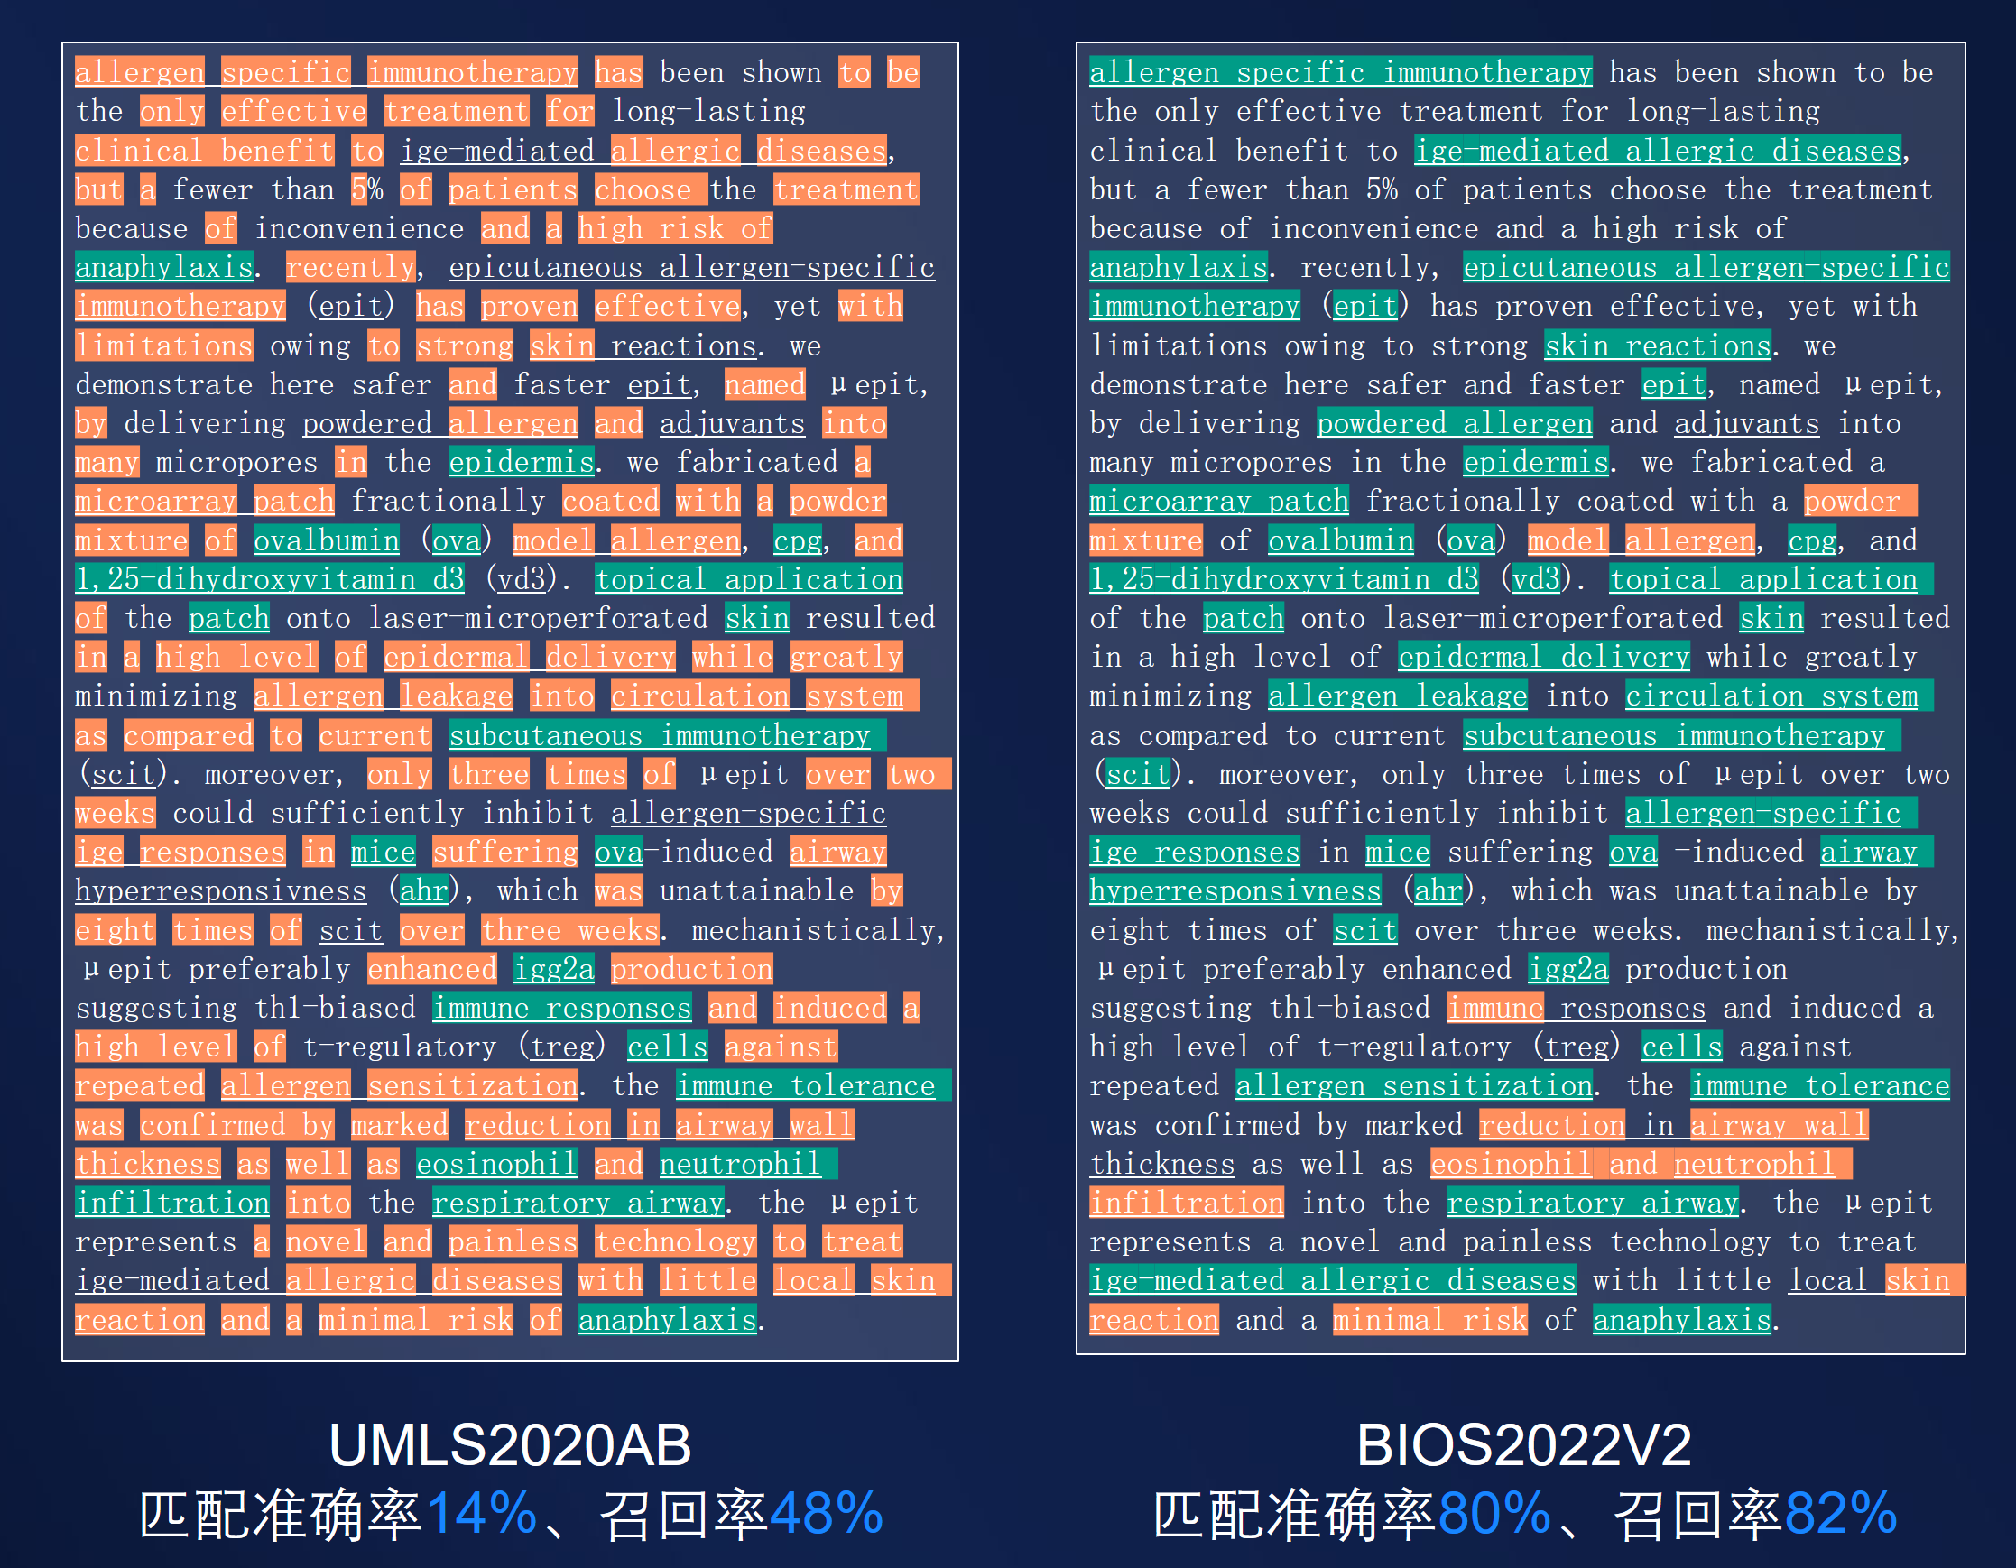
术语质量对比

Slide 29
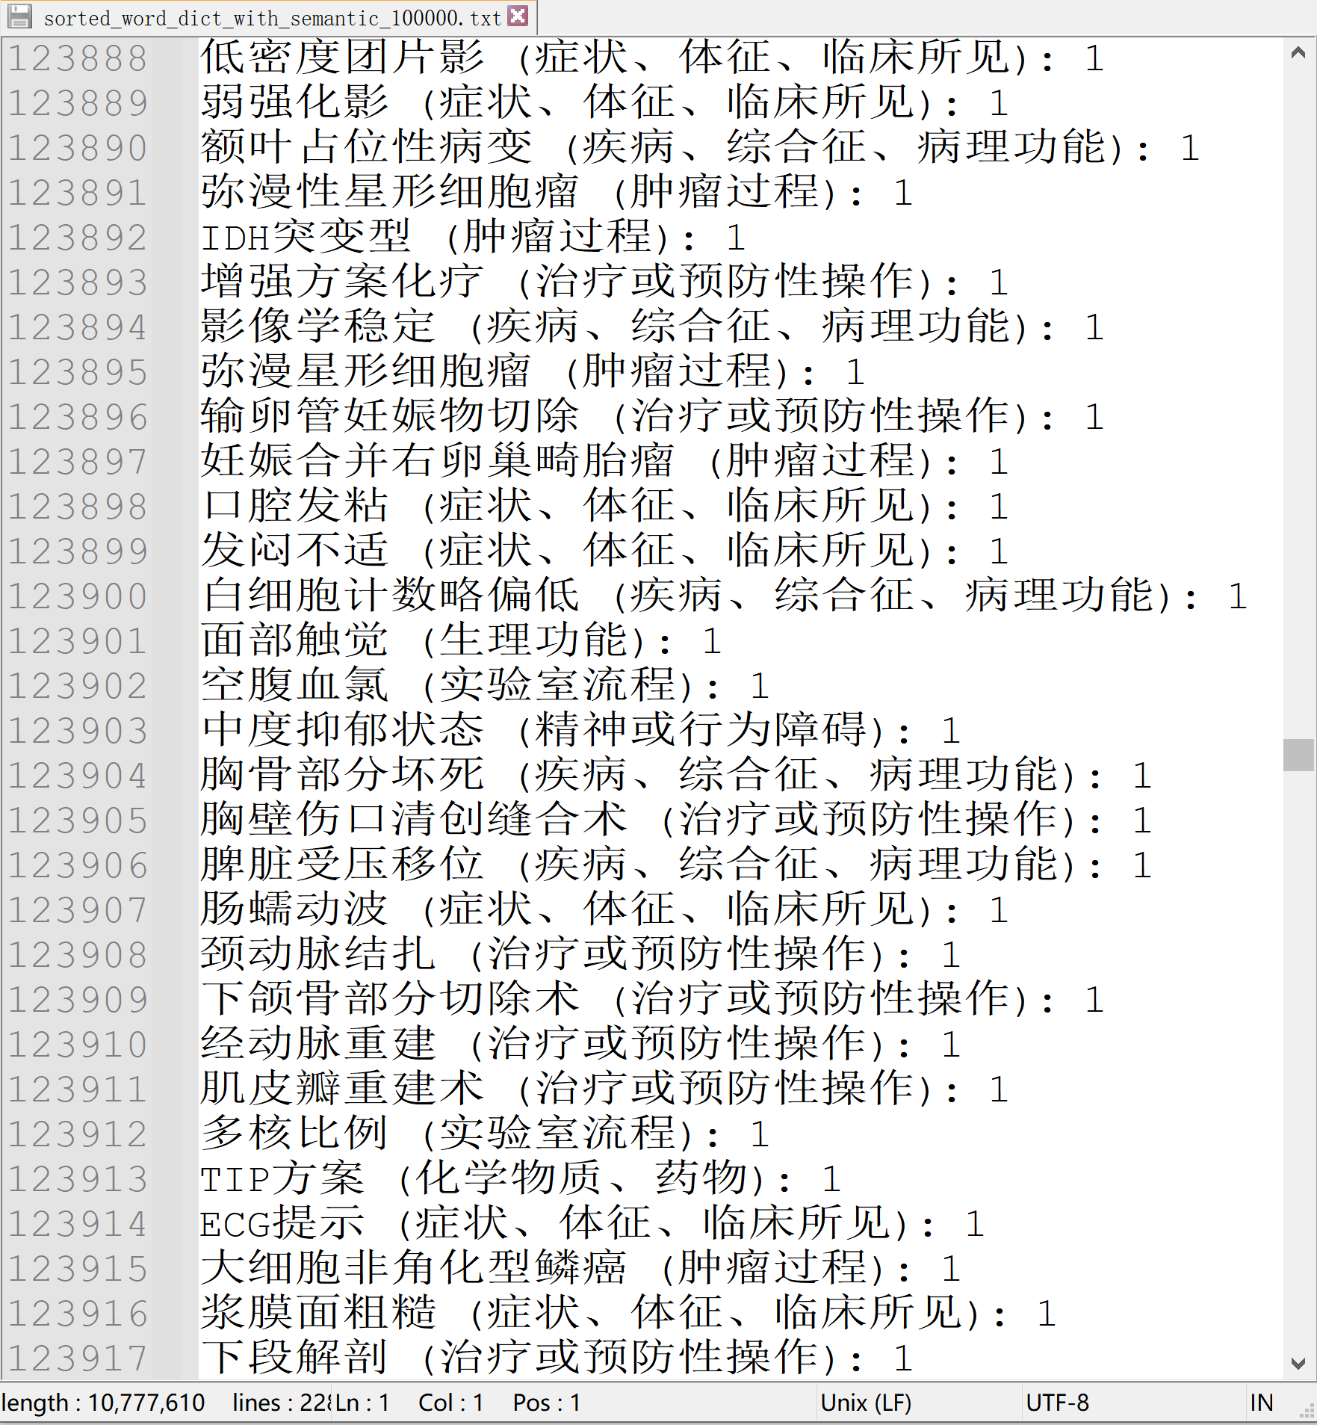
临床术语系统建设
低频术语示例
北京协和医院全部电子病历结构化
约五百万术语
下一步：数据驱动建立临床标准术语系统
同义词结构
层级结构
标准名称

Slide 30
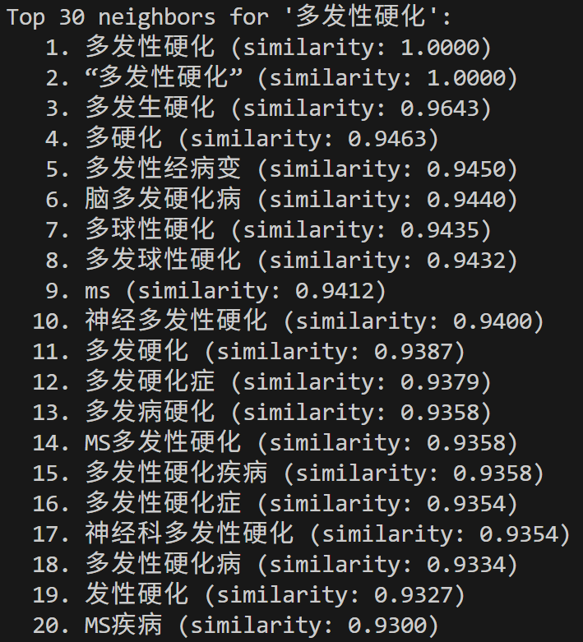
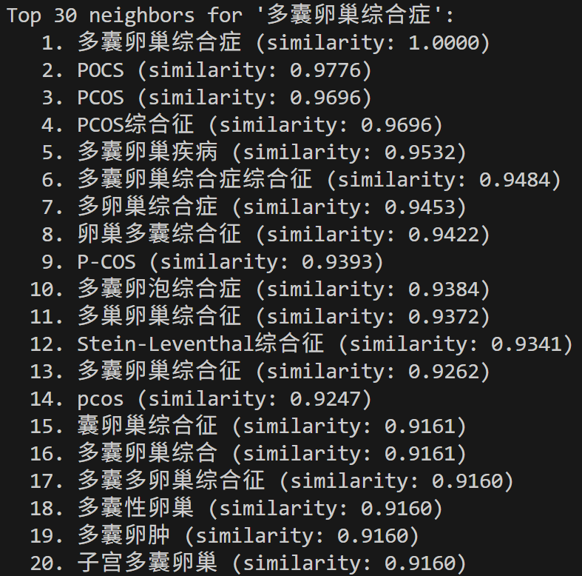
临床术语系统研究进展（潜在同义词搜索）

Slide 31
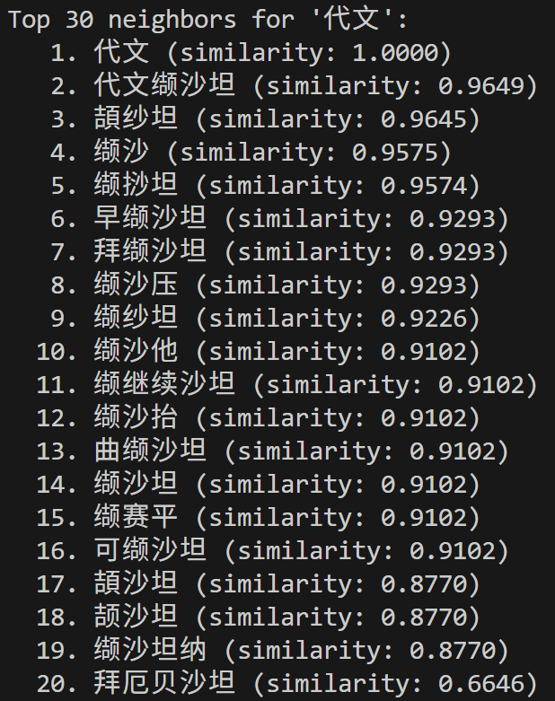
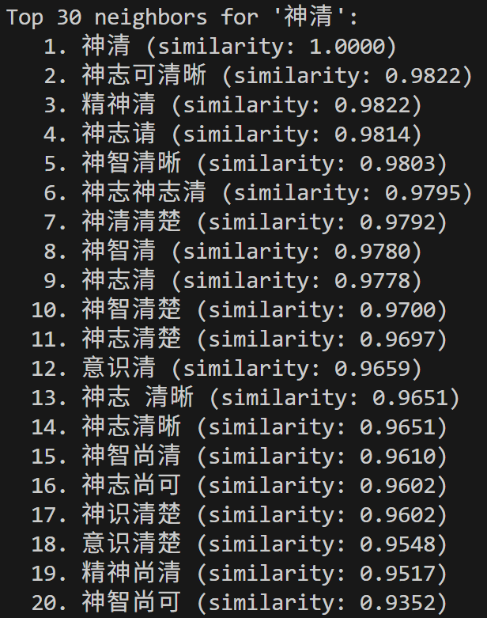
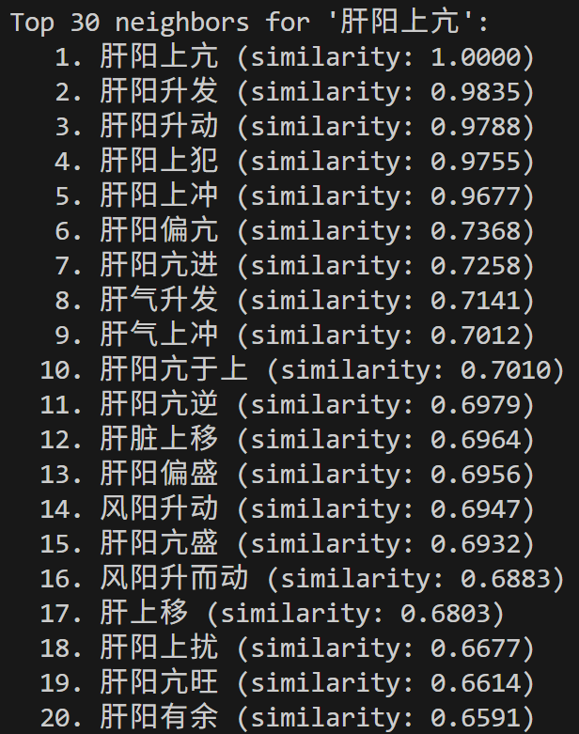
临床术语系统研究进展（潜在同义词搜索）

Slide 32
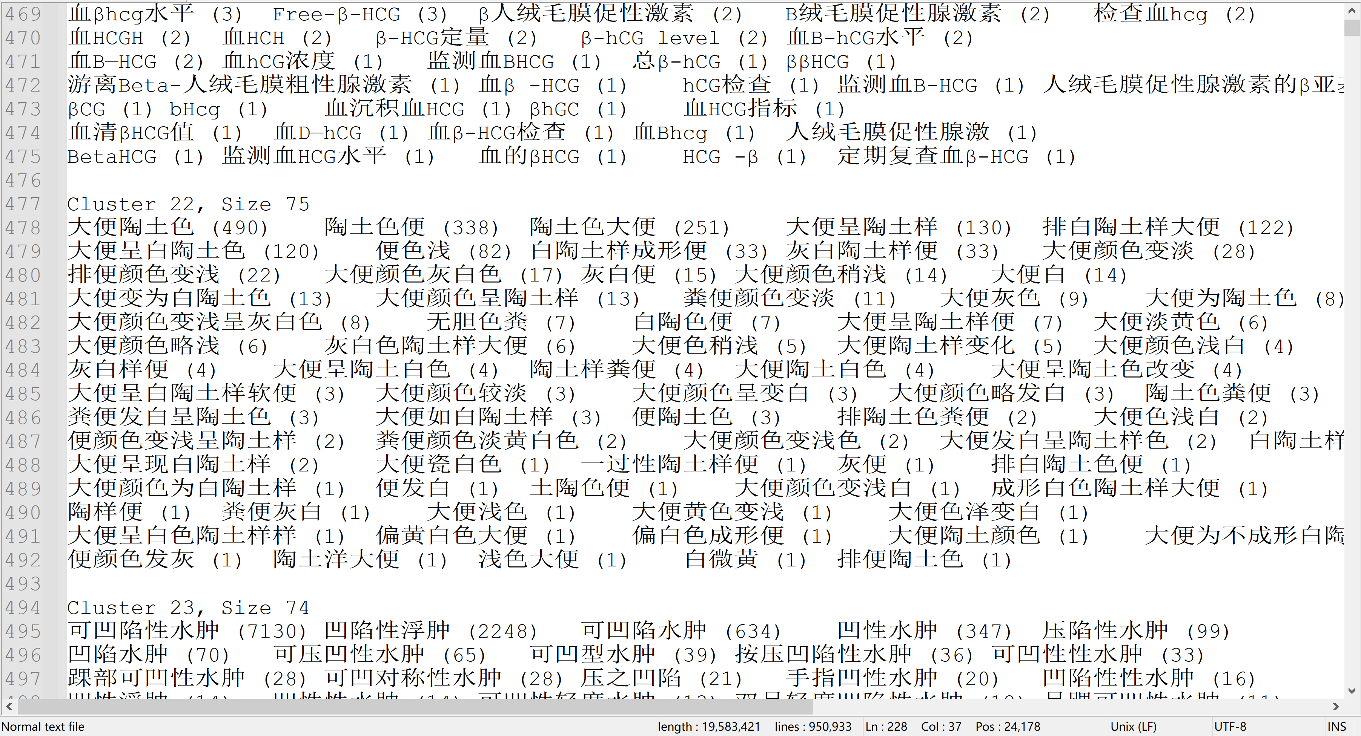
同义词聚类测试

Slide 33
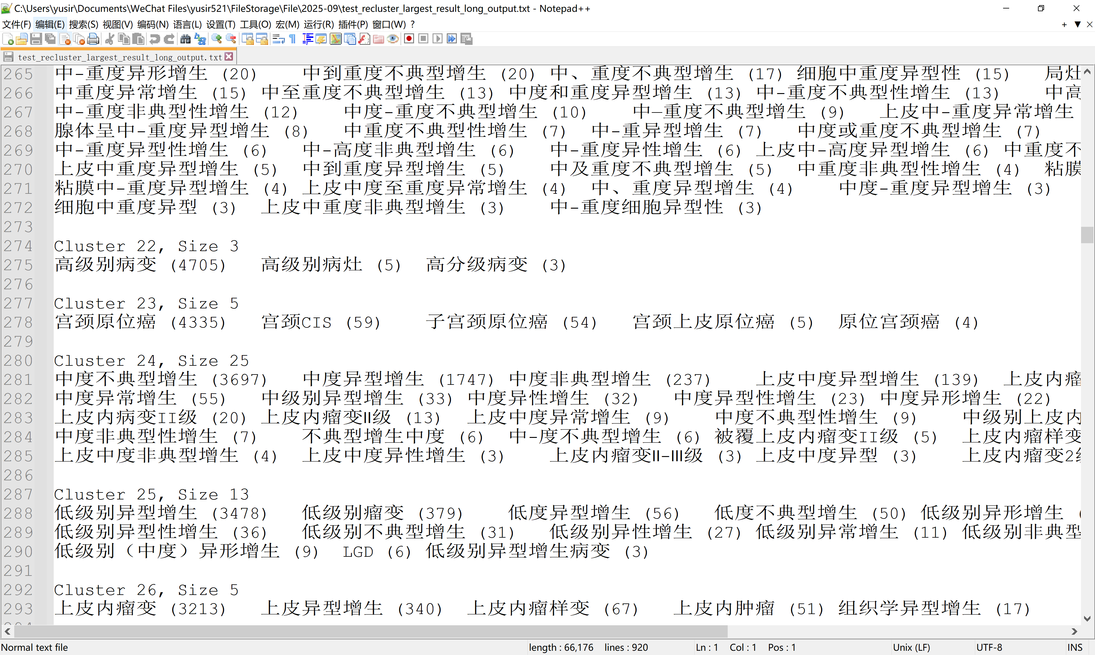
同义词聚类测试

