Slide 1
Efficient and Fast Training with new Zero-th order Hybrid Optimizer
Ziye Ma
Department of Computer Science
City University of Hong Kong

Slide 2
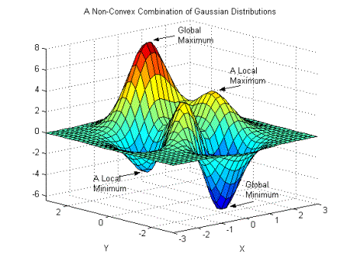
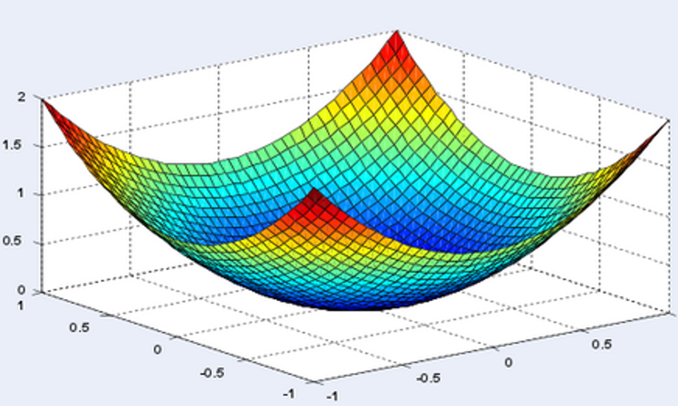
About Myself and Research
U Toronto, B.A.Sc in Engineering Science, 2019; UC Berkeley, Ph.D. in EECS, 2024
My research aims to develop next-generation optimization theory that could lead to more efficient machine learning practices.
Mathematically, my work predominantly addresses non-convex optimization problems, striving for improved solutions with better guarantees. This involves a deep dive into the impacts of uncertainty, parameterization, and algorithms on these problems.
- Induces a paradigm shift in optimization practices
Convex
Non-convex
Would be nice to have some theory around non-convex optimization!

Slide 3
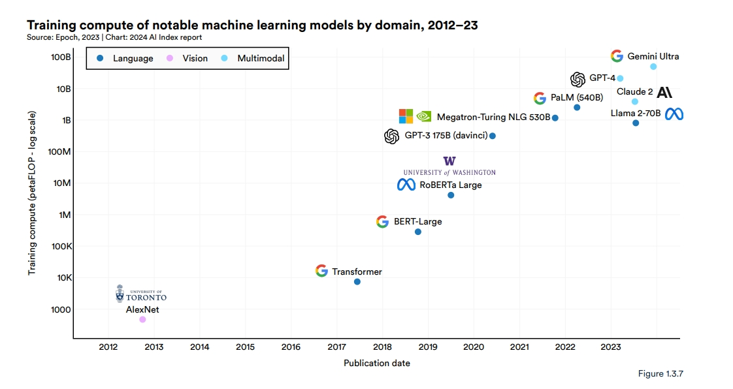
We all know that machine learning models are getting bigger…
Linear Regression
Neural Networks
Early 19th Century
1991
Second-order Methods
Hand Calculation
First-order Methods
CPU
First-order Methods
Single GPU
First-order Methods
GPU Clusters
Computational Cost Prohibitively High!!
Only Big Tech can do!
Zero-order (gradient free) methods?

Slide 4
New Training/Optimization Techniques are Still Needed!
Computational Efficiency
Zero-order (gradient free)
Methods
Stochastic GD
Vanilla GD
Ours (VAMO)
Adaptive SGD (ADAM)
Holy Grail!
Second-order Methods
(Newton’s Method)
Generalization
Convergence Rate

Slide 5
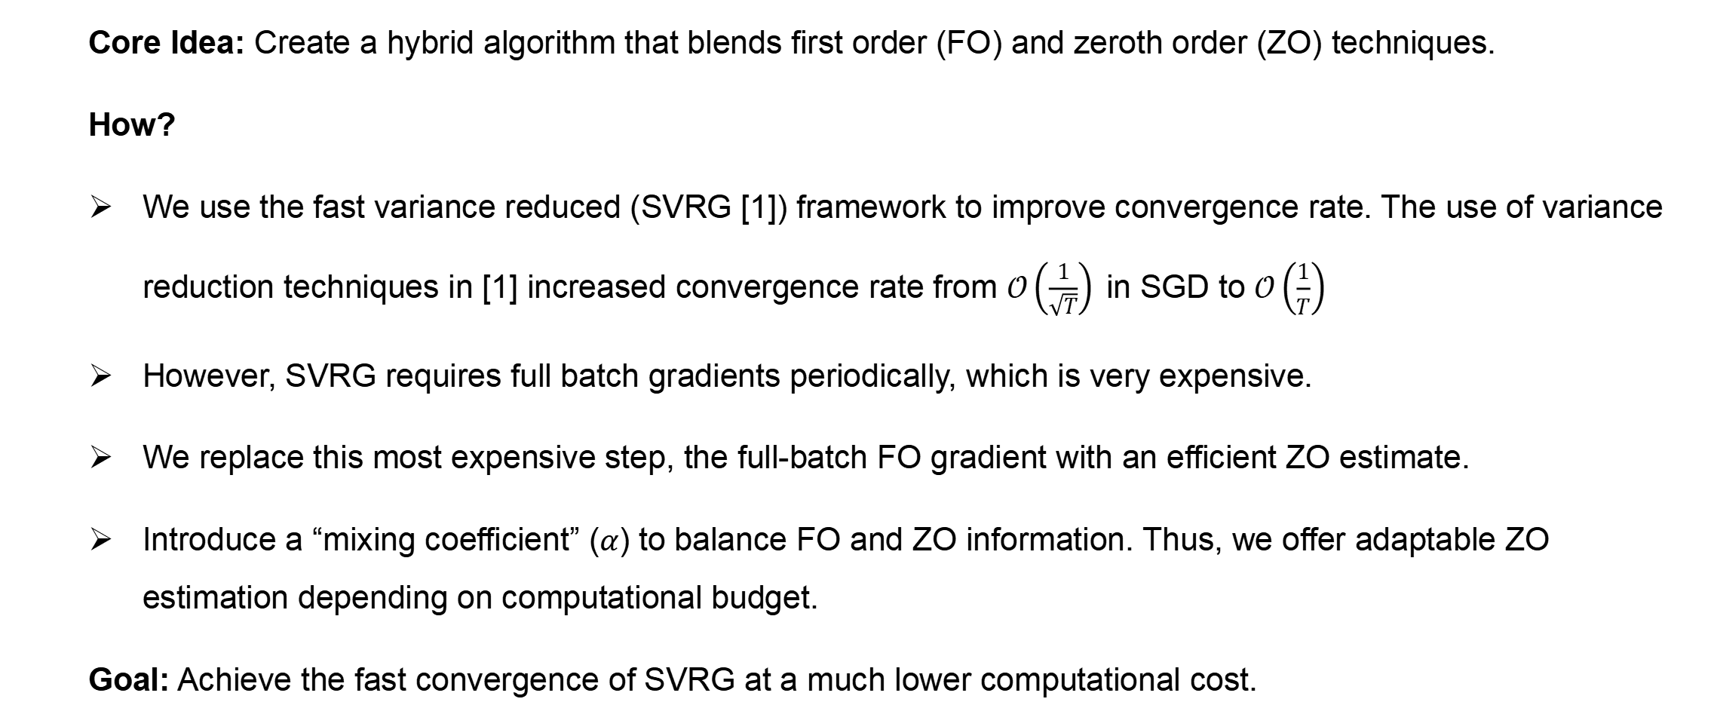
Our Solution: VAMO (VAriance-reduced Mixed-gradient Optimizer)
Core Idea: Create a hybrid algorithm that blends first order (FO) and zeroth order (ZO) techniques.
How?
We use the fast variance reduced (SVRG [1]) framework to improve convergence rate. The use of variance reduction techniques in [1] increased convergence rate from $𝒪\left(\frac{1}{\sqrt{T}}\right)$in SGD to $𝒪\left(\frac{1}{T}\right)$
However, SVRG requires full batch gradients periodically, which is very expensive.
We replace this most expensive step, the full-batch FO gradient with an efficient ZO estimate.
Introduce a “mixing coefficient” ($α$) to balance FO and ZO information. Thus, we offer adaptable ZO estimation depending on computational budget.
Goal: Achieve the fast convergence of SVRG at a much lower computational cost.
[1] Rie Johnson and Tong Zhang. Accelerating stochastic gradient descent using predictive variance reduction. Advances in neural information processing systems, 26, 2013.

Slide 6
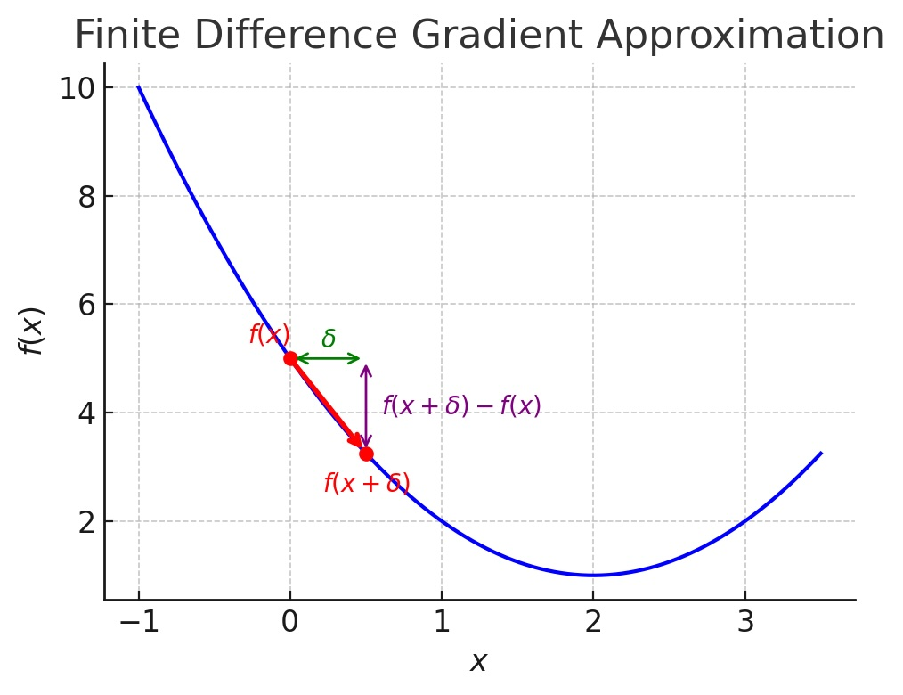
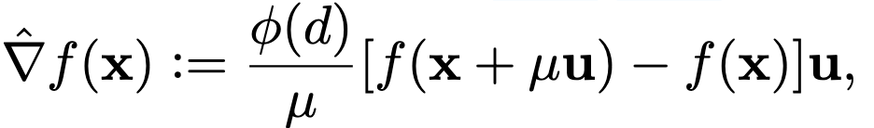
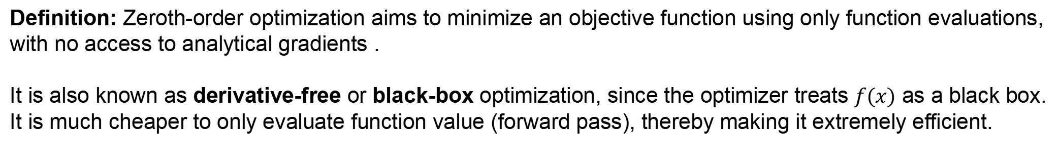
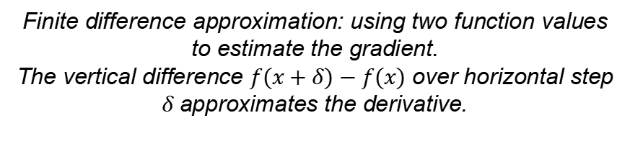
A Primer on Zero-th Order (ZO) Optimization
Definition: Zeroth-order optimization aims to minimize an objective function using only function evaluations, with no access to analytical gradients .
It is also known as derivative-free or black-box optimization, since the optimizer treats $f(x)$ as a black box. It is much cheaper to only evaluate function value (forward pass), thereby making it extremely efficient.
Finite difference approximation: using two function values to estimate the gradient.
The vertical difference $f(x+δ)−f(x)$ over horizontal step $δ$approximates the derivative.
At the core, ZO gradient is like a monte-carlo estimation of true gradient [2]
Where $u$ is a random direction sample from distribution of choice, $φ(d)$ is a dimension dependent constant, and
$μ$ is the smoothing parameter. If $μ⟶0$, $\hat{∇}f(x)$ will tend to be unbiased, but the step will be unbearably small.
[2] Sijia Liu, Pin-Yu Chen, Bhavya Kailkhura, Gaoyuan Zhang, Alfred O Hero III, and Pramod K Varshney. A primer on zeroth-order optimization in signal processing and machine learning: Principals, recent advances, and applications. IEEE Signal Processing Magazine, 37(5):43–54, 2020.

Slide 7
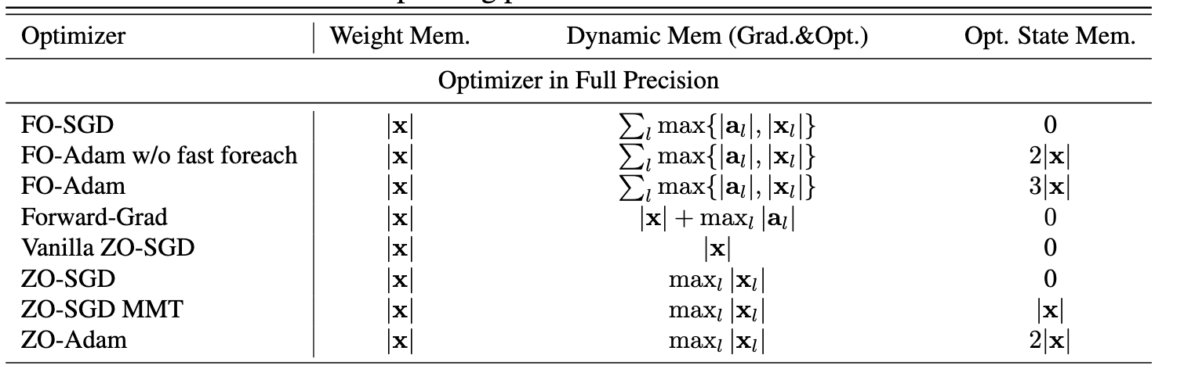


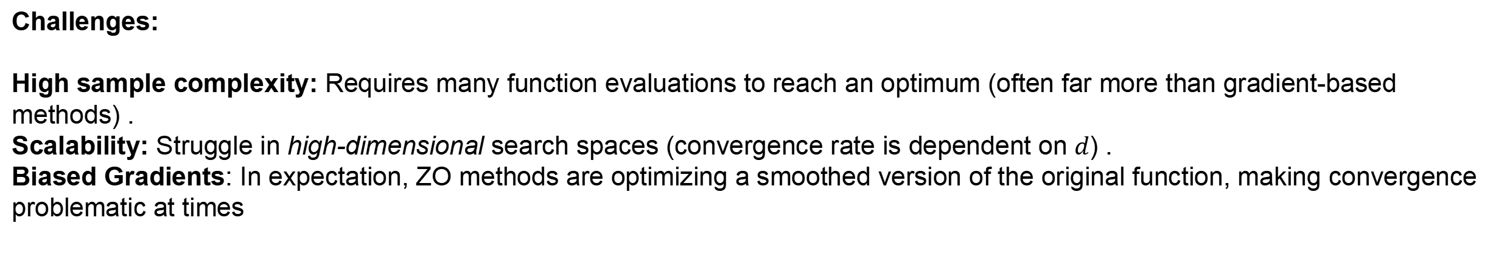
Why Zero-th Order Reduction?
The critical bottleneck of back-propagation mostly lies within the peak memory requirements.
Therefore, the use of ZO methods enables training and fine-tuning on much lighter devices. [3]
memory cost of full-parameter
memory cost of $l^{th}$ layer’s parameters
memory cost of $l^{th}$ layer’s activations
Challenges:
High sample complexity: Requires many function evaluations to reach an optimum (often far more than gradient-based methods) .
Scalability: Struggle in high-dimensional search spaces (convergence rate is dependent on $d$) .
Biased Gradients: In expectation, ZO methods are optimizing a smoothed version of the original function, making convergence problematic at times
[3] Zhang, Y., Li, P., Hong, J., Li, J., Zhang, Y., Zheng, W., ... & Chen, T. (2024). Revisiting zeroth-order optimization for memory-efficient llm fine-tuning: A benchmark. arXiv preprint arXiv:2402.11592.

Slide 8
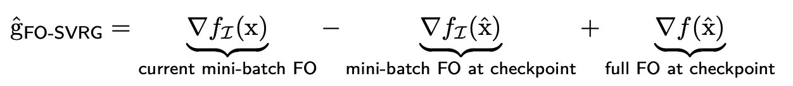
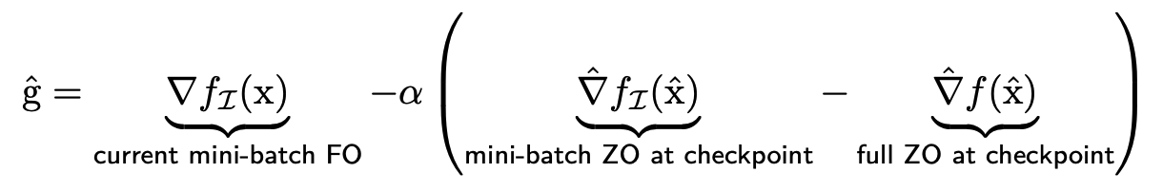
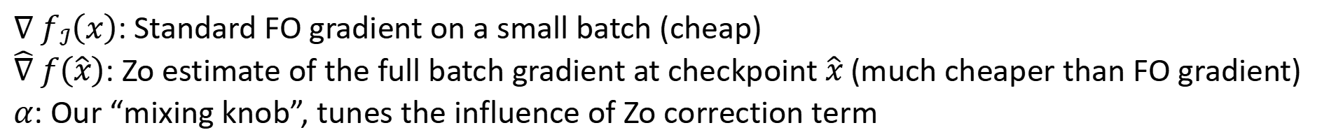
Inside Workings of VAMO
Recall First Order SVRG update:
Full-batch $∇ f\left(\hat{x}\right)$ is the computational bottleneck!
So we replace with a hybrid gradient estimation!
$∇ f_{ℐ}\left(x\right)$: Standard FO gradient on a small batch (cheap)
$\hat{∇} f\left(\hat{x}\right)$: Zo estimate of the full batch gradient at checkpoint $\hat{x}$(much cheaper than FO gradient)
$α$: Our “mixing knob”, tunes the influence of Zo correction term
Key: Unlike purely ZO methods, our correction term is designed to be unbiased.
Achieved this since the two ZO terms cancel each other in expectation

Slide 9
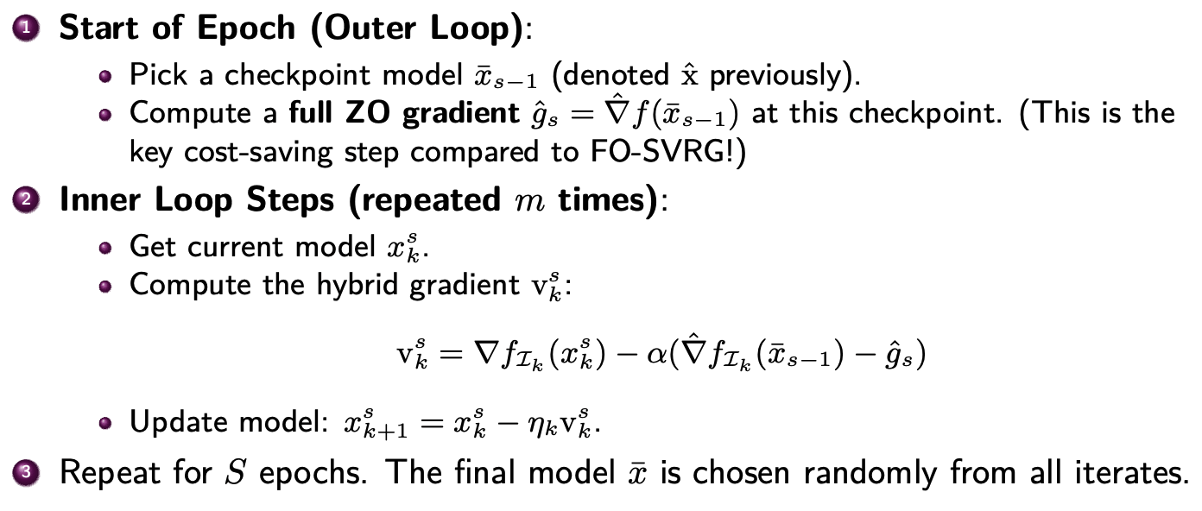
VAMO Algorithm Overview

Slide 10
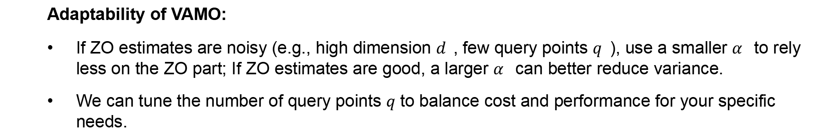
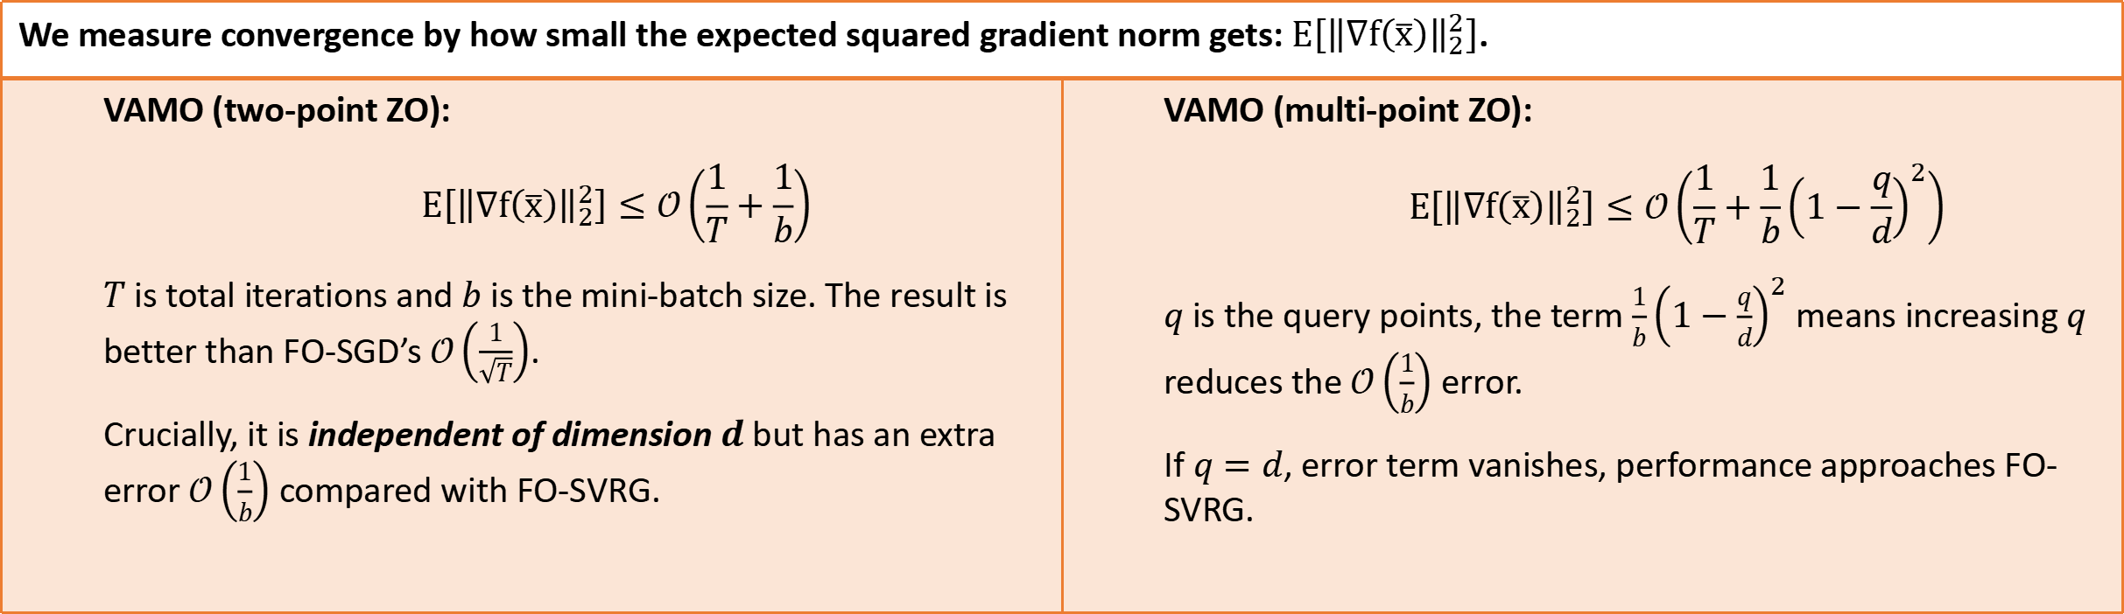
VAMO’s convergence results
We measure convergence by how small the expected squared gradient norm gets: $E\left[{\left\|∇f\left(\overline{x}\right)\right\|}_{2}^{2}\right]$.
VAMO (two-point ZO): $$E\left[{\left\|∇f\left(\overline{x}\right)\right\|}_{2}^{2}\right]≤𝒪\left(\frac{1}{T}+\frac{1}{b}\right)$$ $T$ is total iterations and $b$ is the mini-batch size. The result is better than FO-SGD’s $𝒪\left(\frac{1}{\sqrt{T}}\right)$. Crucially, it is independent of dimension $d$but has an extra error $𝒪\left(\frac{1}{b}\right)$ compared with FO-SVRG. | VAMO (multi-point ZO): $$E\left[{\left\|∇f\left(\overline{x}\right)\right\|}_{2}^{2}\right]≤𝒪\left(\frac{1}{T}+\frac{1}{b}{\left(1−\frac{q}{d}\right)}^{2}\right)$$ $q$ is the query points, the term $\frac{1}{b}{\left(1−\frac{q}{d}\right)}^{2}$ means increasing $q$ reduces the $𝒪\left(\frac{1}{b}\right)$ error. If $q=d$, error term vanishes, performance approaches FO-SVRG.
Adaptability of VAMO:
If ZO estimates are noisy (e.g., high dimension 𝑑, few query points 𝑞), use a smaller 𝛼 to rely less on the ZO part; If ZO estimates are good, a larger 𝛼 can better reduce variance.
We can tune the number of query points $q$ to balance cost and performance for your specific needs.

Slide 11
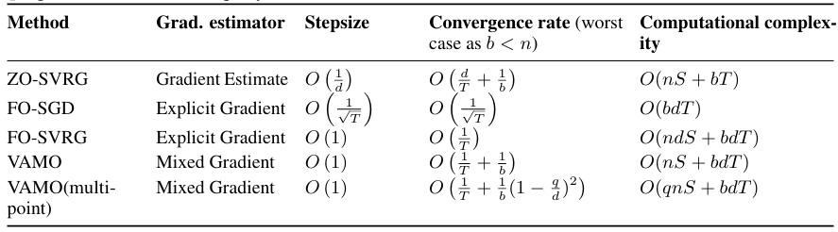

Comparison to existing literature
Faster convergence ($𝒪(1/T)$) than FO-SGD and dimension-independent.
The speed-up comes with manageable inner-loop costs like FO-SGD. The ZO checkpoint overhead ($𝒪(nS)$queries) is often a ”minor fractional overhead” for large models.
This contrasts with FO-SVRG’s $𝒪(ndS)$cost, which is “prohibitively high” [3]
$n$: dataset size, $d$: model dim., $b$: batch size, $T$ : total iter., $S$: epochs.
Main Idea: Achieve FO-SVRG like convergence rate with minor addition in computational cost compared to SGD
[3] Sashank J Reddi, Ahmed Hefny, Suvrit Sra, Barnabas Poczos, and Alex Smola. Stochastic variance reduction for nonconvex optimization. In International conference on machine learning, pages 314–323. PMLR, 2016.

Slide 12
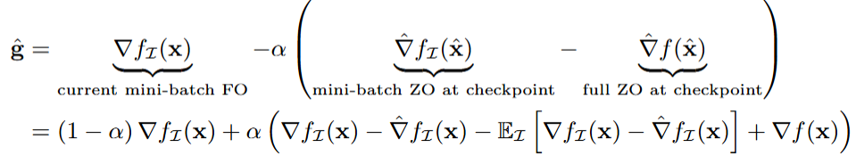

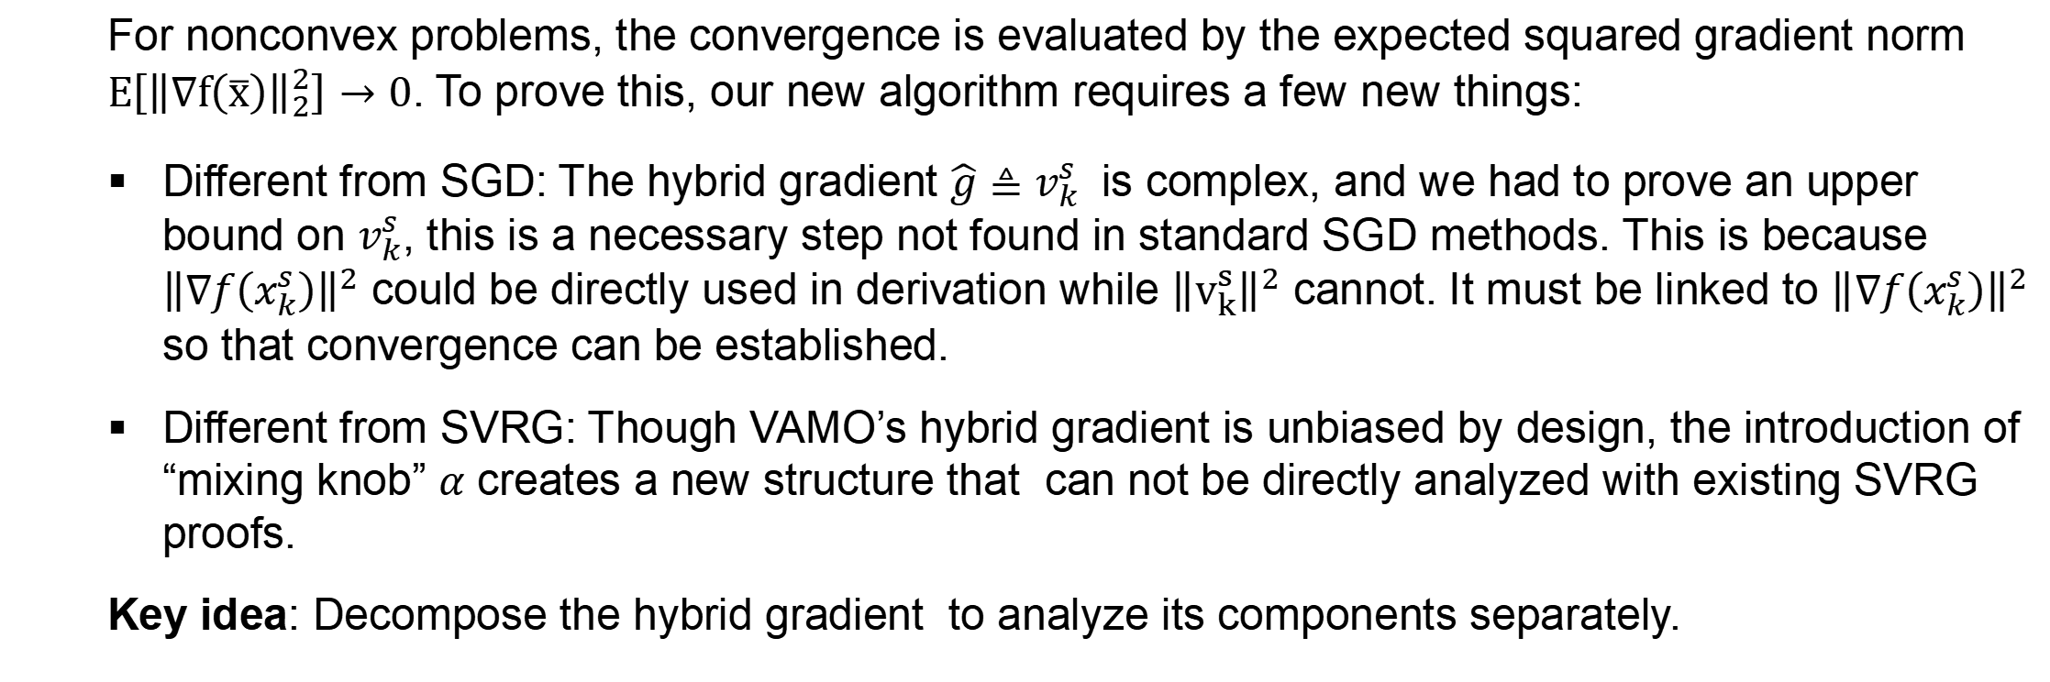
Proof Highlights
For nonconvex problems, the convergence is evaluated by the expected squared gradient norm $E\left[{\left\|∇f\left(\overline{x}\right)\right\|}_{2}^{2}\right]→0$. To prove this, our new algorithm requires a few new things:
Different from SGD: The hybrid gradient $\hat{g}≜v_{k}^{s}$ is complex, and we had to prove an upper bound on $v_{k}^{s}$, this is a necessary step not found in standard SGD methods. This is because ${\left\|∇f\left(x_{k}^{s}\right)\right\|}^{2}$ could be directly used in derivation while ${\left\|v_{k}^{s}\right\|}^{2}$ cannot. It must be linked to ${\left\|∇f\left(x_{k}^{s}\right)\right\|}^{2}$ so that convergence can be established.
Different from SVRG: Though VAMO’s hybrid gradient is unbiased by design, the introduction of “mixing knob” $α$ creates a new structure that can not be directly analyzed with existing SVRG proofs.
Key idea: Decompose the hybrid gradient to analyze its components separately.

Slide 13
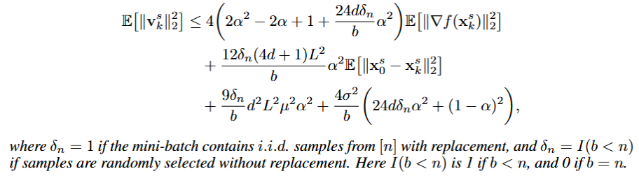
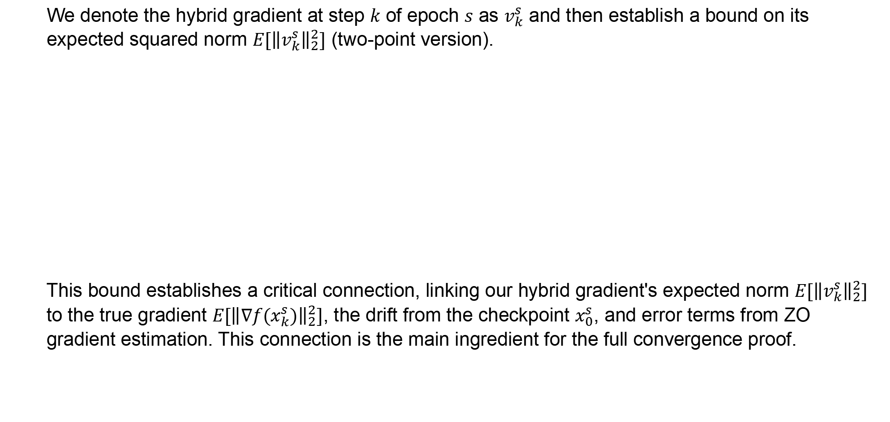
Step 1: Bounding the Hybrid Gradient
We denote the hybrid gradient at step $k$ of epoch $s$ as $v_{k}^{s}$ and then establish a bound on its expected squared norm $E[{\left\|v_{k}^{s}\right\|}_{2}^{2}]$ (two-point version).
This bound establishes a critical connection, linking our hybrid gradient's expected norm $E[{\left\|v_{k}^{s}\right\|}_{2}^{2}]$ to the true gradient $E[{\left\|∇f(x_{k}^{s})\right\|}_{2}^{2}]$, the drift from the checkpoint $x_{0}^{s}$, and error terms from ZO gradient estimation. This connection is the main ingredient for the full convergence proof.

Slide 14
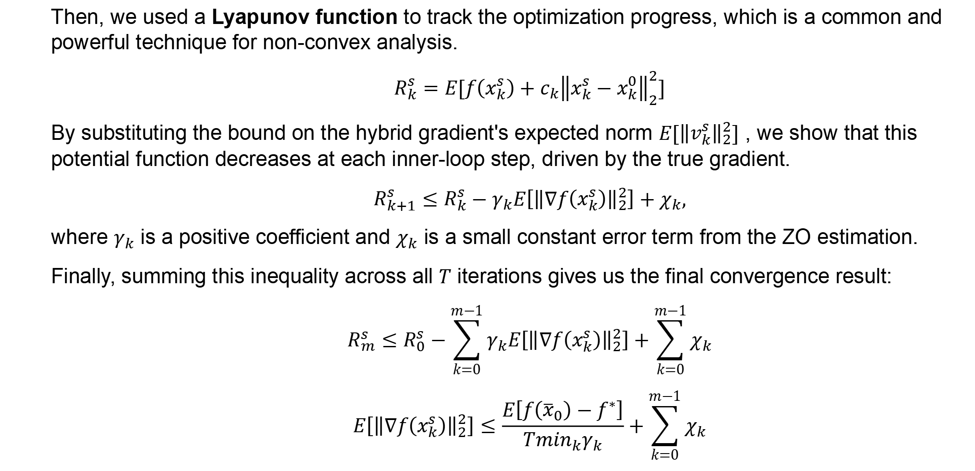
Step 2: Convergence with a Lyapunov Function
Then, we used a Lyapunov function to track the optimization progress, which is a common and powerful technique for non-convex analysis.
$$R_{k}^{s}=E[f\left(x_{k}^{s}\right)+c_{k}{\left\|x_{k}^{s}−x_{k}^{0}\right\|}_{2}^{2}]$$
By substituting the bound on the hybrid gradient's expected norm $E[{\left\|v_{k}^{s}\right\|}_{2}^{2}]$ , we show that this potential function decreases at each inner-loop step, driven by the true gradient.
$$R_{k+1}^{s}≤R_{k}^{s}−γ_{k}E\left[{\left\|∇f\left(x_{k}^{s}\right)\right\|}_{2}^{2}\right]+χ_{k},$$
where $γ_{k}$​ is a positive coefficient and $χ_{k}$ ​is a small constant error term from the ZO estimation.
Finally, summing this inequality across all $T$ iterations gives us the final convergence result:
$$R_{m}^{s}≤R_{0}^{s}−\sum_{k=0}^{m−1}{γ_{k}E\left[{\left\|∇f\left(x_{k}^{s}\right)\right\|}_{2}^{2}\right]}+\sum_{k=0}^{m−1}{χ_{k}}$$
$$E\left[{\left\|∇f\left(x_{k}^{s}\right)\right\|}_{2}^{2}\right]≤\frac{E\left[f\left({\overline{x}}_{0}\right)−f^{∗}\right]}{T\min_{k}γ_{k}}+\sum_{k=0}^{m−1}{χ_{k}}$$

Slide 15
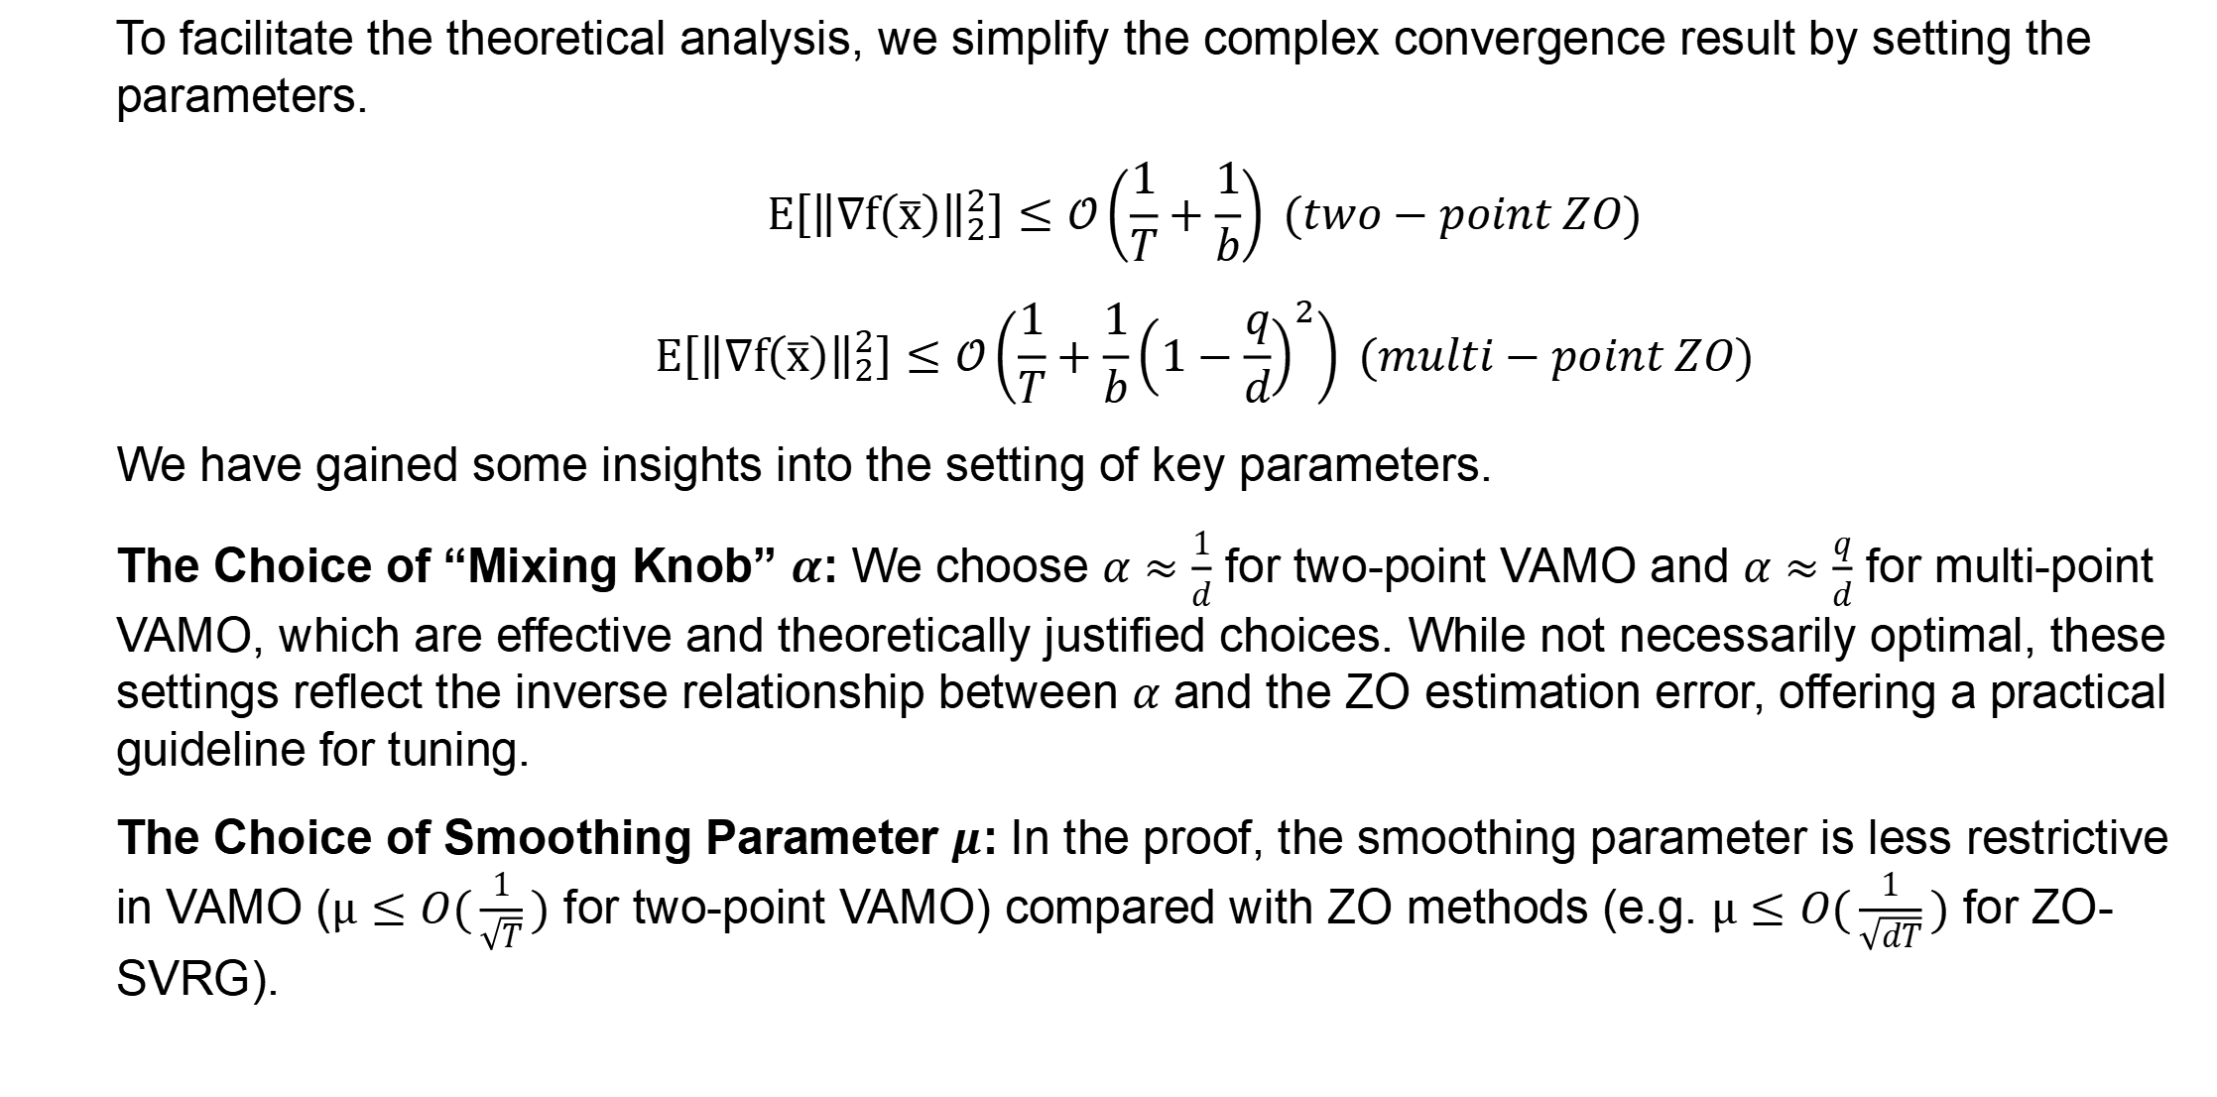
Proof Insights
To facilitate the theoretical analysis, we simplify the complex convergence result by setting the parameters.
$$E\left[{\left\|∇f\left(\overline{x}\right)\right\|}_{2}^{2}\right]≤𝒪\left(\frac{1}{T}+\frac{1}{b}\right) (two−point ZO)$$
$$E\left[{\left\|∇f\left(\overline{x}\right)\right\|}_{2}^{2}\right]≤𝒪\left(\frac{1}{T}+\frac{1}{b}{\left(1−\frac{q}{d}\right)}^{2}\right) (multi−point ZO)$$
We have gained some insights into the setting of key parameters.
The Choice of “Mixing Knob” $α$: We choose $α≈\frac{1}{d}$ for two-point VAMO and $α≈\frac{q}{d}$ for multi-point VAMO, which are effective and theoretically justified choices. While not necessarily optimal, these settings reflect the inverse relationship between $α$ and the ZO estimation error, offering a practical guideline for tuning.
The Choice of Smoothing Parameter $μ$: In the proof, the smoothing parameter is less restrictive in VAMO ($μ≤O(\frac{1}{\sqrt{T}})$ for two-point VAMO) compared with ZO methods (e.g. $μ≤O(\frac{1}{\sqrt{dT}})$ for ZO-SVRG).

Slide 16
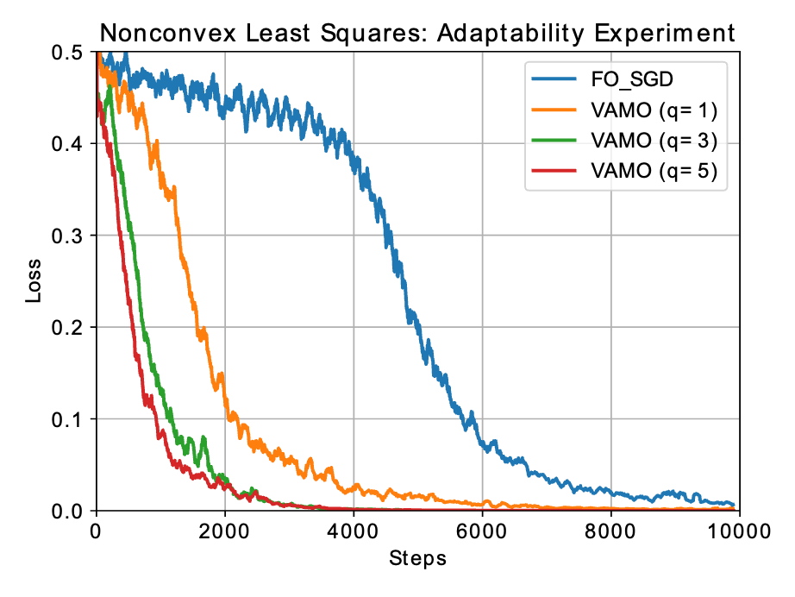
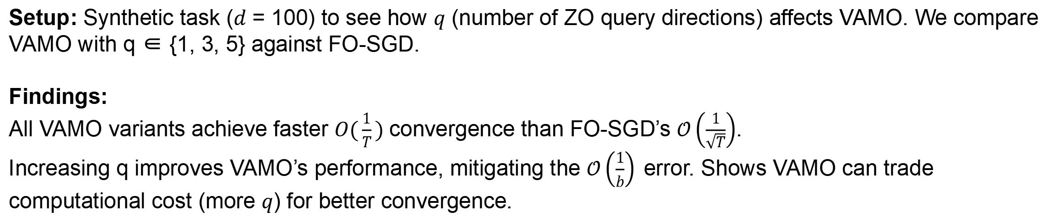
Experiments – Nonconvex Least Squares
Setup: Synthetic task ($d$ = 100) to see how $q$ (number of ZO query directions) affects VAMO. We compare VAMO with q ∈ {1, 3, 5} against FO-SGD.
Findings:
All VAMO variants achieve faster $O(\frac{1}{T})$convergence than FO-SGD’s $𝒪\left(\frac{1}{\sqrt{T}}\right)$.
Increasing q improves VAMO’s performance, mitigating the $𝒪\left(\frac{1}{b}\right)$error. Shows VAMO can trade computational cost (more $q$) for better convergence.

Slide 17
Experiments – MNIST Classification
Setup: Trained an MLP on MNIST dataset. Compared VAMO (q = 1) with FO-SGD [4], ZO-SGD [5], and ZO-SVRG [1].
Findings:
VAMO significantly outperforms purely ZO methods (ZO-SGD, ZO-SVRG) in speed and final loss.
VAMO outperforms first order methods as well, underscoring the effectiveness of the hybrid strategy.
[4] Herbert Robbins and Sutton Monro. A stochastic approximation method. The annals of mathematical statistics, pages 400–407, 1951.
[5] Saeed Ghadimi and Guanghui Lan. Stochastic first-and zeroth-order methods for nonconvex stochastic programming. SIAM journal on optimization, 23(4):2341–2368, 2013.

Slide 18
Experiments – LLM Finetuning

Slide 19
Experiments – LLM Finetuning

Slide 20
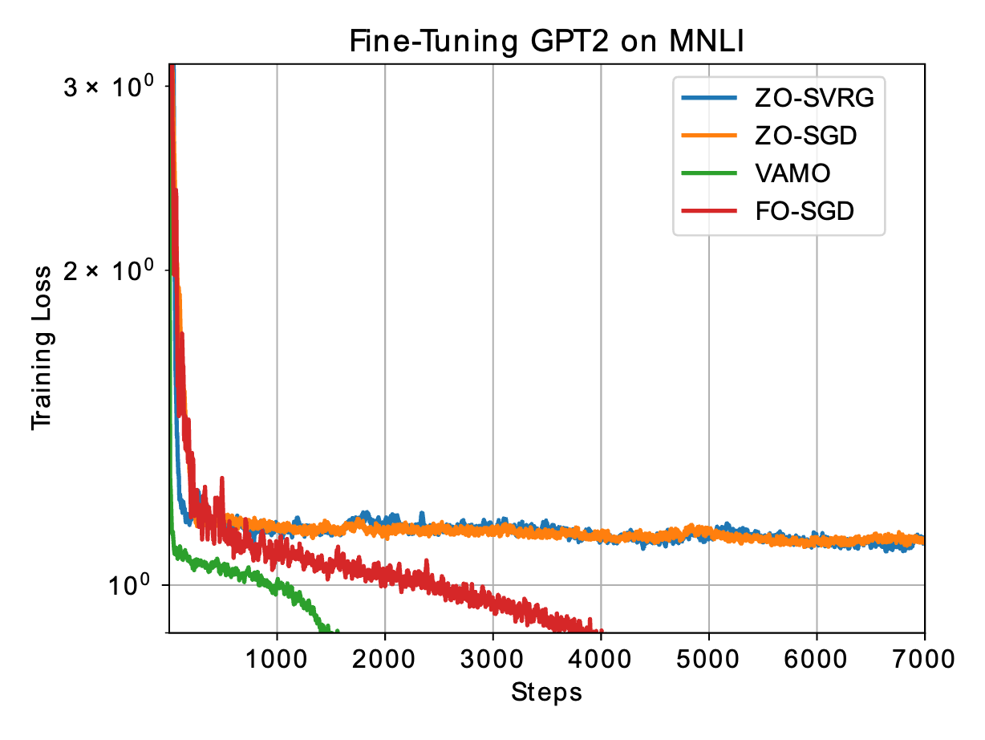
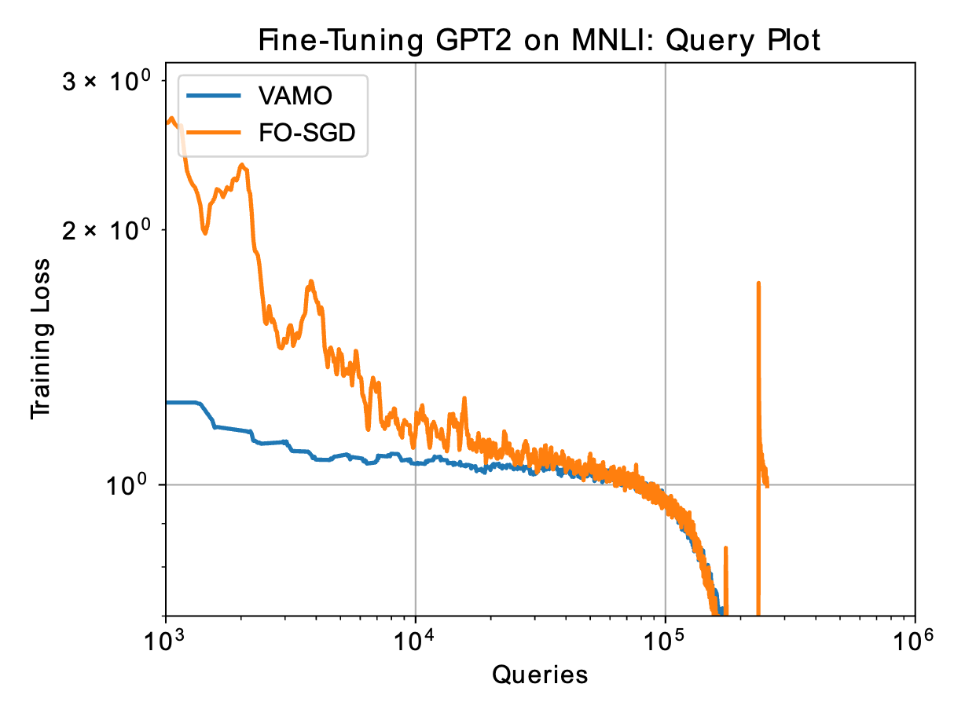
Experiments – LLM Finetuning
Setup: Fine-tuned pre-trained GPT-2 [6] on MNLI [7]. VAMO was benchmarked against FO-SGD and representative ZO methods (e.g., ZO-SGD, ZO-SVRG [8]). SVRG was not compared because it was too expensive to run.
Findings:
With only slightly higher total query cost, VAMO achieves significantly faster and more stable convergence per query.
A ”query” is one forward/backward pass of one sample.
[6] Alec Radford, Jeffrey Wu, Rewon Child, David Luan, Dario Amodei, Ilya Sutskever, et al. Language models are unsupervised multitask learners. OpenAI blog, 1(8):9, 2019.
[7] Adina Williams, Nikita Nangia, and Samuel R Bowman. A broad-coverage challenge corpus for sentence understanding through inference. arXiv preprint arXiv:1704.05426, 2017.
[8] Sijia Liu, Bhavya Kailkhura, Pin-Yu Chen, Paishun Ting, Shiyu Chang, and Lisa Amini. Zeroth-order stochastic variance reduction for nonconvex optimization. Advances in neural information processing systems, 31, 2018

Slide 21
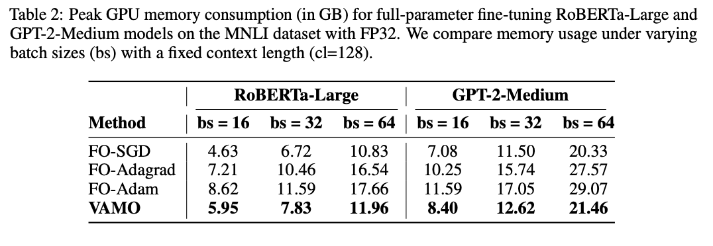
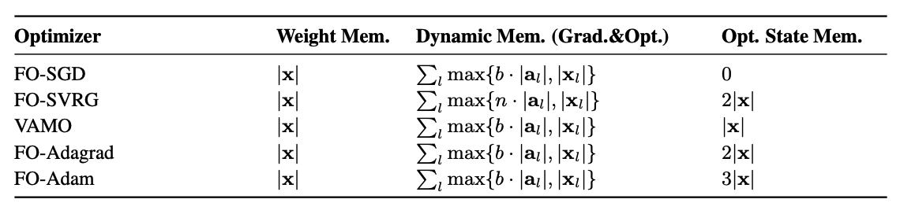
Why is VAMO efficient?
VAMO saves both memory storage and computation time compared to SVRG

Slide 22
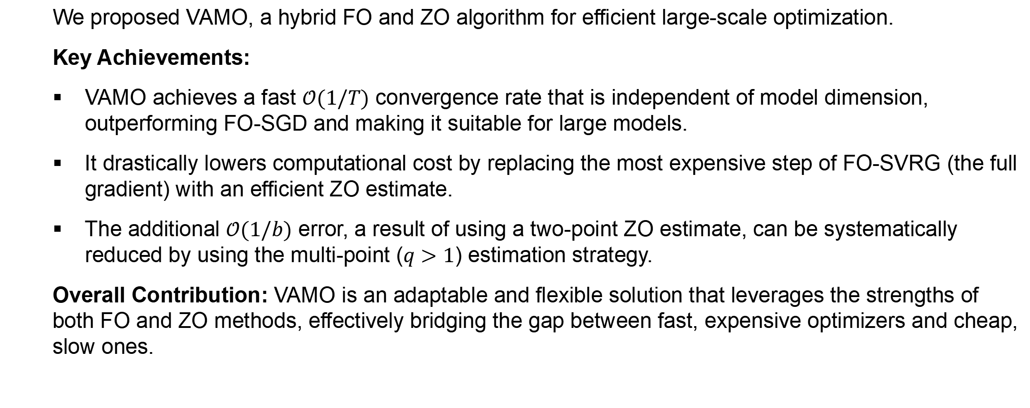
Conclusion
We proposed VAMO, a hybrid FO and ZO algorithm for efficient large-scale optimization.
Key Achievements:
VAMO achieves a fast $𝒪(1/T)$ convergence rate that is independent of model dimension, outperforming FO-SGD and making it suitable for large models.
It drastically lowers computational cost by replacing the most expensive step of FO-SVRG (the full gradient) with an efficient ZO estimate.
The additional $𝒪(1/b)$ error, a result of using a two-point ZO estimate, can be systematically reduced by using the multi-point ($q>1$) estimation strategy.
Overall Contribution: VAMO is an adaptable and flexible solution that leverages the strengths of both FO and ZO methods, effectively bridging the gap between fast, expensive optimizers and cheap, slow ones.

Slide 23
Thank you!
Questions Welcome!

