Slide 1
What Makes Looped Transformers Perform
Better Than Non-Recursive Ones (Provably)
Jiaye Teng
School of Statistics and Data Science，
Shanghai University of Finance and Economics
Joint work with our excellent collaborators Zixuan Gong (RUC) and Yong Liu (RUC)

Slide 2
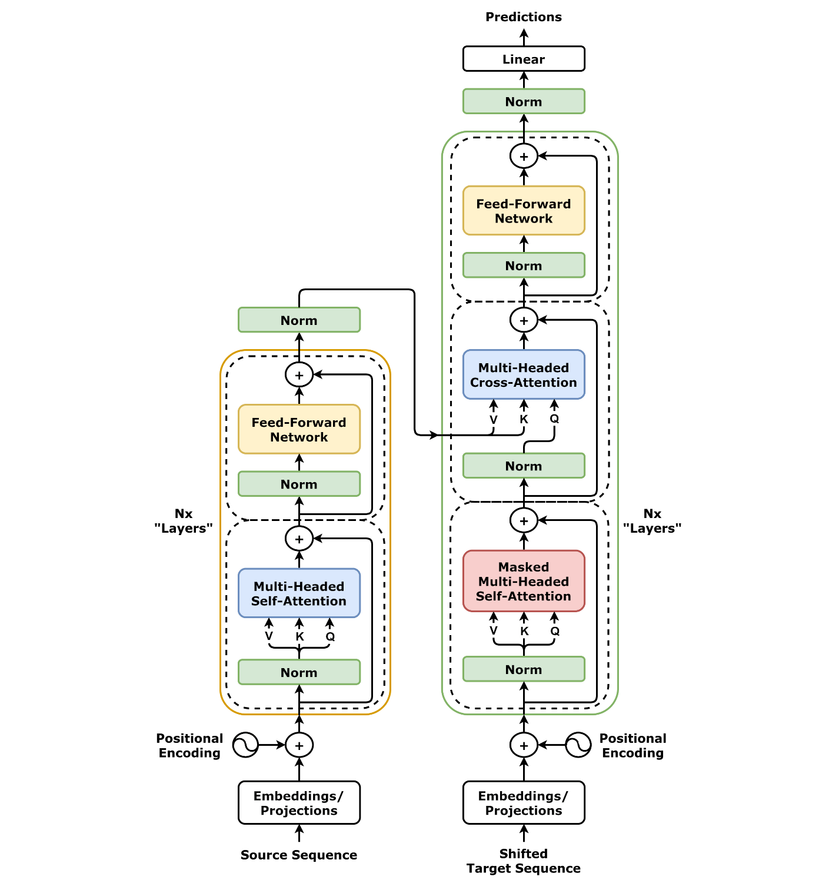
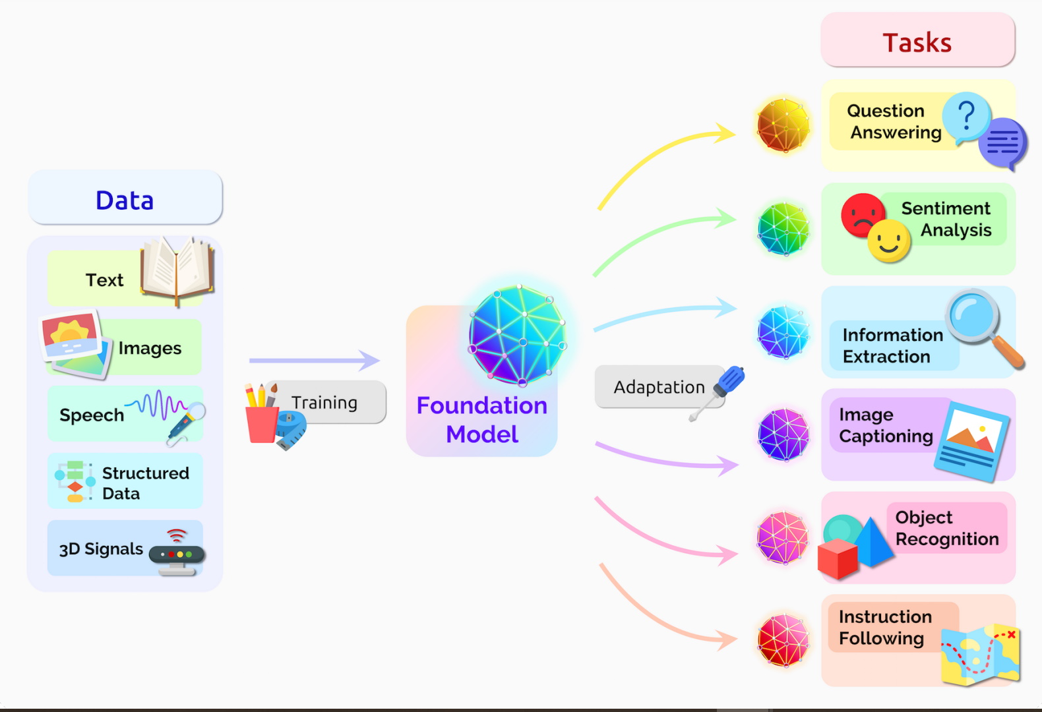
What Makes Looped Transformers Perform Better Than Non-Recursive Ones (Provably)
Transformers have emerged as a cornerstone across various fields with extensive applications
Large language models
Vision recognition
Image generation
Graph data modeling
Scientific discovery
…

Slide 3
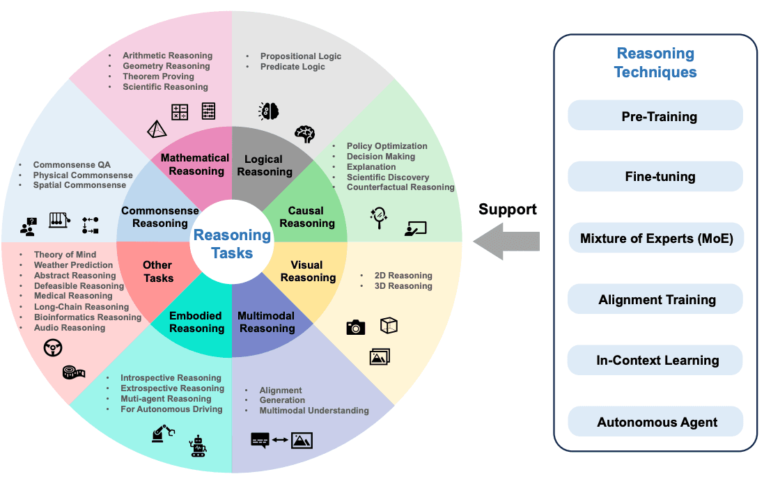
What Makes Looped Transformers Perform Better Than Non-Recursive Ones (Provably)
Transformers in Reasoning Tasks
“Reasoning” encompasses cognitive processes and logical thinking employed to analyze information, make deductions, draw conclusions, and formulate coherent arguments.
https://www.promptingguide.ai/research/llm-reasoning

Slide 4
What Makes Looped Transformers Perform Better Than Non-Recursive Ones (Provably)
Transformers in Reasoning Tasks
“Reasoning” encompasses cognitive processes and logical thinking employed to analyze information, make deductions, draw conclusions, and formulate coherent arguments.
Step-wise Thinking
[1] https://www.promptingguide.ai/research/llm-reasoning

Slide 5
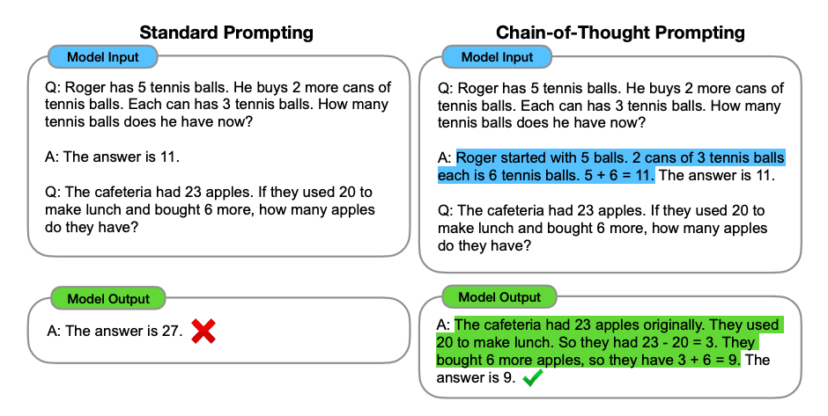
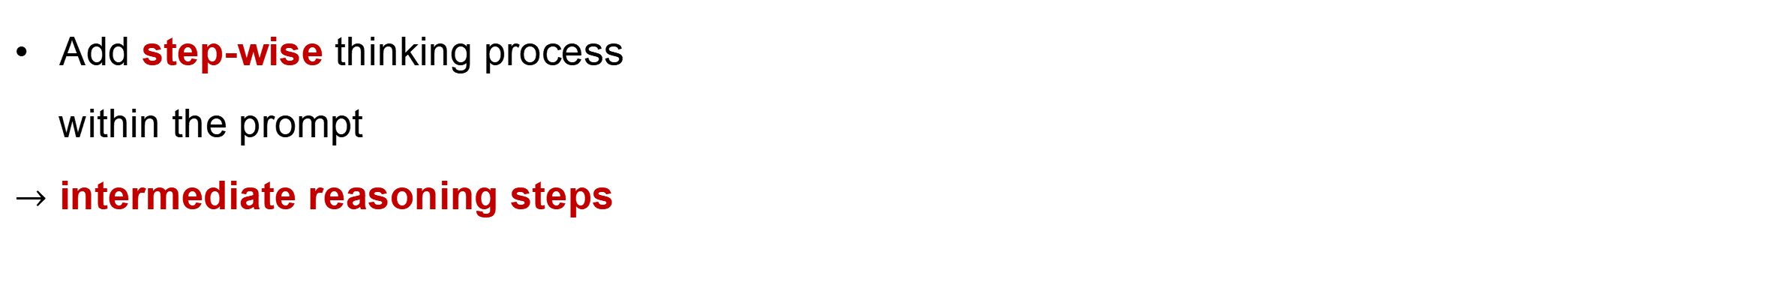
What Makes Looped Transformers Perform Better Than Non-Recursive Ones (Provably)
Reasoning and Chain-of-Thought (CoT) Prompting
Few-shot CoT
Add step-wise thinking process
within the prompt
$→$ intermediate reasoning steps
[1] Chain-of-Thought Prompting Elicits Reasoning in Large Language Models

Slide 6
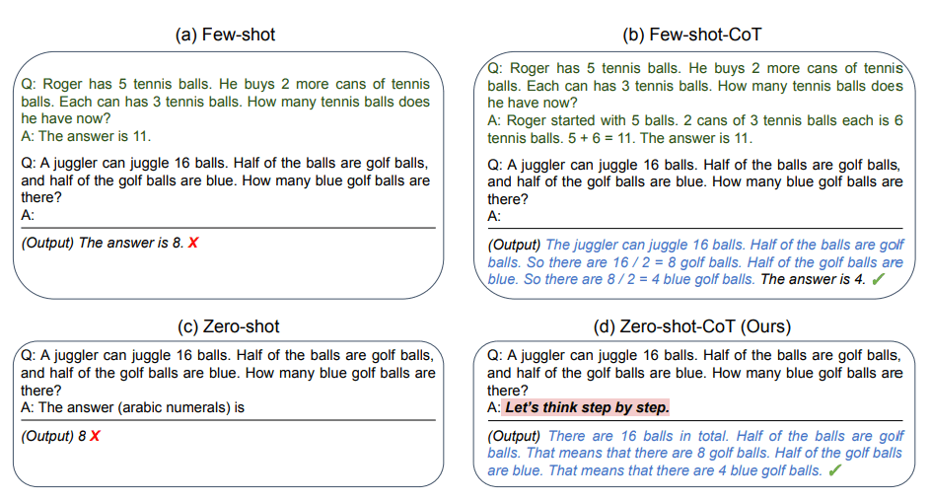
What Makes Looped Transformers Perform Better Than Non-Recursive Ones (Provably)
Reasoning and Chain-of-Thought (CoT) Prompting
Zero-shot CoT
Add step-wise thinking prompt
Let’s think step by step
[1] Large Language Models are Zero-Shot Reasoners

Slide 7
What Makes Looped Transformers Perform Better Than Non-Recursive Ones (Provably)
Reasoning and Chain-of-Thought (CoT) Prompting
Zero-shot CoT
Few-shot CoT
However, CoT does not always work pretty well for long reasoning steps, potentially due to the fixed depth transformer
[1] Looped Transformers for Length Generalization.

Slide 8
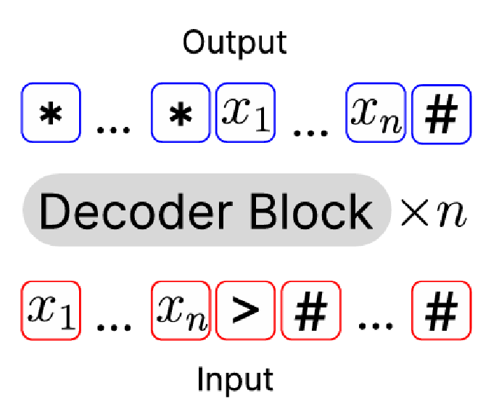
What Makes Looped Transformers Perform Better Than Non-Recursive Ones (Provably)
Reasoning with Looped Transformers
Standard Transformers:
transformers with only one self-attention
Looped Transformers:
transformers with recursive self-attentions

Slide 9
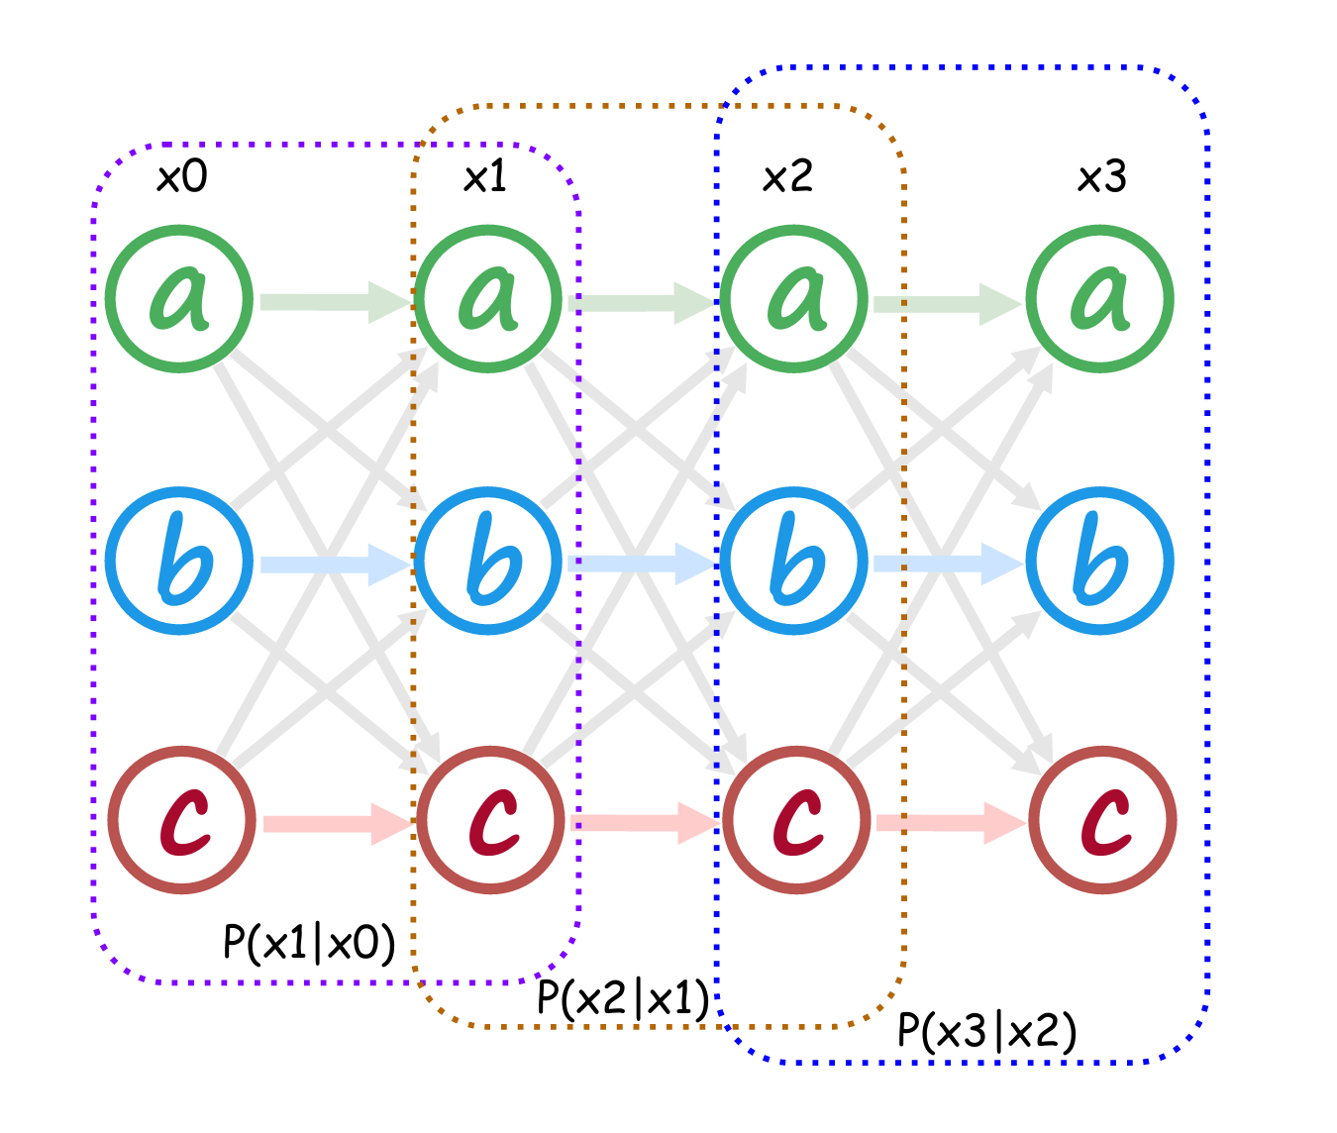
What Makes Looped Transformers Perform Better Than Non-Recursive Ones (Provably)
Facts on Looped Transformers
can mimic iterative algorithms (like GD) [1]
better at length generalization [2]
...
[1] Looped transformers are better at learning learning algorithms.
[2] Looped Transformers for Length Generalization.

Slide 10
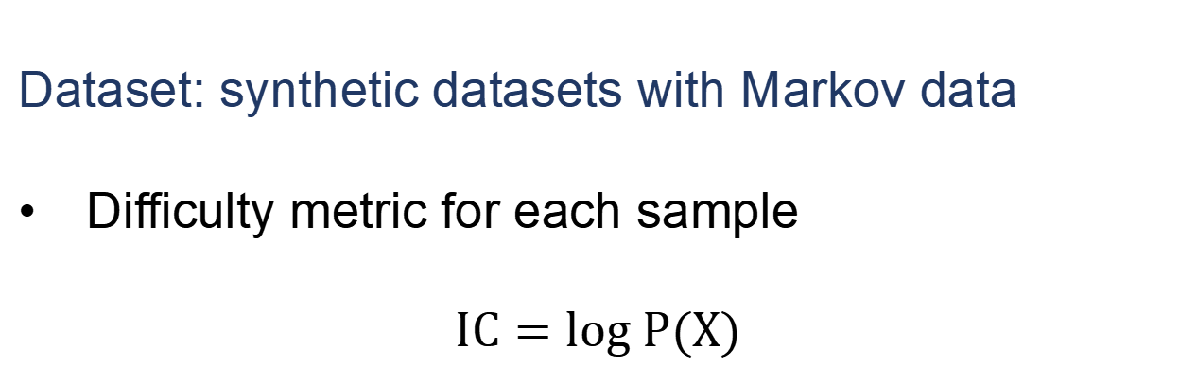
What Makes Looped Transformers Perform Better Than Non-Recursive Ones (Provably)
Some oberservations from looped transformers
Dataset: synthetic datasets with Markov data
Difficulty metric for each sample
$$IC=log P(X)$$

Slide 11
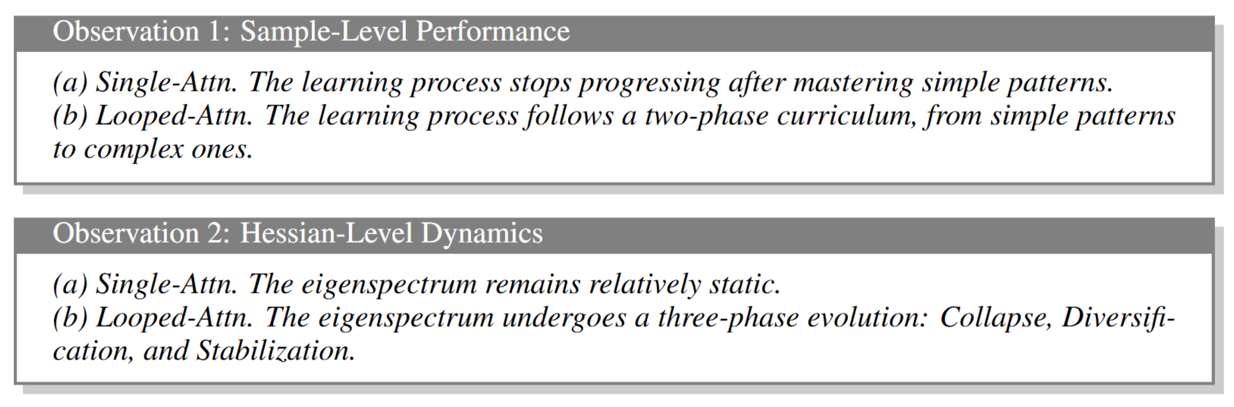
What Makes Looped Transformers Perform Better Than Non-Recursive Ones (Provably)
Some oberservations from looped transformers

Slide 12
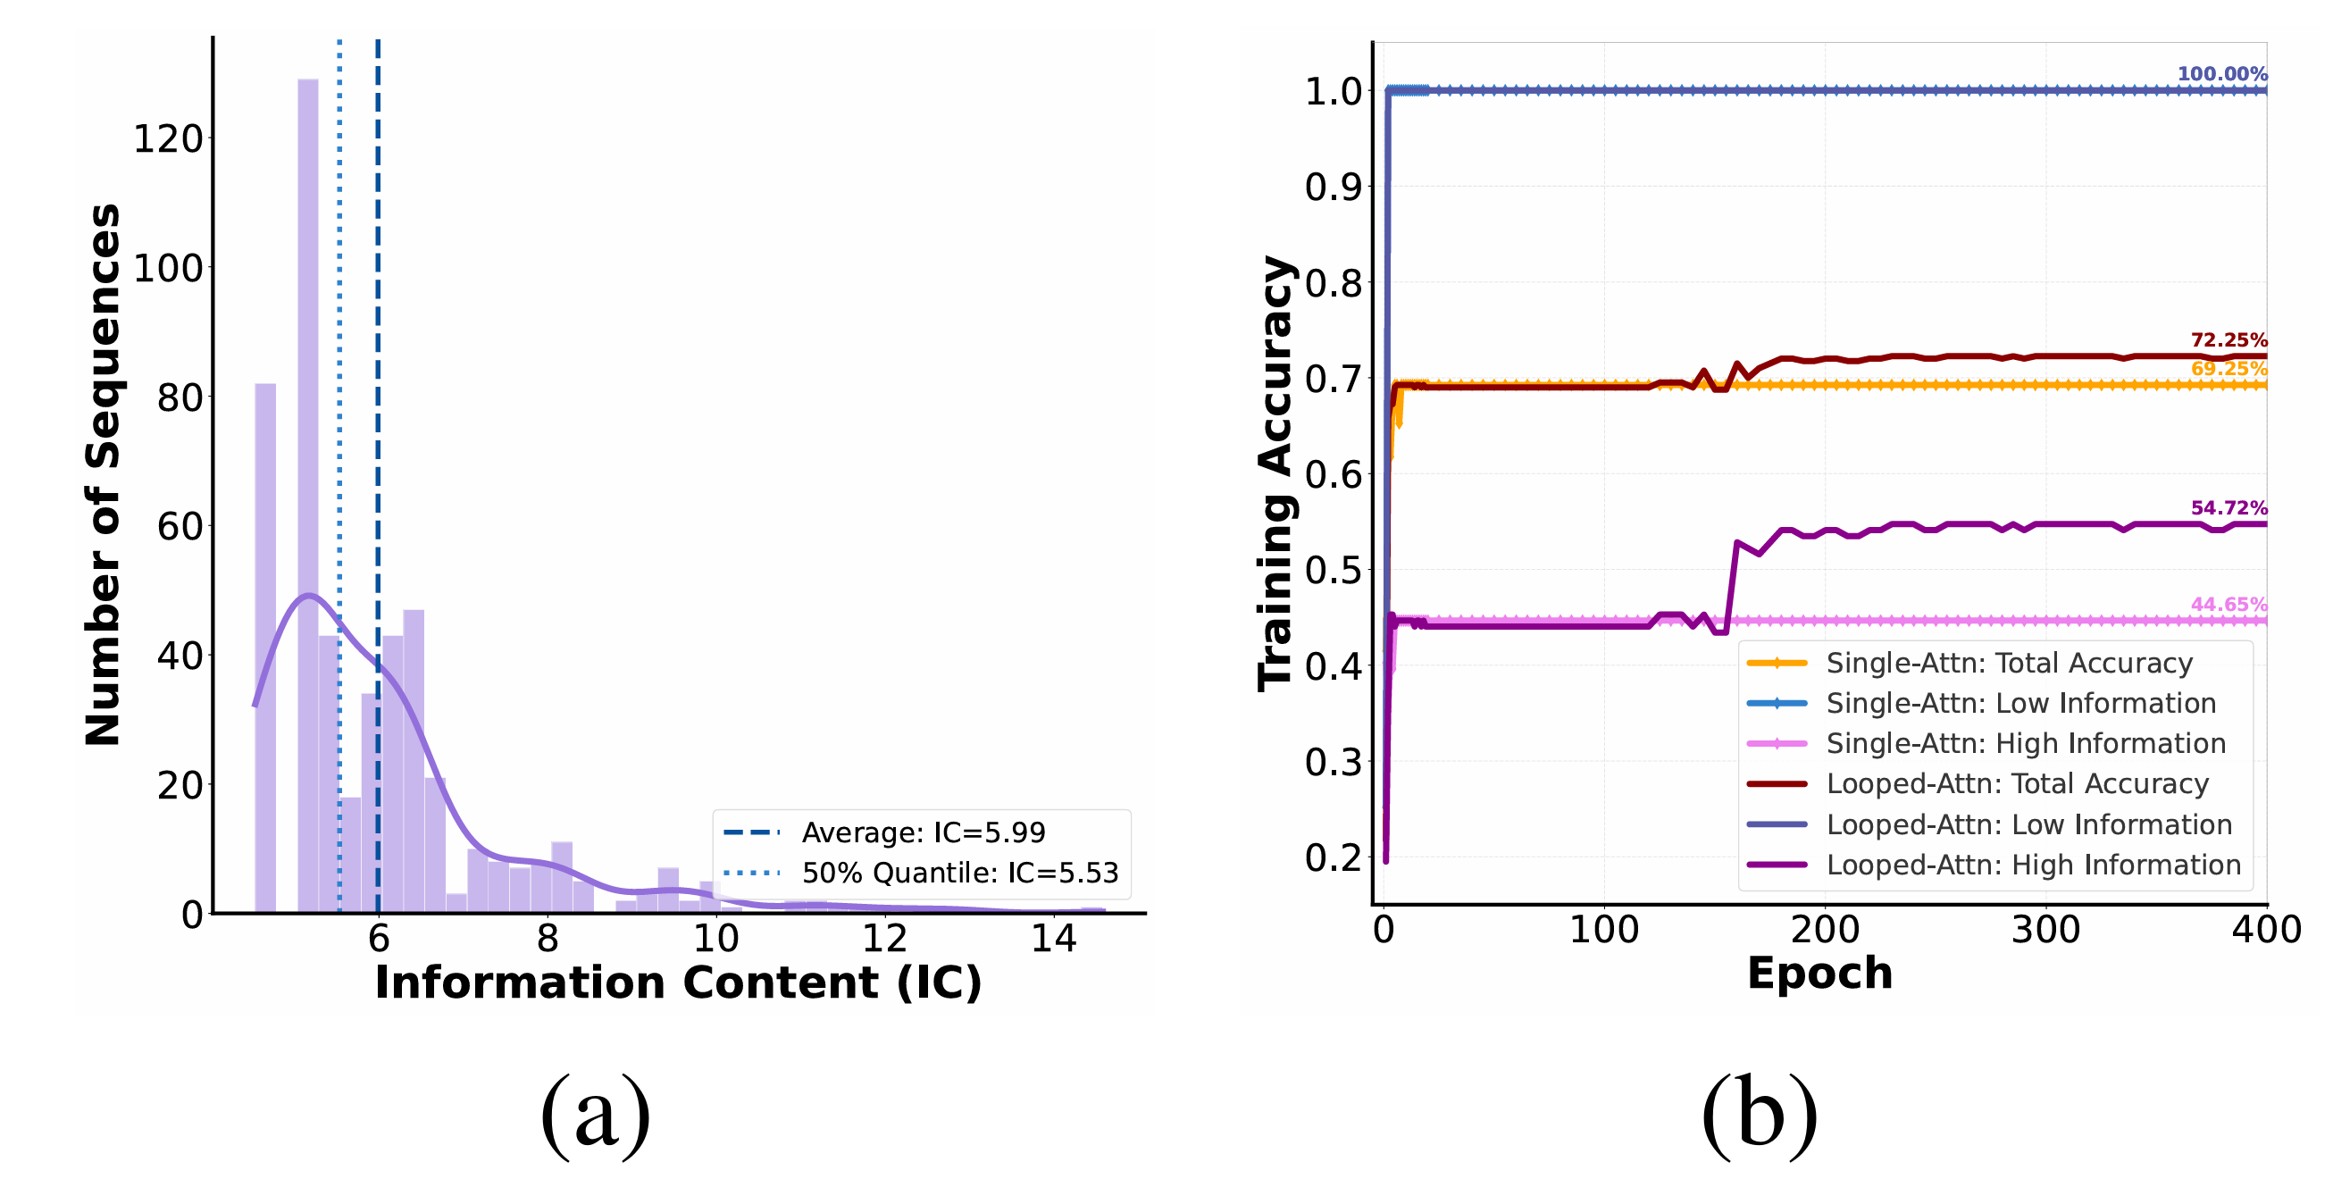
What Makes Looped Transformers Perform Better Than Non-Recursive Ones (Provably)

Slide 13
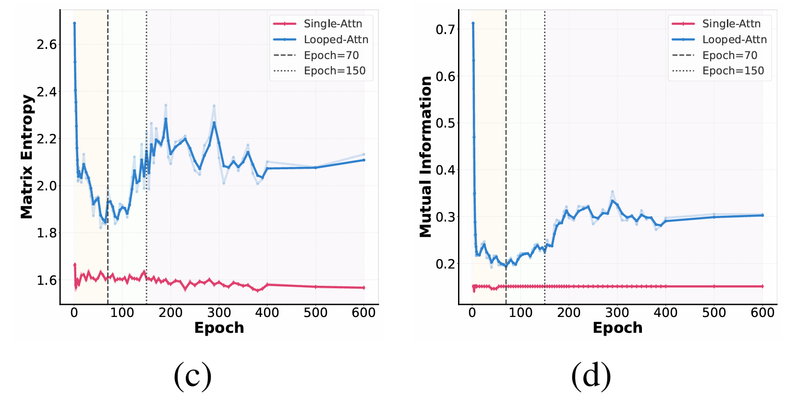
What Makes Looped Transformers Perform Better Than Non-Recursive Ones (Provably)

Slide 14
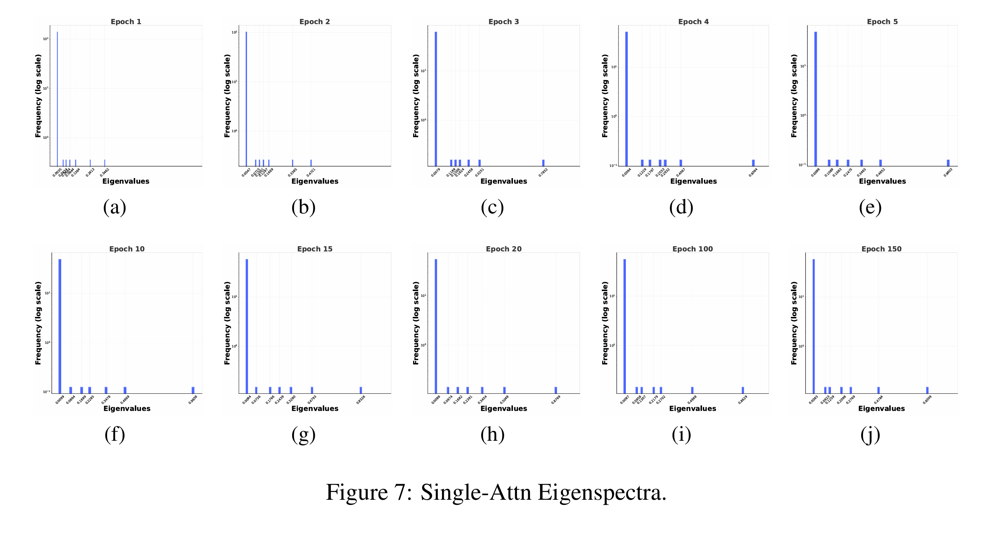
What Makes Looped Transformers Perform Better Than Non-Recursive Ones (Provably)

Slide 15
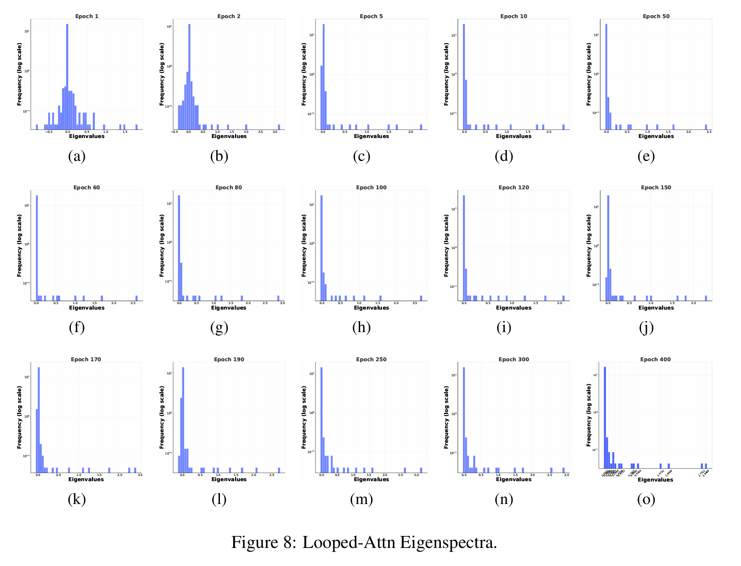
What Makes Looped Transformers Perform Better Than Non-Recursive Ones (Provably)

Slide 16
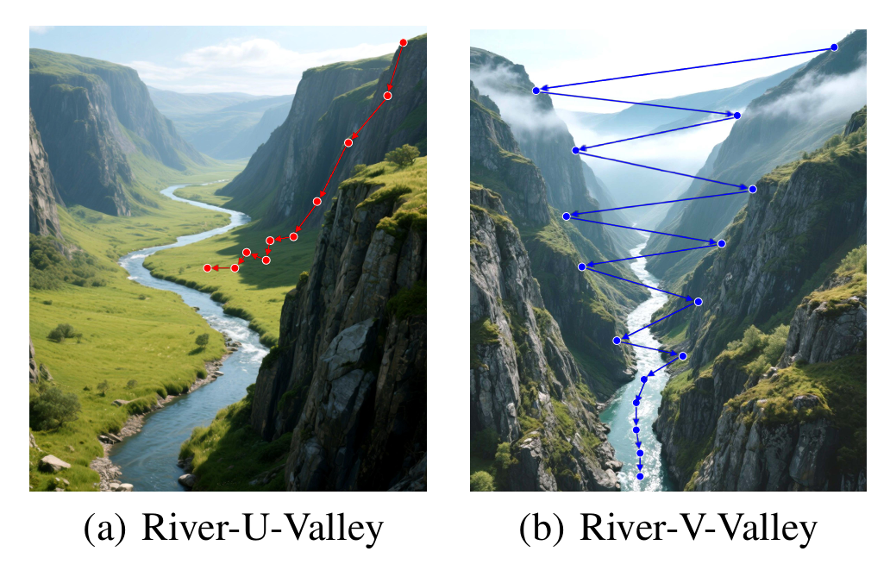
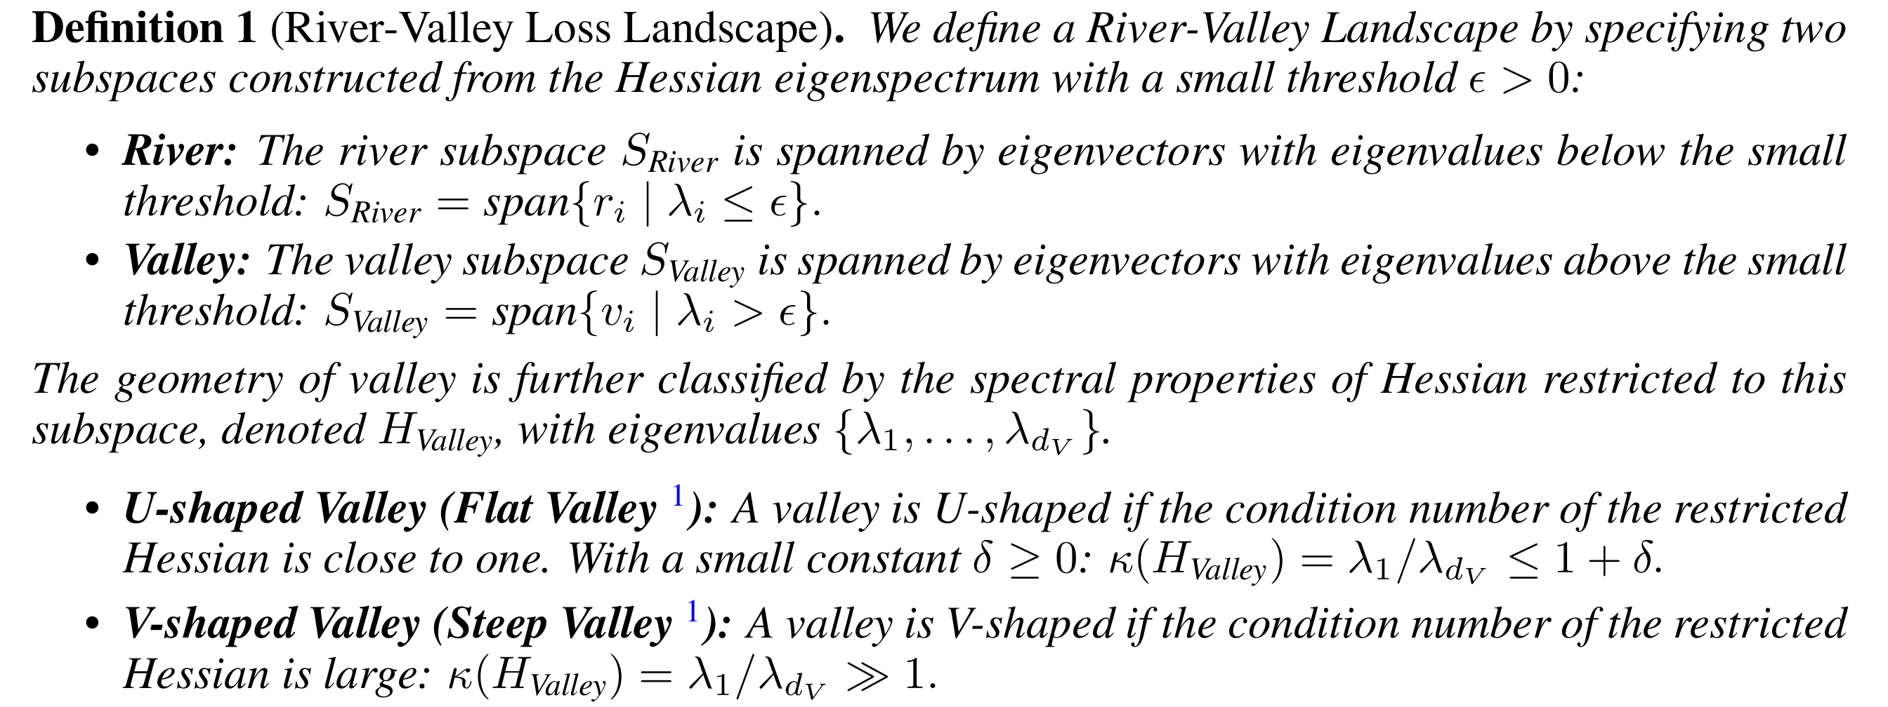
What Makes Looped Transformers Perform Better Than Non-Recursive Ones (Provably)
Explanation: (refined) River-Vally structure

Slide 17
What Makes Looped Transformers Perform Better Than Non-Recursive Ones (Provably)
Conjecture: (refined) River-Vally structure
Single-Attention: U-Vally
Easily get trapped in the U-Vally
Does not perform well on complext tasks
Loop-Attention: V-Vally
Find a better river region

Slide 18
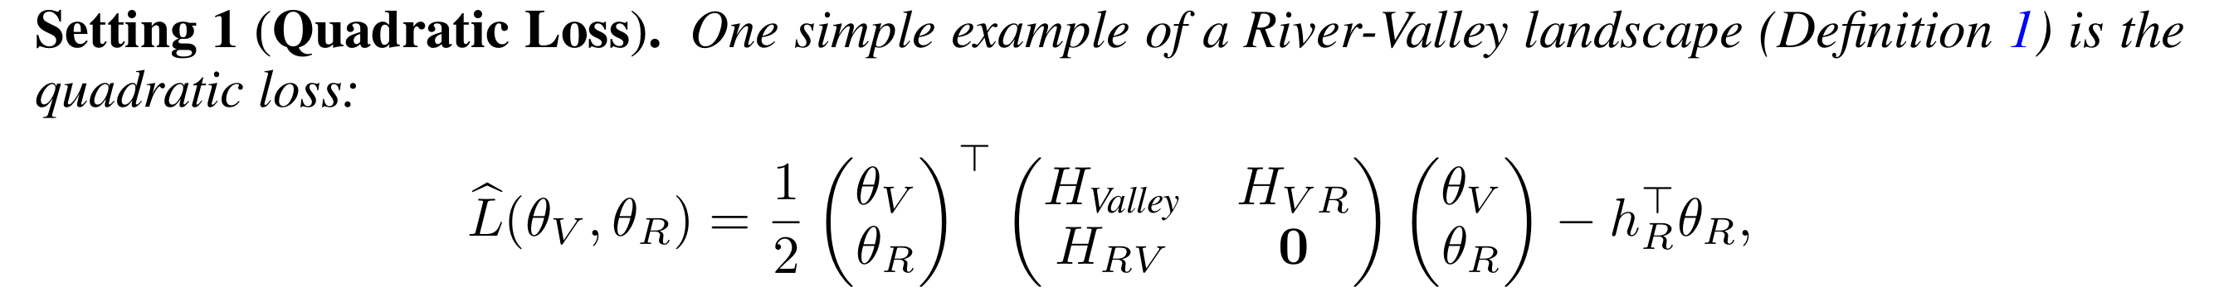
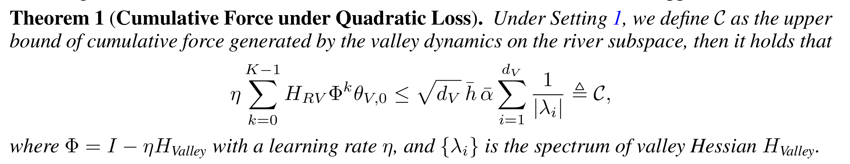
What Makes Looped Transformers Perform Better Than Non-Recursive Ones (Provably)
Some theoretical results based on River-Vally structure (motivating example)

Slide 19
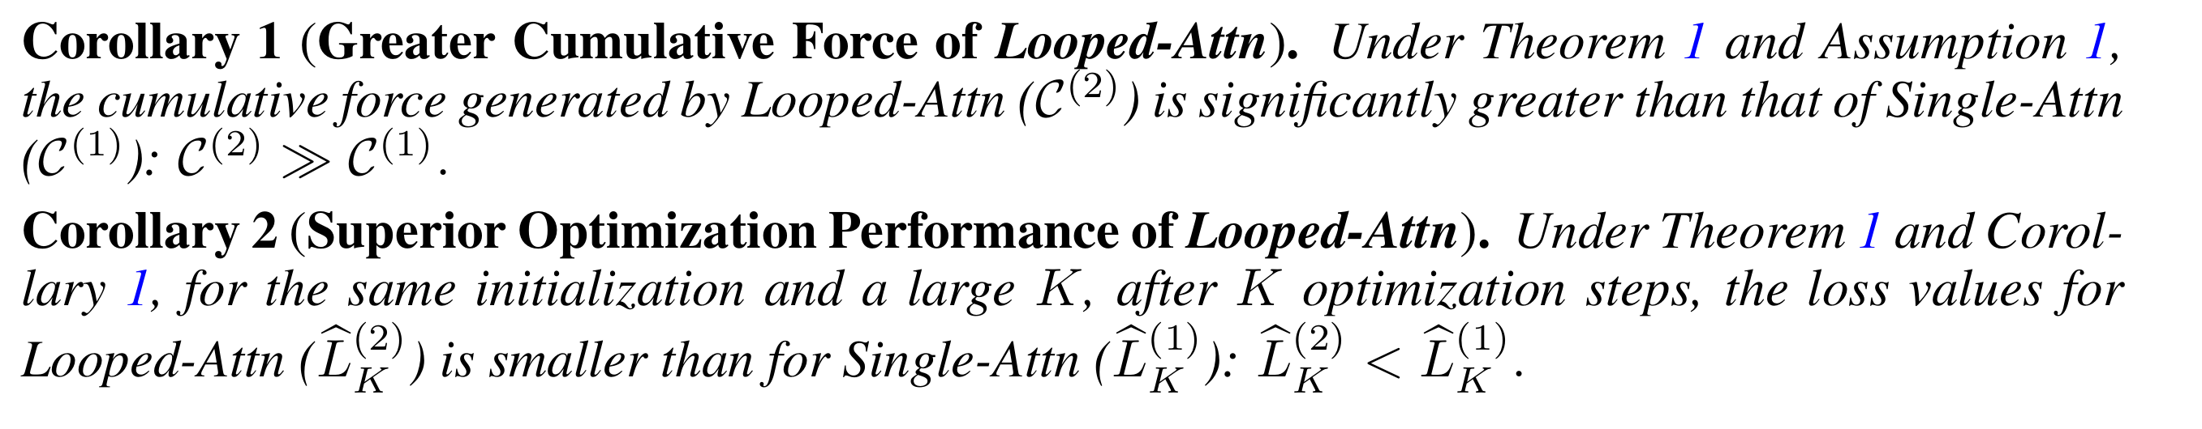
What Makes Looped Transformers Perform Better Than Non-Recursive Ones (Provably)
Some theoretical results based on River-Vally structure (motivating example)

Slide 20
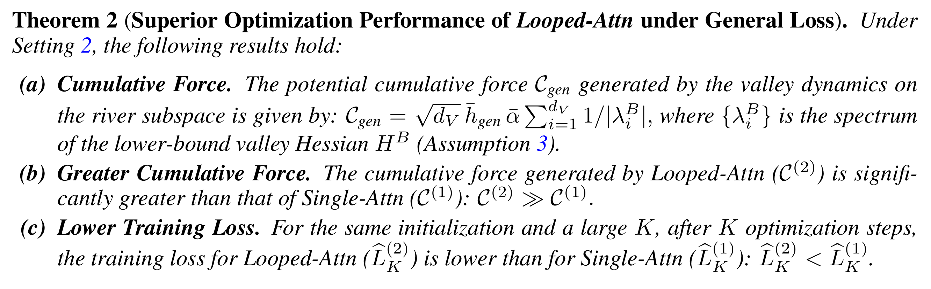
What Makes Looped Transformers Perform Better Than Non-Recursive Ones (Provably)
Some theoretical results based on River-Vally structure

Slide 21
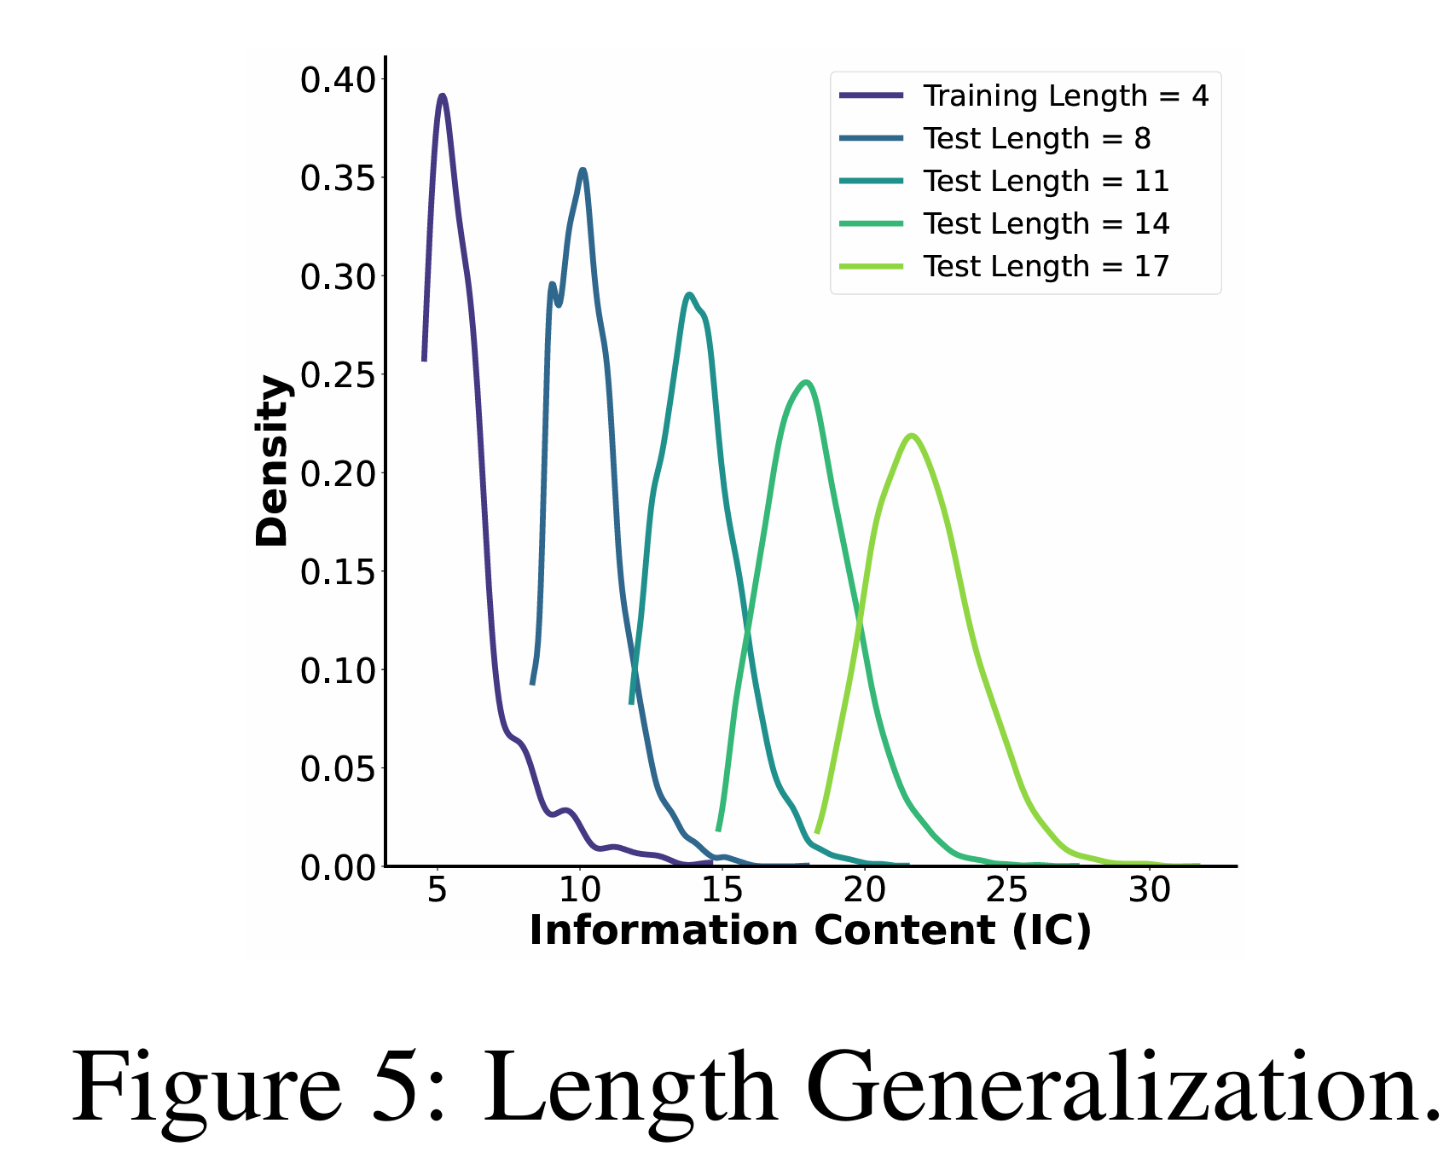
What Makes Looped Transformers Perform Better Than Non-Recursive Ones (Provably)
Relationship with Length Generalization
Large length relates with complex tasks
Different task distribution under different test length
Explanation with river-vally explanations

Slide 22
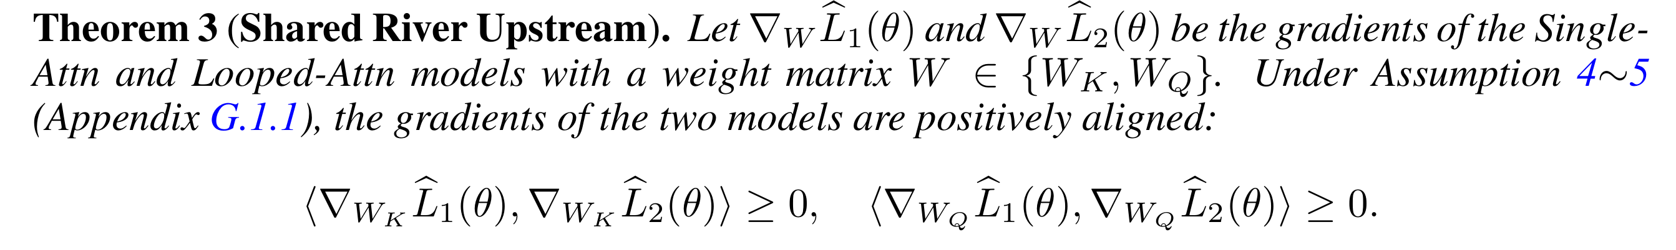
What Makes Looped Transformers Perform Better Than Non-Recursive Ones (Provably)
SHIFT: a two-stage algorithm to reduce the computational cost
Stage One: Training with Single-Attention
Stage Two: Training with Looped-Attention
Insights: the first stage deals with the simple patterns
When to transite?

Slide 23
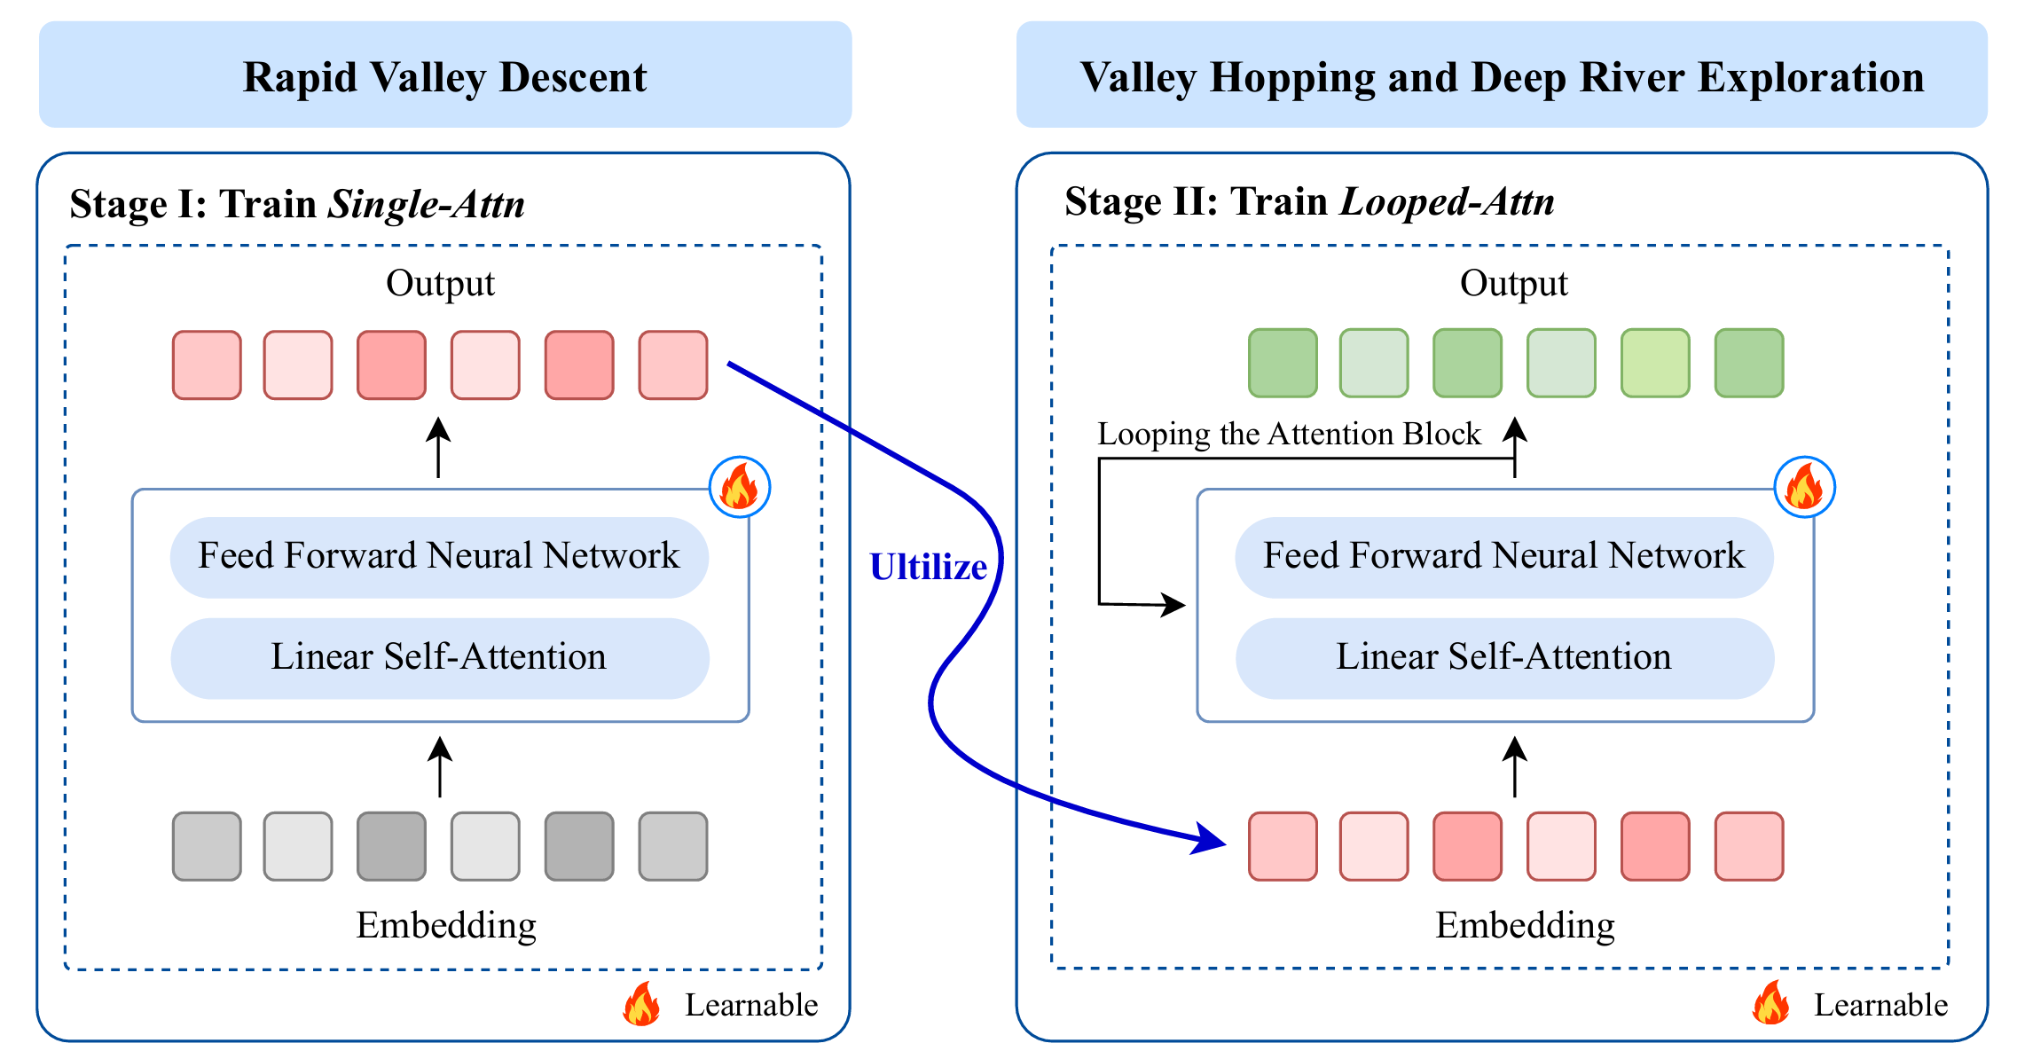
What Makes Looped Transformers Perform Better Than Non-Recursive Ones (Provably)
SHIFT: transition point
When to transite?
Ceriterion One: performance reaches the plateau
Ceriterion Two: gradient becomes stable

Slide 24
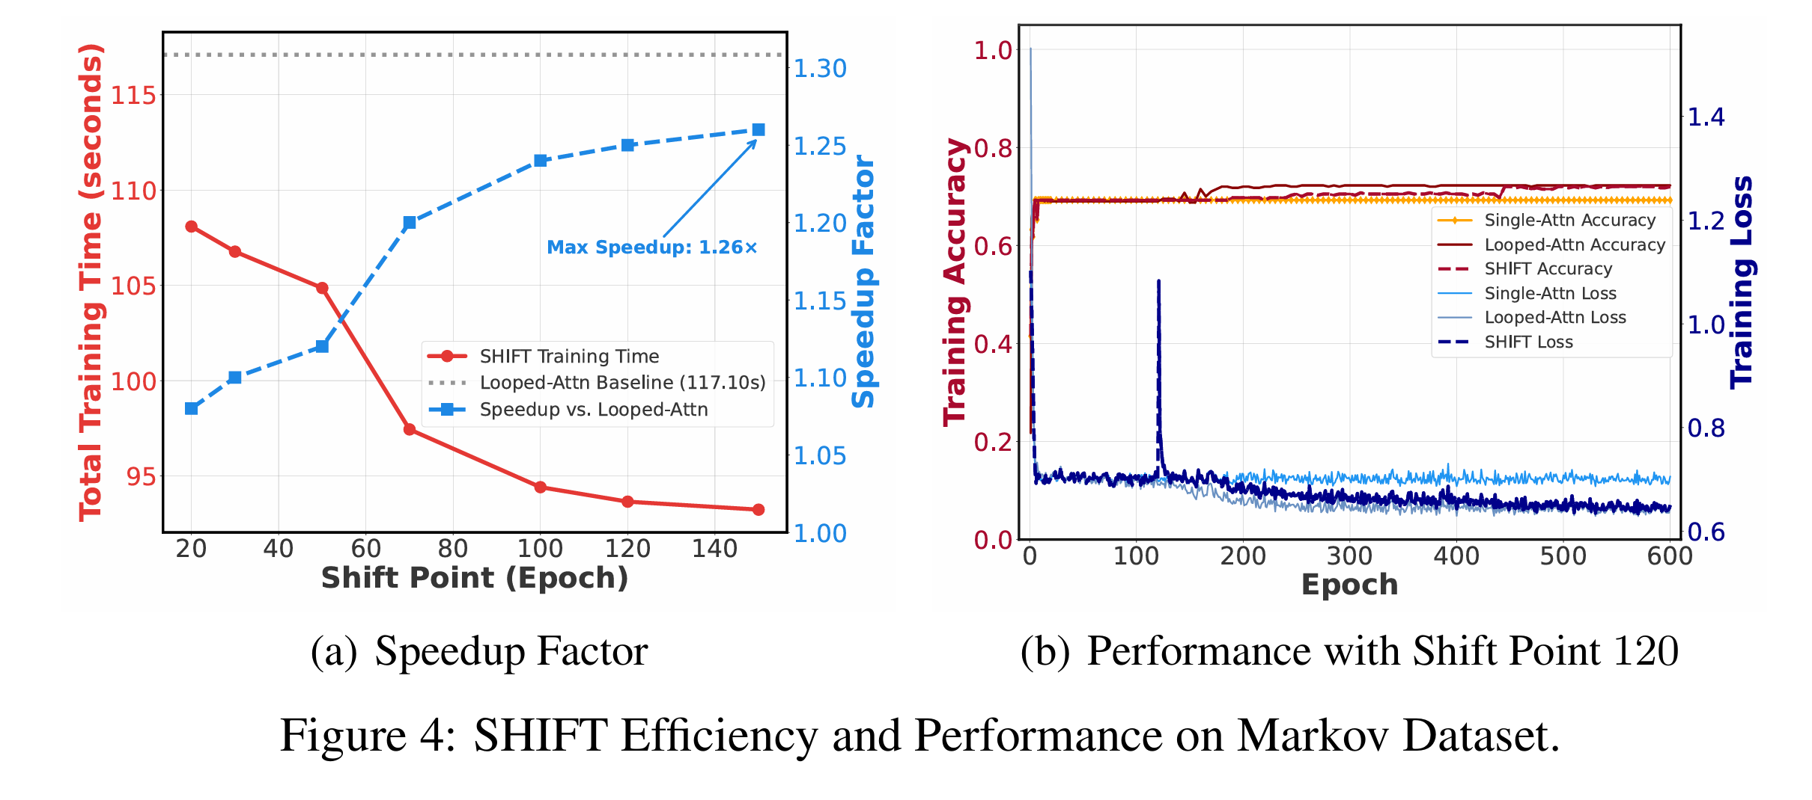
What Makes Looped Transformers Perform Better Than Non-Recursive Ones (Provably)
Acceleration: 1.26x
Comparable Performance

Slide 25
What Makes Looped Transformers Perform
Better Than Non-Recursive Ones (Provably)
Take-away Messages:
Looped Transformers has different performances on both sample-level and Hessian-level
River-Valley landscapes potentially account for that difference
SHIFT: a two-stage strategy for training looped transformers
Advertisement on a seminar: FAI-Seminar (www.fai-seminar.ac.cn)
High-quality talks (mostly in Chinese) on each Friday
Each speaker is elected via voting
Topic around theoretical foundations of AI
70 talks with over 330k views (4.7k views per talk in ave)
Thanks!

