Slide 1



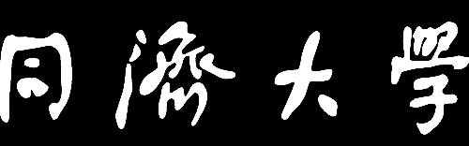
TONGJI UNIVERSITY
On the Emergence of Weak-to-Strong Generalization: A Bias-Variance Perspective
2025 X-AGI & The 18th China-R Conference
2025-10-18
Ziqiao Wang

Slide 2

01
Background
CONTENTS
02
Misfit-based Analysis
03
W2SG on MSE Loss
04
W2SG on CE Loss
05
Experiments

Slide 3


01
Background

Slide 4
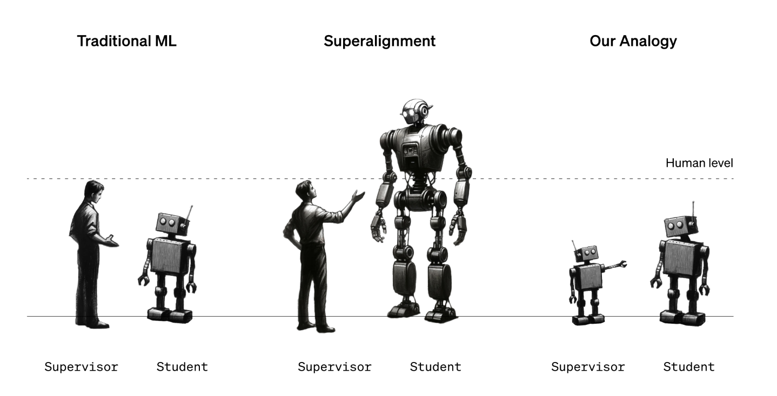
Superalignment
Burns, et al. "Weak-to-Strong Generalization: Eliciting Strong Capabilities With Weak Supervision." In ICML, 2024.
1

Slide 5
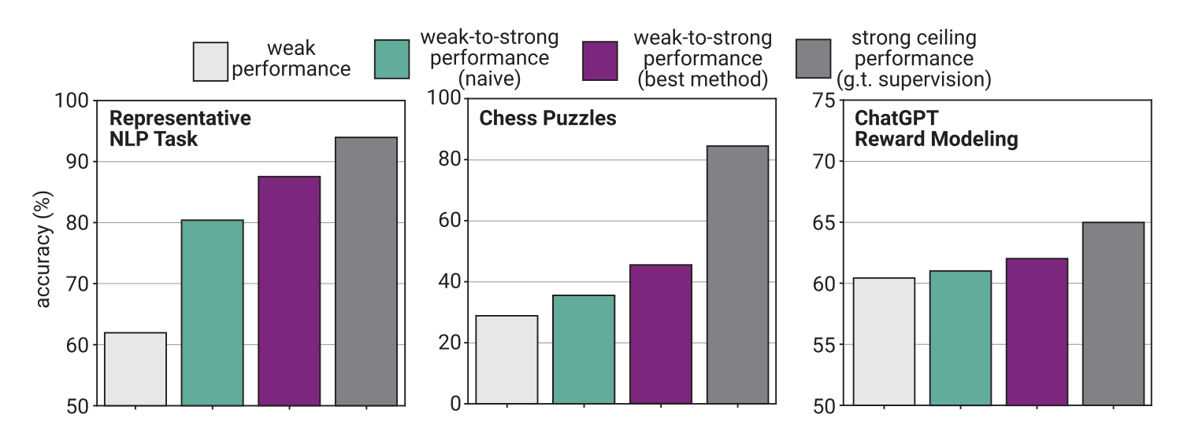







Weak-to-Strong Generalization (W2SG)
Weak Teacher Training
Strong Student Training
W2SG
$$X_{i}∼P_{X}$$
Data
$$X_{j}∼P_{X}$$
Data
Test Acc.
$$f^{∗}$$
$$Y_{i}=f^{∗}\left(X_{i}\right)$$
$$f_{teacher}$$
$${\hat{Y}}_{j}=f_{teacher}\left(X_{j}\right)$$
$$f_{student}$$
Ground-truth model
True Label
Teacher Model
Pseudo Label
Student Model
Teacher Model
Student Model
Burns, et al. “Weak-to-Strong Generalization: Eliciting Strong Capabilities With Weak Supervision.” In ICML, 2024.
2

Slide 6
W2SG
Why Does the Weak-to-Strong Generalization Phenomenon Occur?
Pretraining provides the student model with sufficient prior knowledge relevant to downstream tasks.
Student model’s capacity far exceeds that of the teacher model.
Other training techniques (e.g., early stopping, soft labels) may also contribute.
3

Slide 7
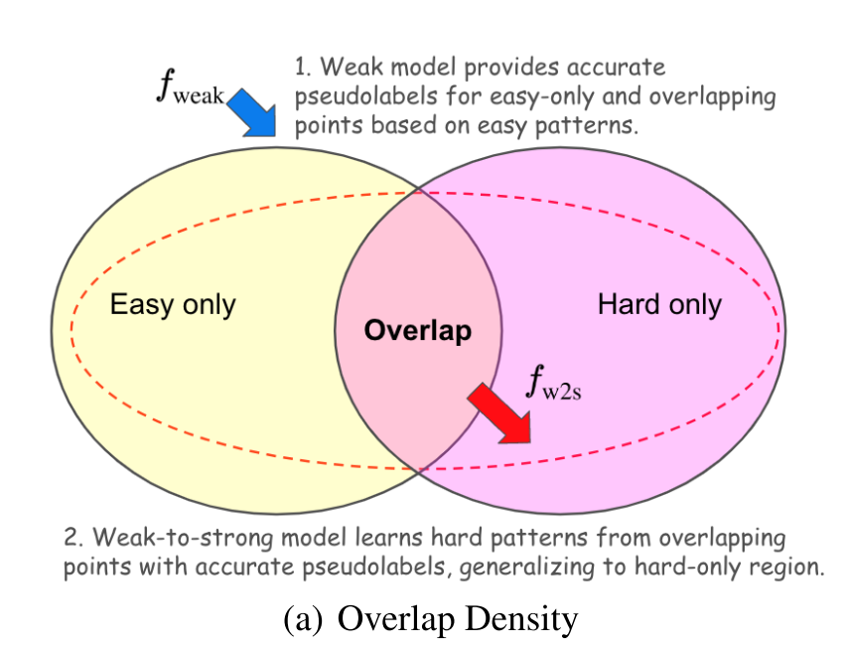
W2SG
Existing Analysis
Data characteristics perspective:
[1] Hunter Lang, David Sontag, and Aravindan Vijayaraghavan. Theoretical analysis of weak-tostrong generalization. Advances in neural information processing systems, 37:46837–46880, 2024.
[2] Changho Shin, John Cooper, and Frederic Sala. Weak-to-strong generalization through the data-centric lens. In The Thirteenth International Conference on Learning Representations, 2025.
[3] Junsoo Oh, Jerry Song, and Chulhee Yun. "From Linear to Nonlinear: Provable Weak-to-Strong Generalization through Feature Learning." High-dimensional Learning Dynamics 2025.
Data contain easy patterns and hard patterns, the weak model can learn the easy patterns but makes mistakes on the hard ones, while the student model does not overfit these mistaken parts.
4

Slide 8
W2SG
Existing Analysis
Model capacity perspective:
[4] David Xing Wu, and Anant Sahai. Provable weak-to-strong generalization via benign overfitting. In The Thirteenth International Conference on Learning Representations, 2025.
[5]Muhammed Emrullah Ildiz, et al. "High-dimensional Analysis of Knowledge Distillation: Weak-to-Strong Generalization and Scaling Laws." In The Thirteenth International Conference on Learning Representations, 2025.
[6] Yijun Dong, et al. "Discrepancies are Virtue: Weak-to-Strong Generalization through Lens of Intrinsic Dimension." In Forty-second International Conference on Machine Learning, 2025.
[7] Marko Medvedev, et al. "Weak-to-Strong Generalization Even in Random Feature Networks, Provably." In Forty-second International Conference on Machine Learning, 2025.
Student model has a larger capacity than the teacher model, resulting in lower bias or variance.
5

Slide 9
02
Misfit-based Analysis

Slide 10
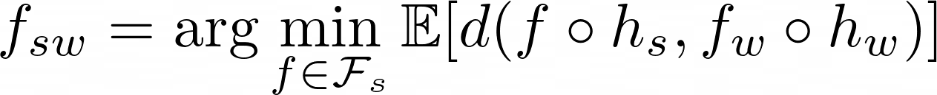
Misfit-based Analysis
Misfit-Based Mechanistic Analysis of W2SG
Charikar, Moses, et al. "Quantifying the Gain in Weak-to-Strong Generalization." In NeurIPS, 2024.
Assumptions
Only the classifier of strong model is fine-tuned, and the classifier function family（$f_{s}∈ℱ_{s}$）is convex
Realizability：
Mean squared error loss $d$, the strong model under weak supervision is
Main Result
Student’s test error $≤$ Teacher’s test error $−$ Misfit between the student and teacher
6

Slide 11
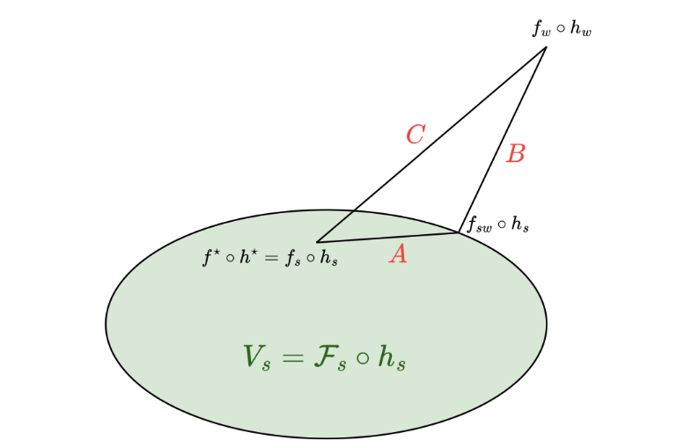
Misfit-based Analysis
Misfit-Based Mechanistic Analysis of W2SG
Charikar, Moses, et al. "Quantifying the Gain in Weak-to-Strong Generalization." In NeurIPS, 2024.
Proof idea: Generalized Pythagorean theorem (Law of cosines)
Limitation: Relies on the convexity assumption and only analyzes the MSE loss.
7

Slide 12
Misfit-based Analysis
Misfit-Based Mechanistic Analysis of W2SG
Mulgund, et al. " Relating Misfit to Gain in Weak-to-Strong Generalization Beyond the Squared Loss." In ICML, 2025.
Assumptions
Only the classifier of strong model is fine-tuned, and the classifier function family（$f_{s}∈ℱ_{s}$）is convex
Realizability：
Bregman loss $d$, the strong model under weak supervision is
Main Result
Using Generalized Pythagorean Inequality for Bregman divergence to obtain：
8

Slide 13



Misfit-based Analysis
On the Emergence of Weak-to-Strong Generalization:
A Bias-Variance Perspective
Collaborated with
Gengze Xu
Wei Yao
Yong Liu
9

Slide 14



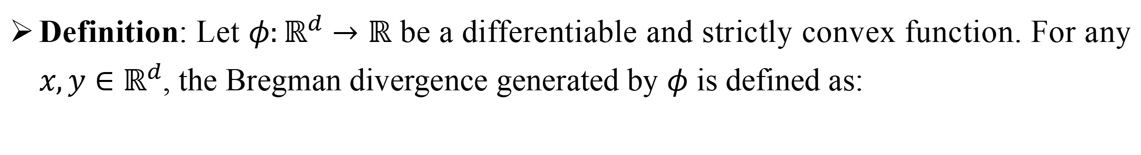
Misfit-based Analysis
Bregman Divergence
Definition: Let $φ:ℝ^{d}→ℝ$ be a differentiable and strictly convex function. For any $x,y∈ℝ^{d}$, the Bregman divergence generated by $φ$ is defined as:
Properties:
Non-negativity:
Identity of indiscernibles :
Asymmetry:
Duality: $φ^{∗}$ is the convex conjugate of $φ$, then
where
10

Slide 15
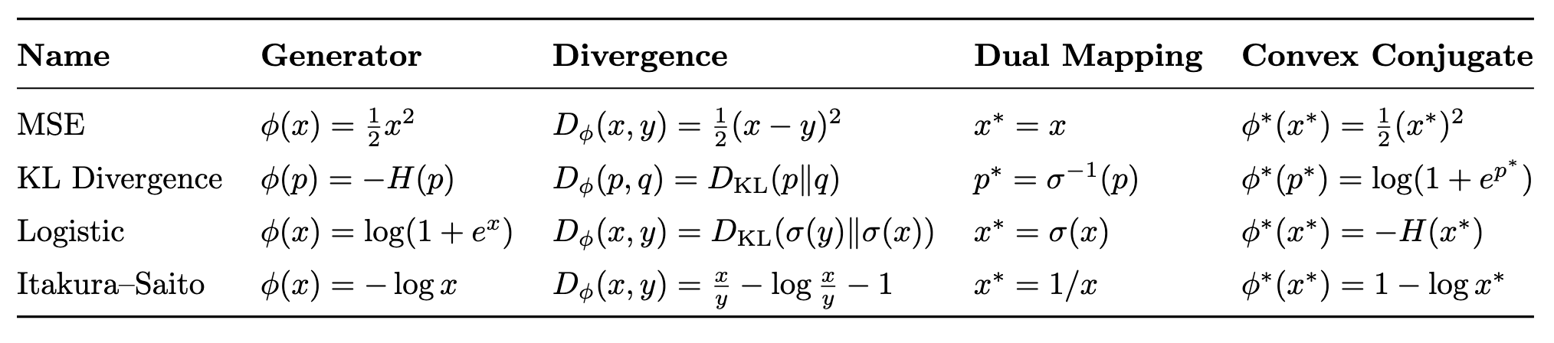
Misfit-based Analysis
Some Common Bregman Divergences
11

Slide 16
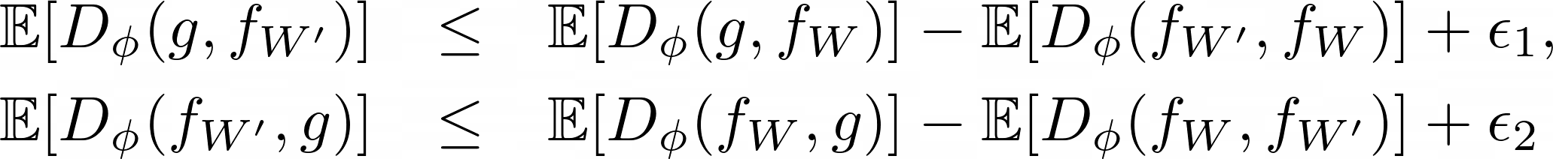
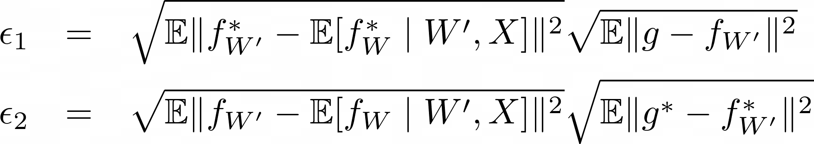
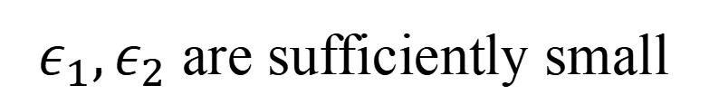
Misfit-based Analysis
W2SG Inequality Based on Expected Bregman Divergence
Teacher model: $f_{W}$ Student model: $f_{W′}$ Ground-truth labeling function: $g$
Student error
Teacher error
Student-teacher misfit
Forward Div.
Backward Div.
where
$ε_{1},ε_{2}$ are sufficiently small
W2SG occurs
12

Slide 17
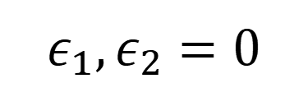
Misfit-based Analysis
W2SG Inequality Based on Expected Bregman Divergence
$$ε_{1},ε_{2}=0$$
W2SG is guaranteed to occur
若
若
When the student model’s predictions approach the teacher model in posterior expectation
W2SG occurs
13

Slide 18
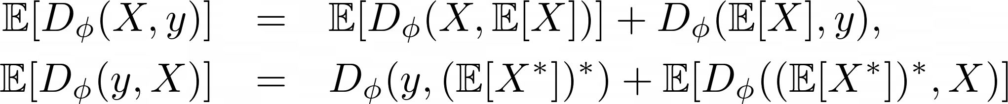
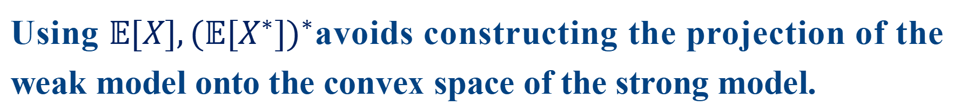
Misfit-based Analysis
Unlike the previous misfit-based analysis, the convexity assumption is removed
Instead of using the “generalized Pythagorean theorem”, we adopt the bias–variance decomposition of the expected Bregman divergence:
Using $𝔼[X],(𝔼[X^{∗}])^{∗}$avoids constructing the projection of the weak model onto the convex space of the strong model.
14

Slide 19
03
W2SG on MSE Loss

Slide 20
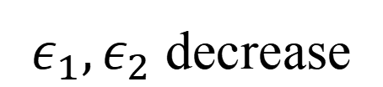
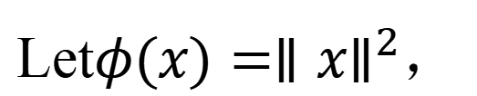
W2SG on MSE Loss
Symmetric Bregman Divergence: Mean Squared Error Loss
Let$φ(x)=∥x∥^{2}$，
此时
Reducing the Misfit
Misfit=0
$ε_{1},ε_{2}$ decrease
W2SG does not occur
15

Slide 21



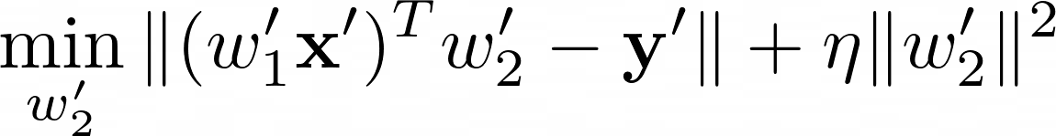
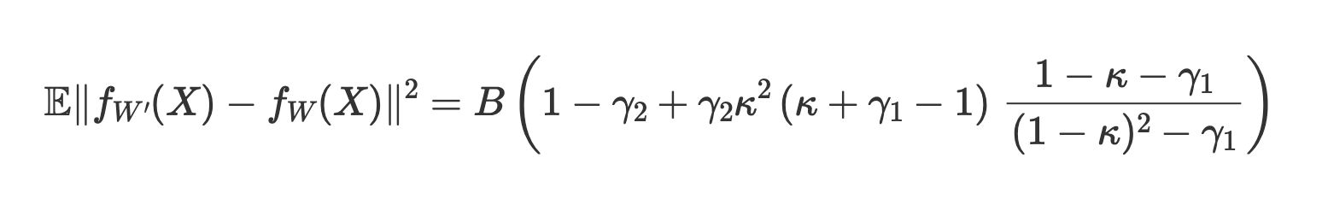
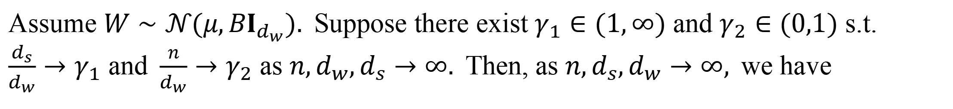
W2SG on MSE Loss
Example：Ridge Regression
Data:
Teacher Model:
Student Model:
Ridge Regression:
$\text{Assume} W∼𝒩(μ,BI_{d_{w}}). \text{Suppose} \text{there} \text{exist} γ_{1}∈(1,∞) \text{and} γ_{2}∈(0,1) \text{s}\text{.}\text{t}\text{. }\frac{d_{s}}{d_{w}}→γ_{1} \text{and} \frac{n}{d_{w}}→γ_{2} \text{as} n,d_{w},d_{s}→∞. \text{Then}\text{, }\text{as} n,d_{s},d_{w}→∞, \text{we} \text{have}$
$$\text{where} κ∈\left(0,1\right) \text{is} \text{the} \text{unique} \text{solution} \text{to} η^{2}\left(1−κ\right)=γ_{2}κ\left(κ+γ_{1}−1\right)\left(1−γ_{2}+γ_{2}κ\right)$$
16

Slide 22
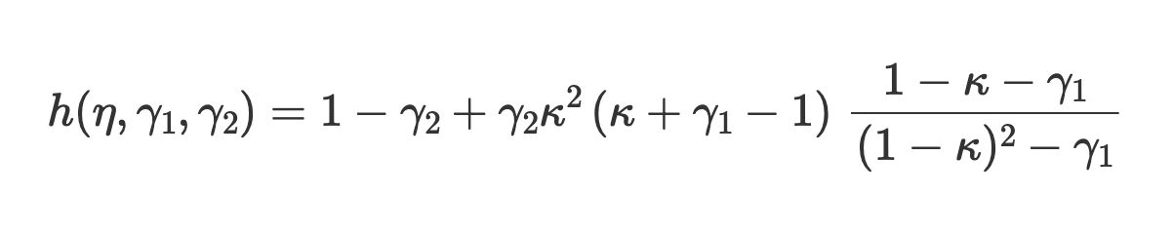
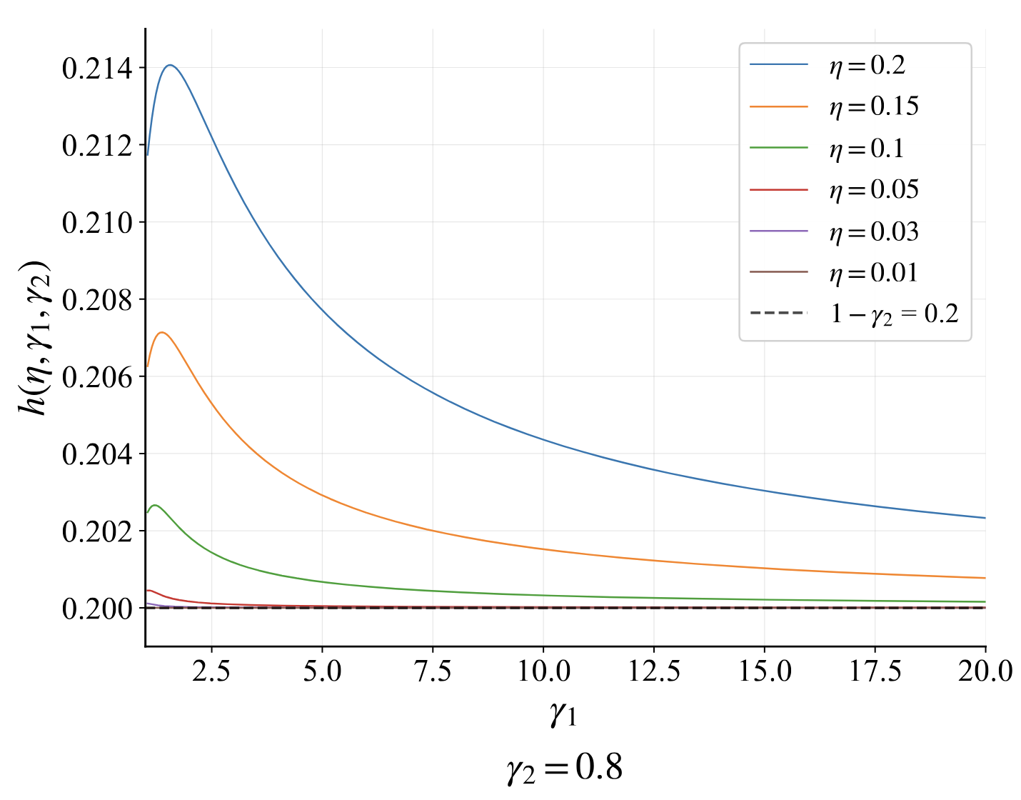
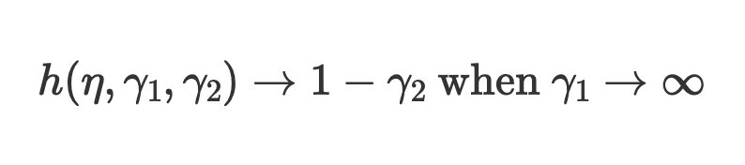
W2SG on MSE Loss
Example：Ridge Regression
A larger student model reduces the misfit and facilitates W2SG, though the performance gain eventually saturates.
17

Slide 23
04
W2SG on CE Loss

Slide 24
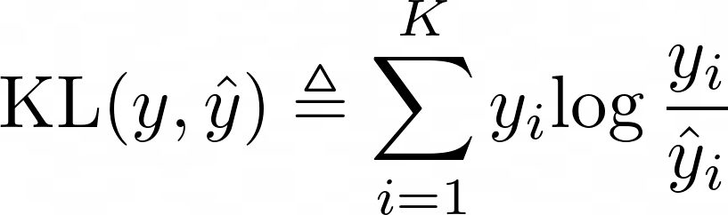
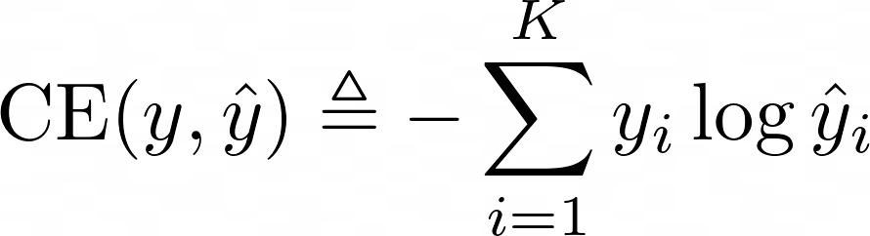
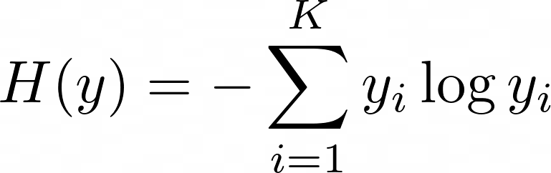
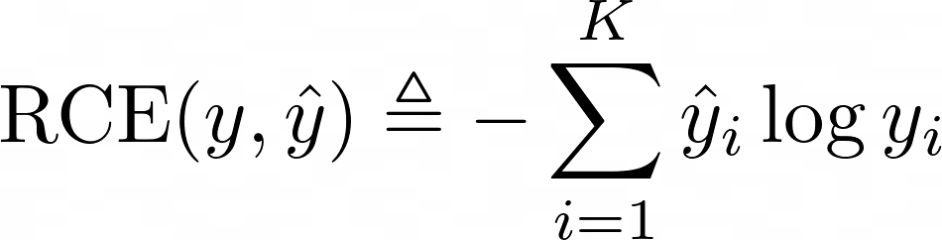
W2SG on CE Loss
Asymmetric Bregman Divergence: KL Divergence
$K$-class classification problem
KL divergence:
Cross-entropy loss:
Entropy:
Let $φ(x)=∑x_{i}logx_{i}$，reverse cross-entropy
18

Slide 25
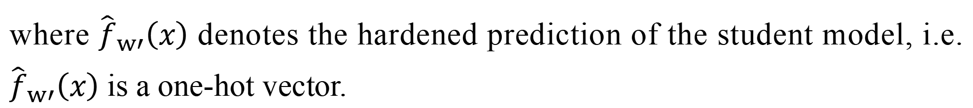
W2SG on CE Loss
Asymmetric Bregman Divergence: KL Divergence
The original W2SG paper designs a regularized loss:
Reducing the entropy of the student’s predictions
where ${\hat{f}}_{w′}\left(x\right)$ denotes the hardened prediction of the student model, i.e. ${\hat{f}}_{w′}\left(x\right)$ is a one-hot vector.
Reducing the entropy of the student model’s outputs (improving the confidence of student predictions) can promote the occurrence of W2SG.
19

Slide 26


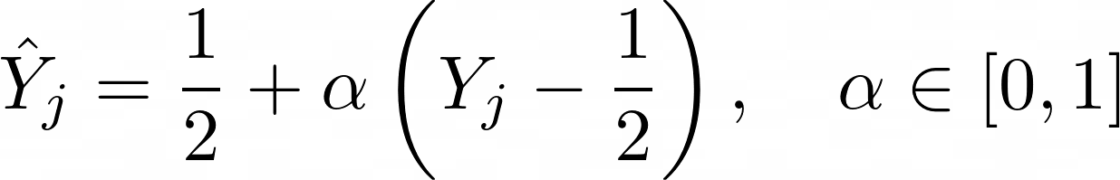
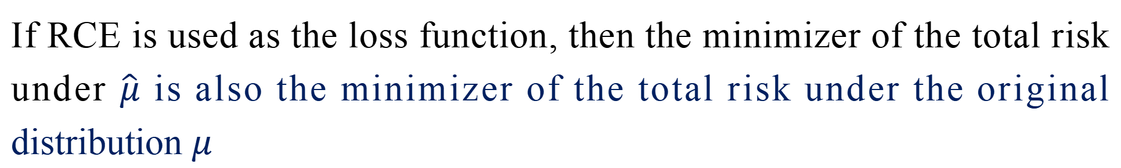
W2SG on CE Loss
Advantage of RCE Loss: Robustness to Low-Confidence Labels
Binary classification problem
Data distribution:
Label-shifted data distribution:
Label shift construction:
If RCE is used as the loss function, then the minimizer of the total risk under $\hat{μ}$ is also the minimizer of the total risk under the original distribution $μ$
20

Slide 27
05
Experiments

Slide 28
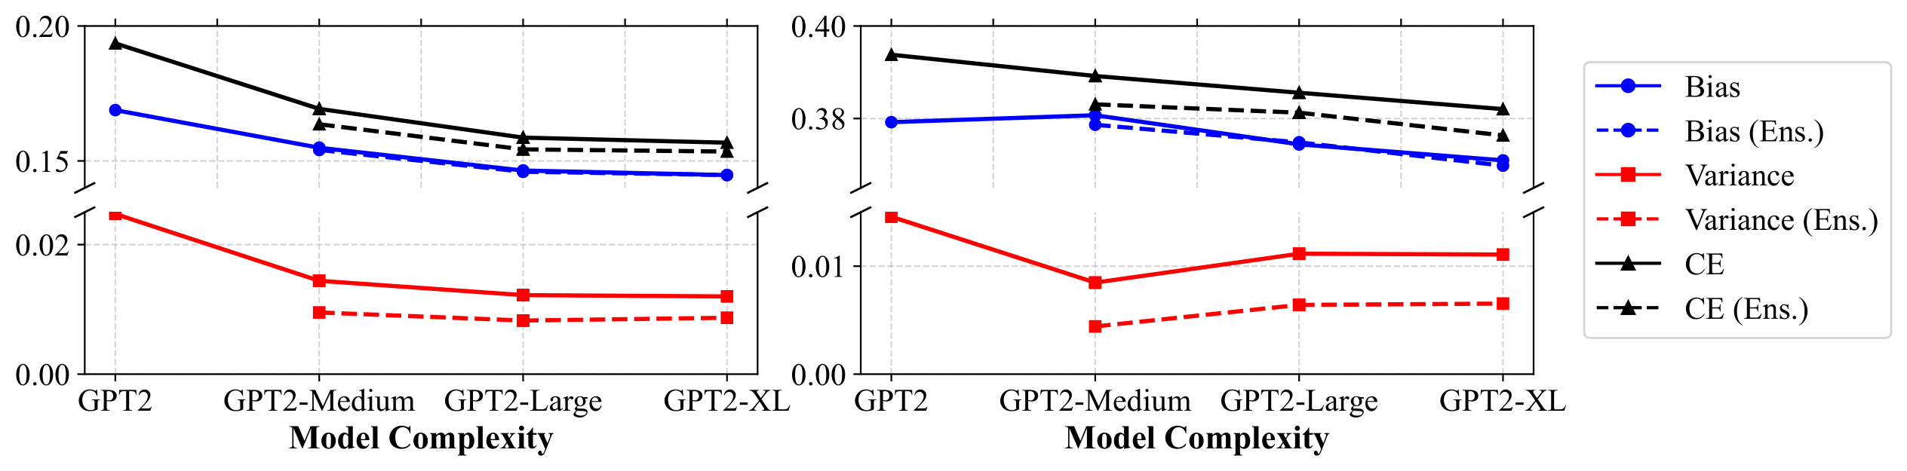
Experiments
Bias-Variance Decomposition of Weak and Strong Models
Amazon Polarity Dataset
Twitter Sentiment Dataset
Student model reduces both bias and variance.
Teacher model ensembles can improve W2SG (serving as a posterior-expectation proxy of the teacher model).
21

Slide 29
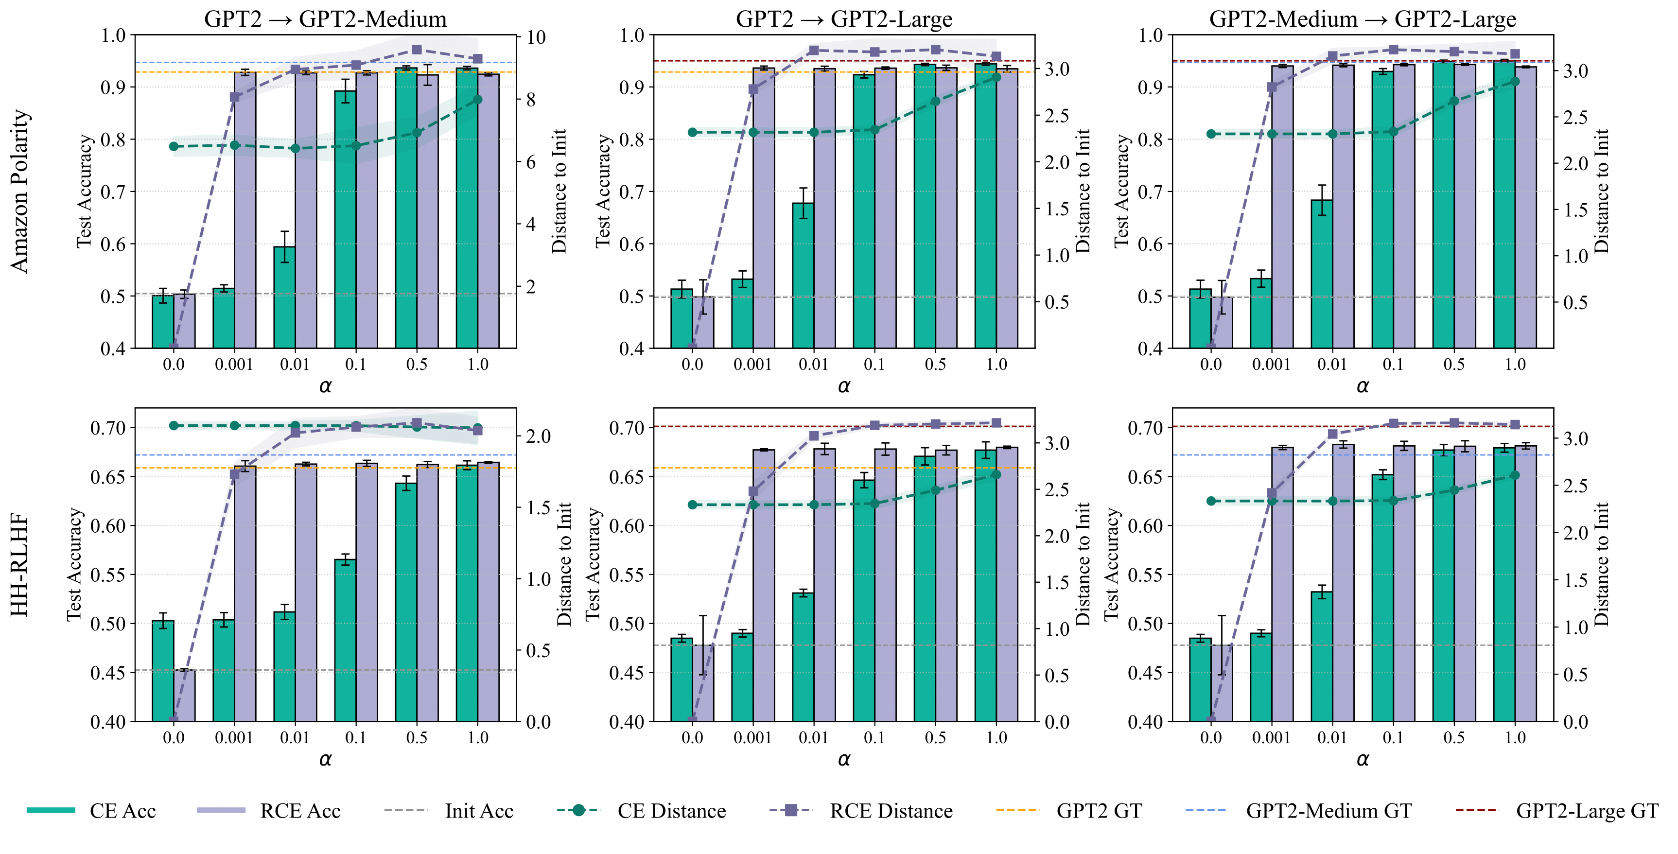

Experiments
Reverse Cross-Entropy vs. Cross-Entropy
Keep hard labels unchanged, reduce teacher model confidence:
RCE performs more robustly when the teacher labels have low confidence (i.e. small $α$）
22

Slide 30
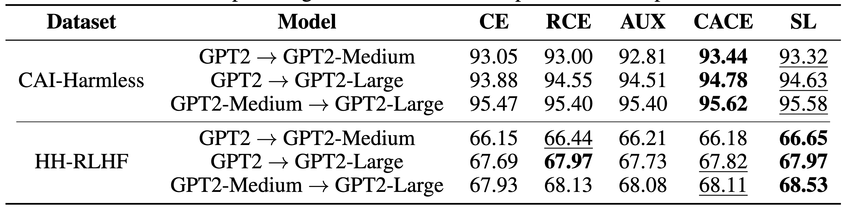
Experiments
Practical Implication: Combining RCE and CE
Confidence-Adaptive Cross Entropy, CACE:
When the teacher model’s output label confidence <c use RCE; otherwise, use CE.
Symmetric Cross Entropy Loss, SL:
Wang, Yisen, et al. “Symmetric cross entropy for robust learning with noisy labels.” In CVPR, 2019.
23

Slide 31

Summary
Take-Home Messages
Increasing the student model’s capacity can promote W2SG, but the performance gain will eventually saturate.
Avoid letting the student model overfit the teacher’s labels, e.g., by reducing prediction entropy.
Pretraining process is not a necessary condition for W2SG (though it may still facilitate it).
RCE shows better robustness under low-confidence soft labels.
Check Our Paper：
24

