Slide 1



Towards Generalist Multi-modal AI
2025年10月18日
Benyou Wang （王本友）
The Chinese University of Hong Kong, Shenzhen & Shenzhen Loop Area Institute

Slide 2
About me
2018-2022, Phd, University of Padova
2022-~, The Chinese University of Hong Kong, Shenzhen (CUHKSZ)
Assistant professor in School of Data Science, School of Medicine in CUHKSZ, as well as the Shenzhen Loop Area Institute (SLAI 深圳市河套学院).
Research:
- Planning of Agent (complex reasoning/math modeling/automatic theorem proof)
- Perception of Agent (audio,vision, time-series, etc.)
- Human-agent interaction (HCI, agent similation, brain-computer interface etc.)
- Applications of Agent (Medical/finnacial/legal/education)
Best papers:
- Best paper Honorable mention for SIGIR 2017
- NAACL 2019 Best Explainable NLP paper
- NLPCC 2022 Best Paper
- ICLR 2025 Finnacial AI 2025
Huggingface: https://huggingface.co/FreedomIntelligence
GitHub: https://github.com/FreedomIntelligence

Slide 3
What is Generalist Multi-modal AI ？
Foundation models: one model fits everything (without or with minor adaptions)
On Modalities
  More Modalities for Understanding
    Images (ALLaVA)，Speech (SoundWave)，EEG (WaveMind)，Motion (MotionLLM)，TCM (ShizhenGPT)
  More Modalities for Generation
    Speech (Echo-X)，Images (Janus-4o)，Video (MedGen)，Micro World Simulation (MicroVerse)
Beyond Modalities
  Longer Context
    MileBench, LongLLaVa
  Better Reasoning
    HuatuoGPT-o1，Video-R1
Future of Multi-modal AI

Slide 4
Why Generalist Multi-modal AI is language–centric ?
Language has massive knowledge
  “The sun rises in the east”
Language is a great tool for communication
  The interface between Humans and Machines
Language can reason and plan
  Language is the Medium of thought (思考的介质)
more (full) modality out
LLMs
Longer context
Better reasoning
more (full) modality in

Slide 5
Generalist Multi-modal AI: Top-down or bottom-up?
GMAI is the final goal
The road towards this goal might involves different specialized Multi-modal LLMs
Open AI develop one model for all
Better model backbone
Better insights/data/benchmark
Different specialized models and merge them

Slide 6
Input with more modalities for LLMs
- Images

Slide 7
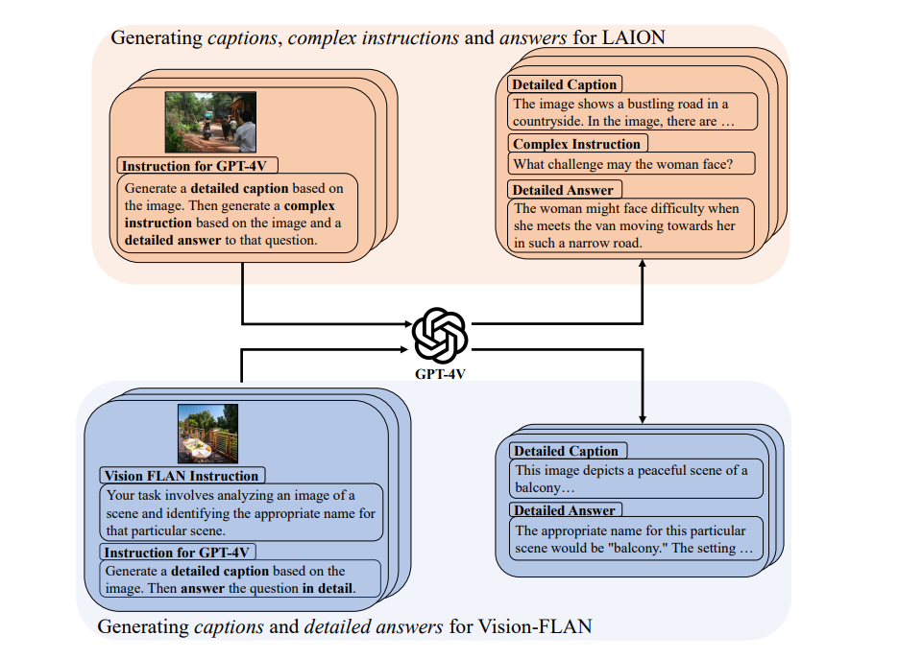
ALLaVA-4V 百万级别高质量数据
Guiming Hardy Chen, Shunian Chen, Ruifei Zhang, Junying Chen, Xiangbo Wu, Zhiyi Zhang, Zhihong Chen, Jianquan Li, Xiang Wan, Benyou Wang. ALLaVA: Harnessing GPT4V-synthesized Data for A Lite Vision-Language Model. https://arxiv.org/abs/2402.11684

Slide 8
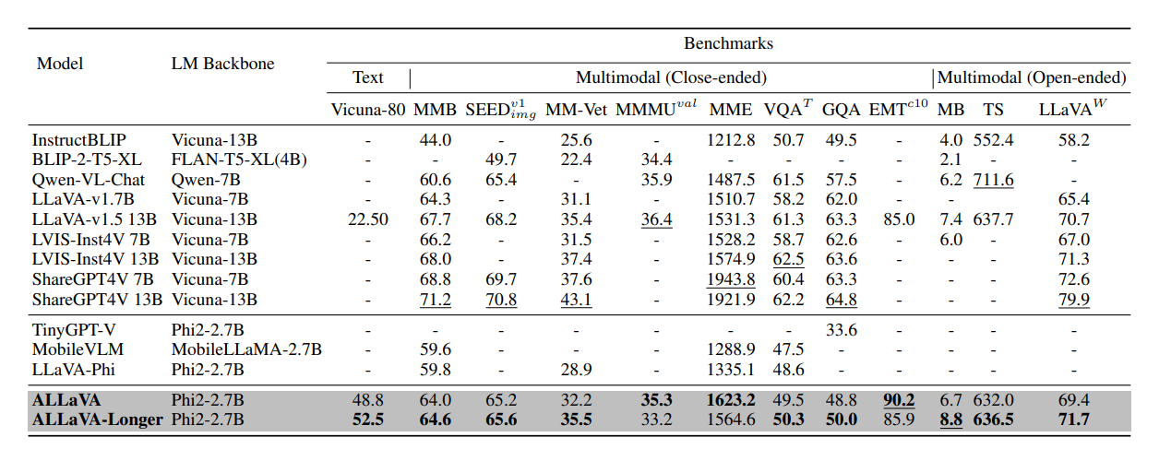
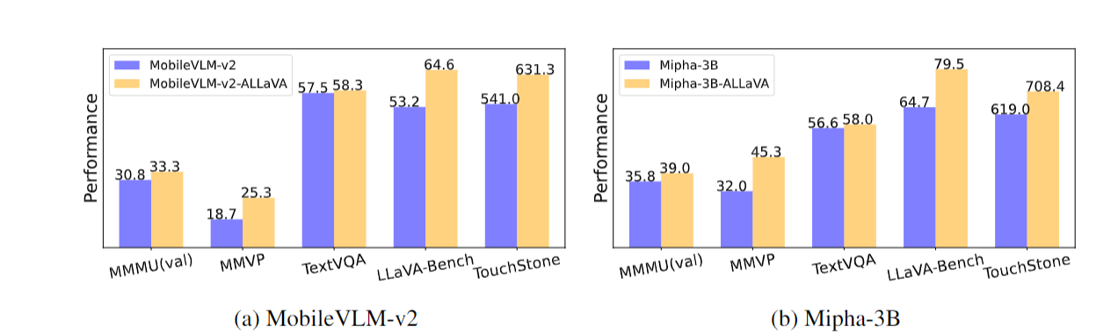
It largely improve performance by replacing original data with ours.

Slide 9
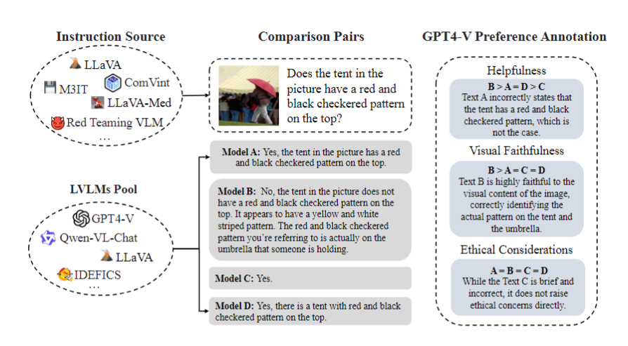
VLFeedback, Preference Data for Vision-Language Models
Lei Li, Zhihui Xie, Mukai Li, Shunian Chen, Peiyi Wang, Liang Chen, Yazheng Yang, Benyou Wang, Lingpeng Kong, Qi Liu. Silkie: Preference distillation for large visual language models. https://arxiv.org/abs/2312.10665

Slide 10
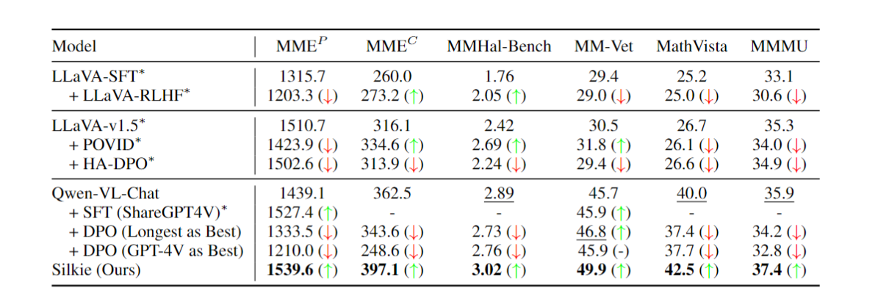
Experiments on Qwen-VL (with DPO using VLFeedback)

Slide 11
Input with more modalities for LLMs
- Speech

Slide 12
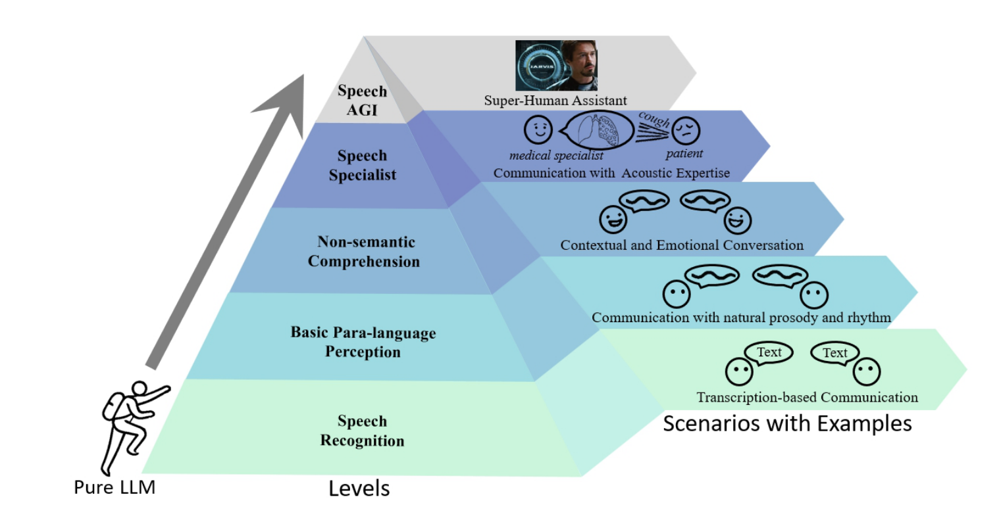
Five Levels for Speech Understanding using LLMs
Fan Bu, Yuhao Zhang, Xidong Wang, Benyou Wang, Qun Liu, Haizhou Li. Roadmap towards Superhuman Speech Understanding using Large Language Models. https://arxiv.org/abs/2410.13268

Slide 13
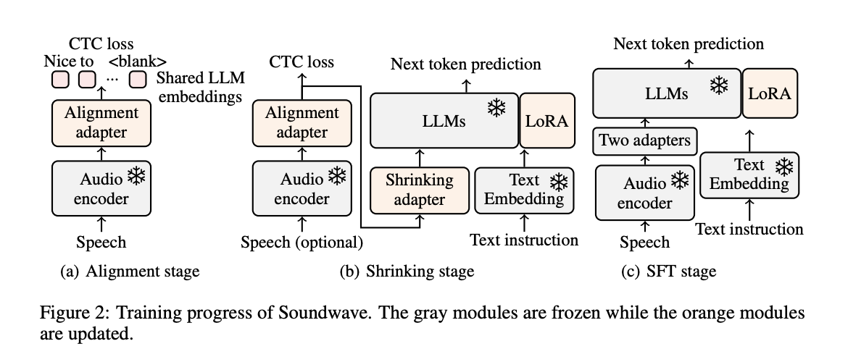
Soundwave：Less is more for Speech-text Alignment
Achieving better performance using 1/50 data compared to Qwen 2- Audio
Yuhao Zhang, Zhiheng Liu, Fan Bu, Ruiyu Zhang, Benyou Wang, Haizhou Li. Soundwave: Less is More for Speech-Text Alignment in LLMs. ACL 2025

Slide 14
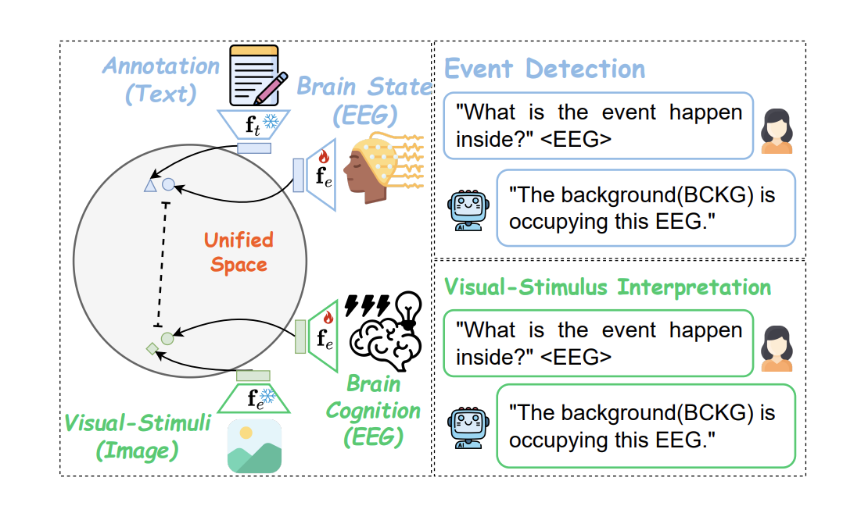
Others- EEG
Alingning EEG with texts and images!
Ziyi Zeng, Zhenyang Cai, Yixi Cai, Xidong Wang, Junying Chen, Rongsheng Wang, Yipeng Liu, Siqi Cai, Benyou Wang, Zhiguo Zhang, Haizhou Li. WaveMind: Towards a Conversational EEG Foundation Model Aligned to Textual and Visual Modalities. https://arxiv.org/abs/2510.00032

Slide 15
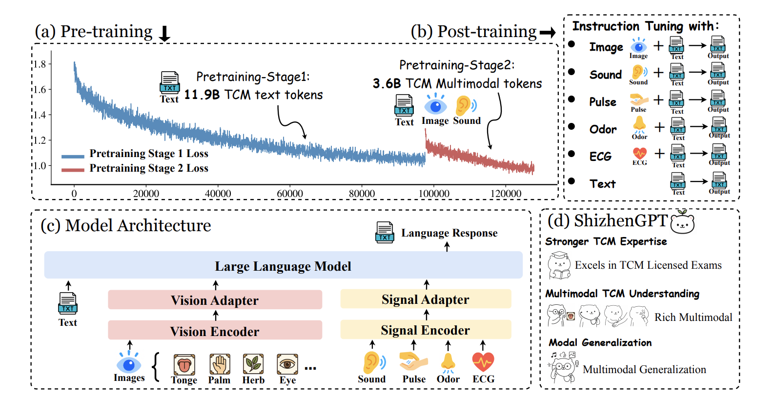
Others- ShizhenGPT (时珍GPT)
First unified model that supports 望闻问切
Junying Chen, Zhenyang Cai, Zhiheng Liu, Yunjin Yang, Rongsheng Wang, Qingying Xiao, Xiangyi Feng, Zhan Su, Jing Guo, Xiang Wan, Guangjun Yu, Haizhou Li, Benyou Wang. ShizhenGPT: Towards Multimodal LLMs for Traditional Chinese Medicine. https://arxiv.org/abs/2508.14706

Slide 16
Output with more modalities for LLMs

Slide 17
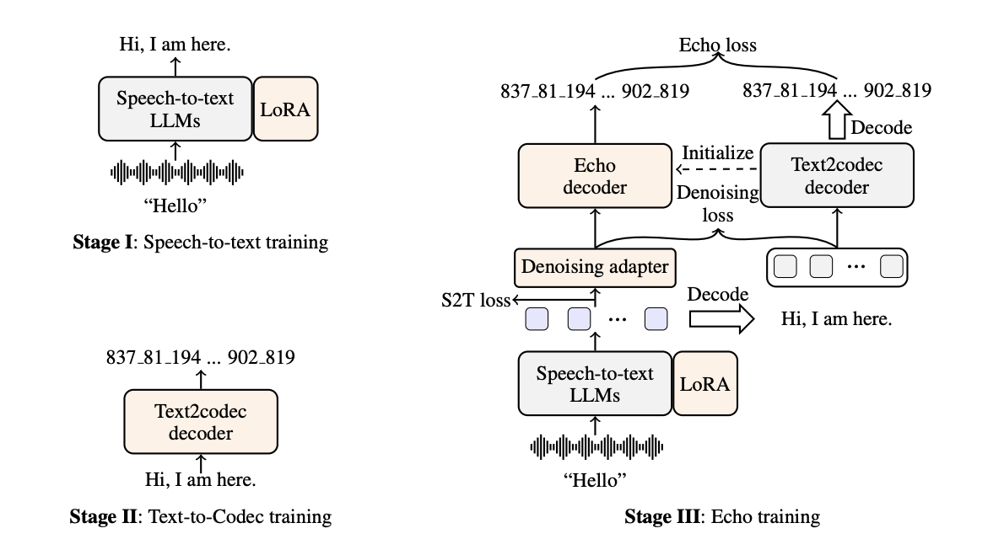
Speech2Seepch ： Echo-X
It achieves decent S2S performance using 6k hours
Yuhao Zhang, Yuhao Du, Zhanchen Dai, Xiangnan Ma, Kaiqi Kou, Benyou Wang, Haizhou Li. Echox: Towards mitigating acoustic-semantic gap via echo training for speech-to-speech llms. https://arxiv.org/abs/2509.09174

Slide 18
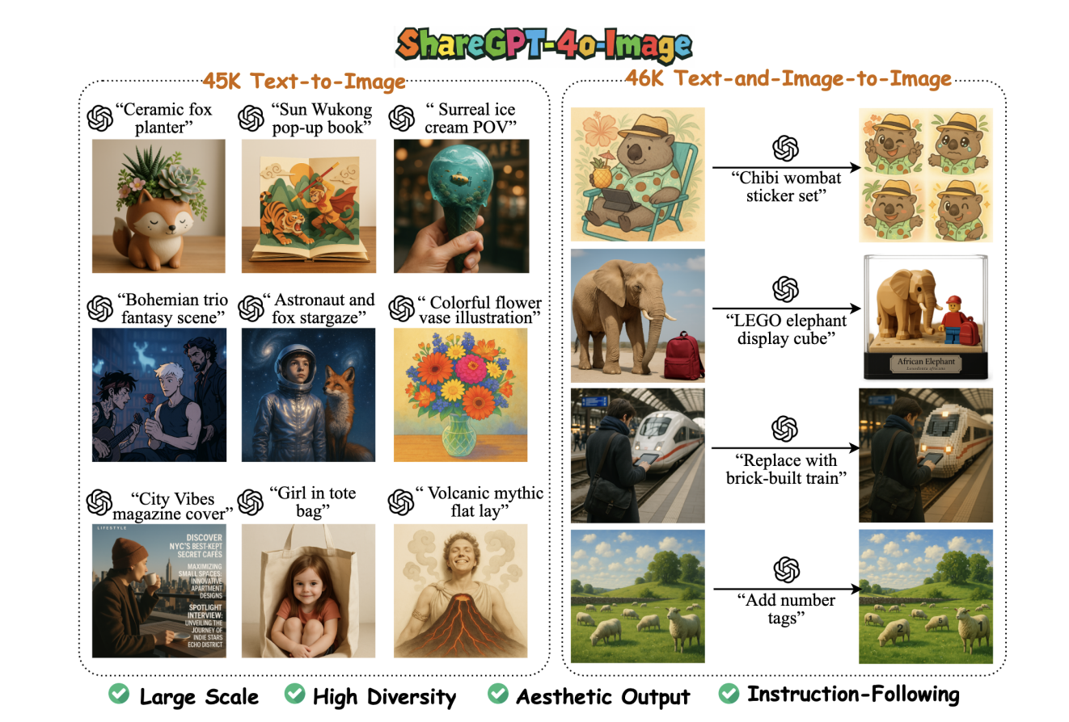
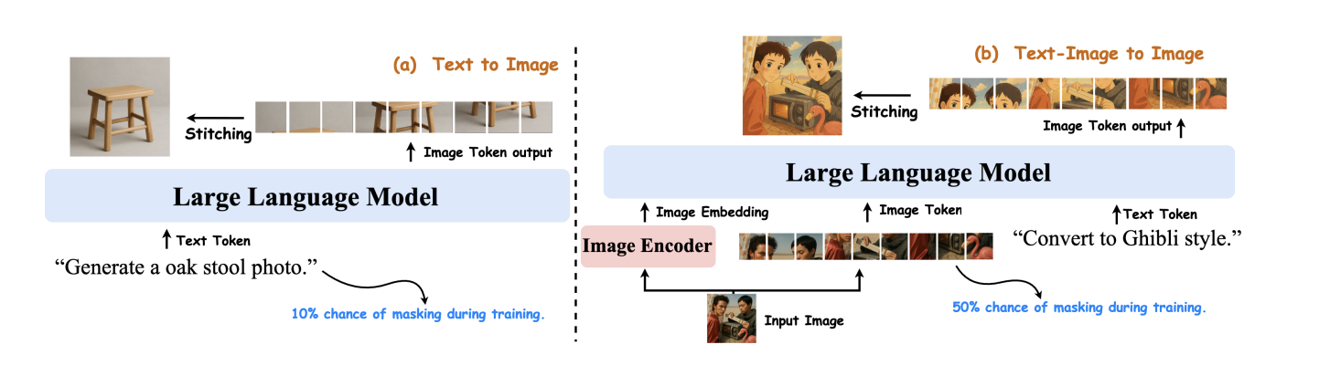
To Images： Janus-4o
Junying Chen, Zhenyang Cai, Pengcheng Chen, Shunian Chen, Ke Ji, Xidong Wang, Yunjin Yang, Benyou Wang. ShareGPT-4o-Image: Aligning Multimodal Models with GPT-4o-Level Image Generation. https://arxiv.org/abs/2506.18095

Slide 19
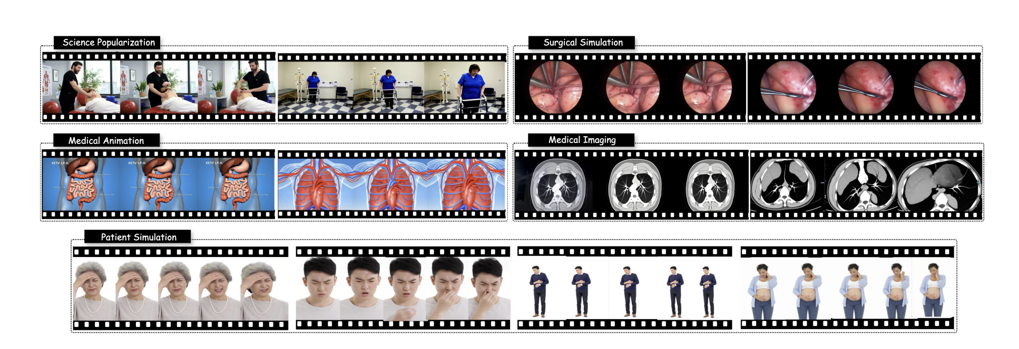
Medical Video Generation： MedGen
Rongsheng Wang, Junying Chen, Ke Ji, Zhenyang Cai, Shunian Chen, Yunjin Yang, Benyou Wang. MedGen: Unlocking Medical Video Generation by Scaling Granularly-annotated Medical Videos. https://arxiv.org/abs/2507.05675

Slide 20
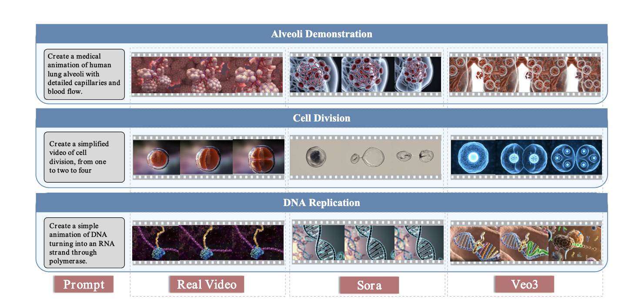
Micro World Simulation (MicroVerse)
Rongsheng Wang, Minghao Wu, Zhou Hongru, Zhihan Yu, Zhenyang Cai, Junying Chen, Benyou Wang. MicroVerse: A Preliminary Exploration Toward a Micro-World Simulation.

Slide 21
Towards Long-context Multimodal LLMs

Slide 22
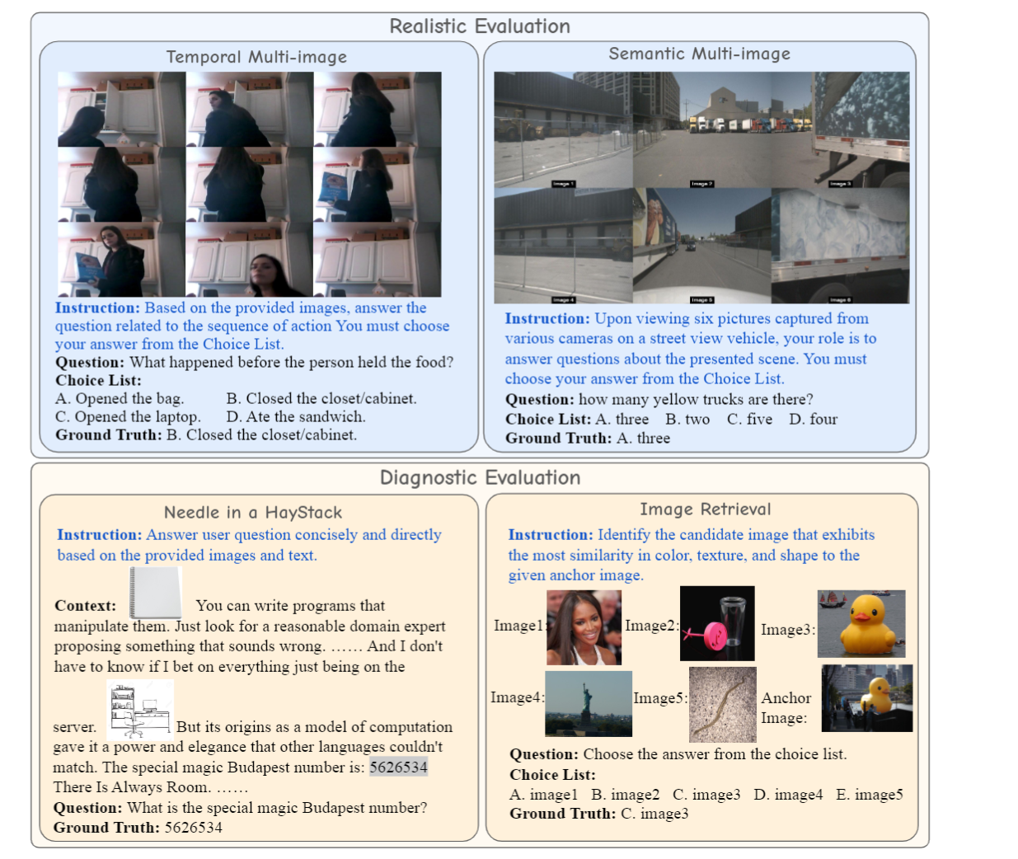
Scaling multi-modal LLMs to 1000 images （Long Context）
Dingjie Song, et.al Benyou Wang. MILEBENCH: Benchmarking MLLMs in Long Context, submitted to COLM 2024. https://arxiv.org/abs/2404.18532
Xidong Wang, et.al. Benyou Wang. LongLLaVA, scaling multi-modal LLMs to 1000 images. In Progress

Slide 23
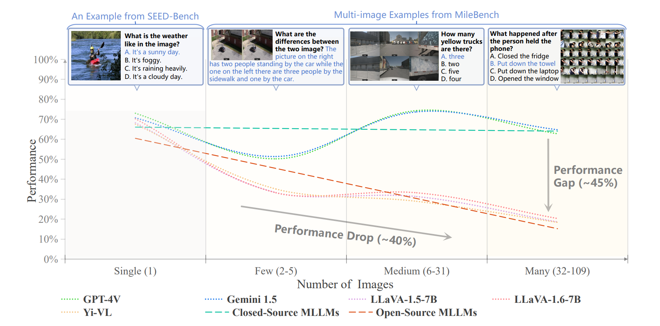
开源模型长上下文效果不佳

Slide 24
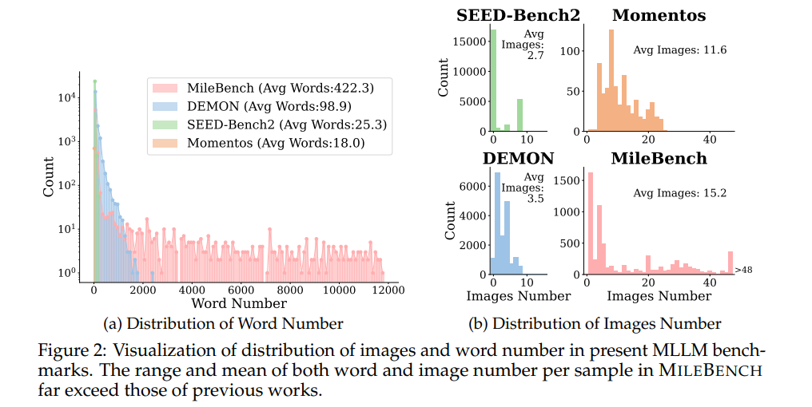
已有benchmark的图片个数较少

Slide 25
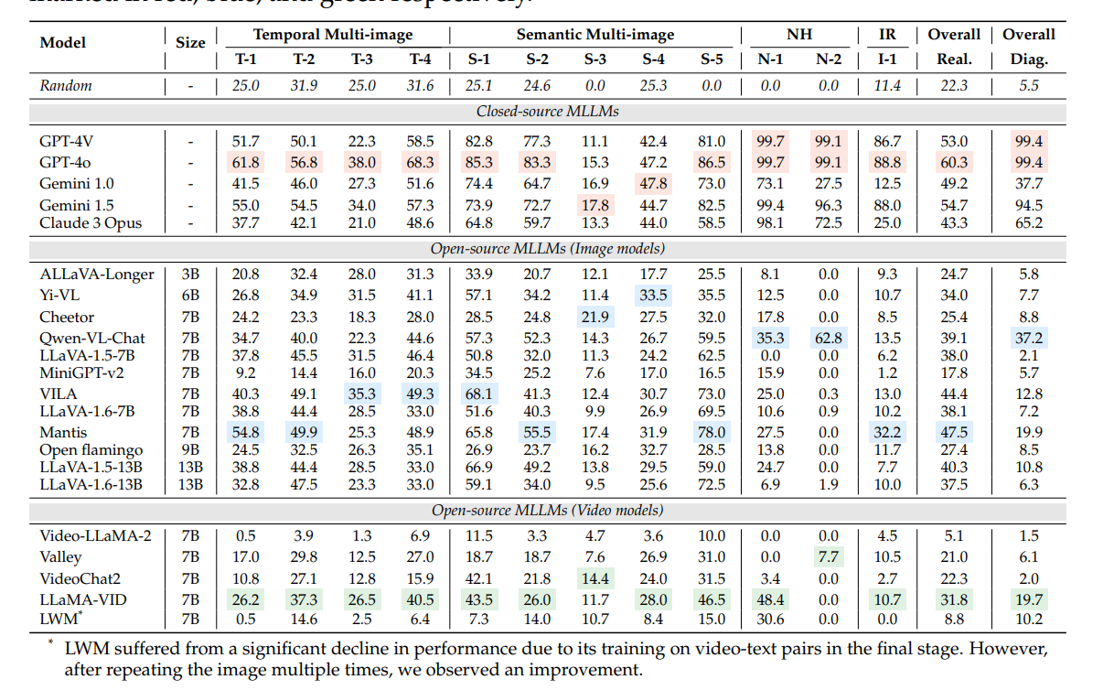
Results

Slide 26
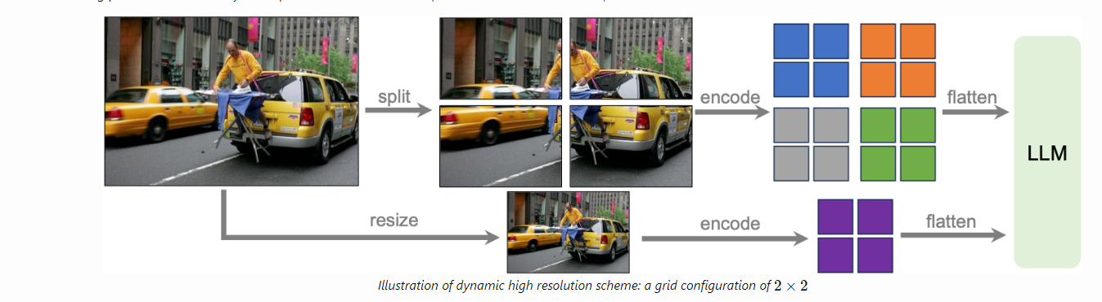
Application 1： 高分辨率的图片理解
套娃patching （模型需要支持更长的上下文）
支持更细粒度的patching： 1*1 2*2 4*4 8*8 16*16
https://llava-vl.github.io/blog/2024-01-30-llava-next/

Slide 27
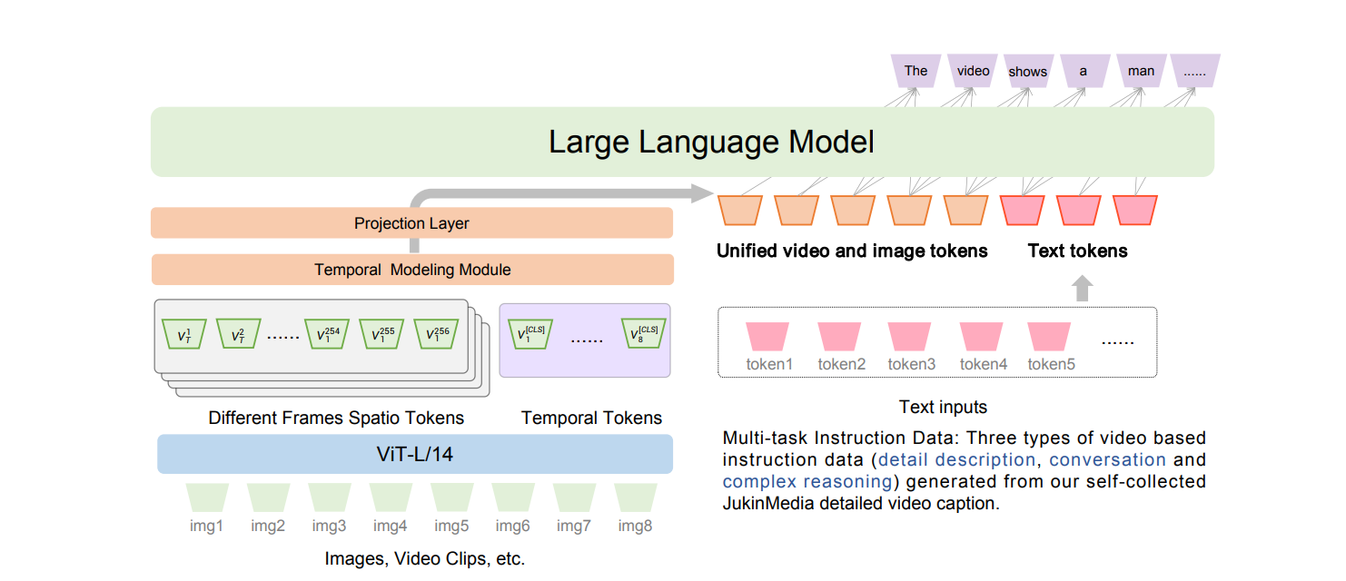
Application 2：视频理解
https://arxiv.org/pdf/2306.07207
https://arxiv.org/abs/2311.10122

Slide 28
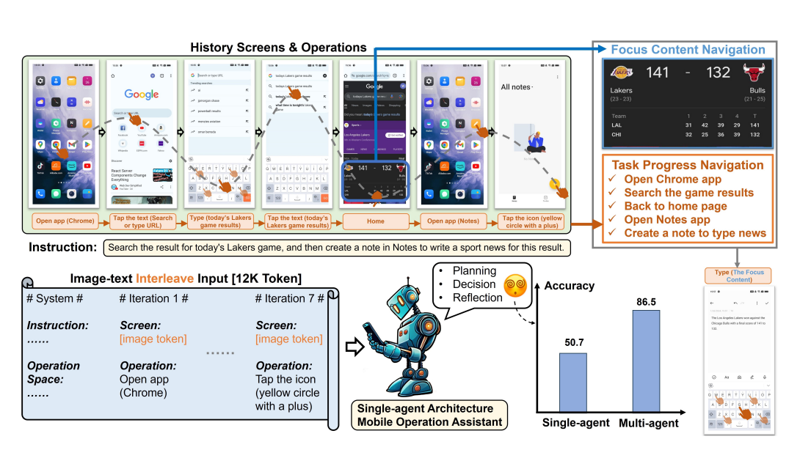
Application 3：长上下文的多模态Agent （Mobile Agent）
Software Testing
Junyang Wang, Haiyang Xu, Haitao Jia, Xi Zhang, Ming Yan, Weizhou Shen, Ji Zhang, Fei Huang, Jitao Sang. Mobile-Agent-v2: Mobile Device Operation Assistant with Effective Navigation via Multi-Agent Collaboration. https://arxiv.org/pdf/2406.01014

Slide 29
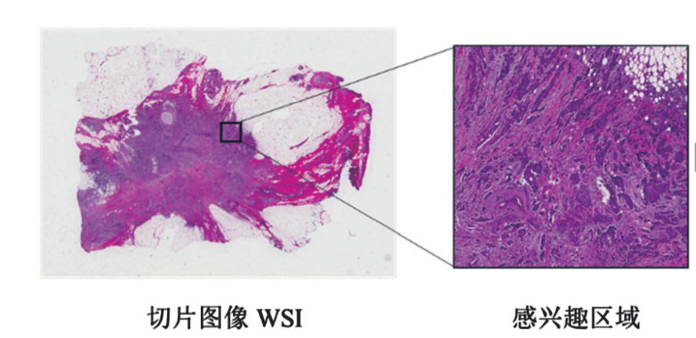
Application 4：病理图像理解
https://www.nsfc.gov.cn/csc/20345/20348/pdf/2022/202202-225-234.pdf

Slide 30
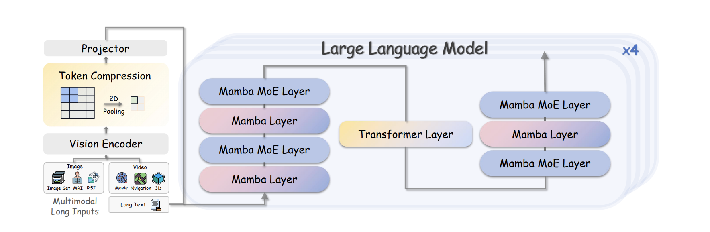
LongLLaVA: Scaling LLMs to 1000 Images
Xidong Wang, Dingjie Song, Shunian Chen, Junyin Chen, Zhenyang Cai, Chen Zhang, Lichao Sun, Benyou Wang. LongLLaVA: Scaling Multi-modal LLMs to 1000 Images Efficiently via a Hybrid Architecture. Findings of EMNLP 2025

Slide 31
Better Reasoning

Slide 32
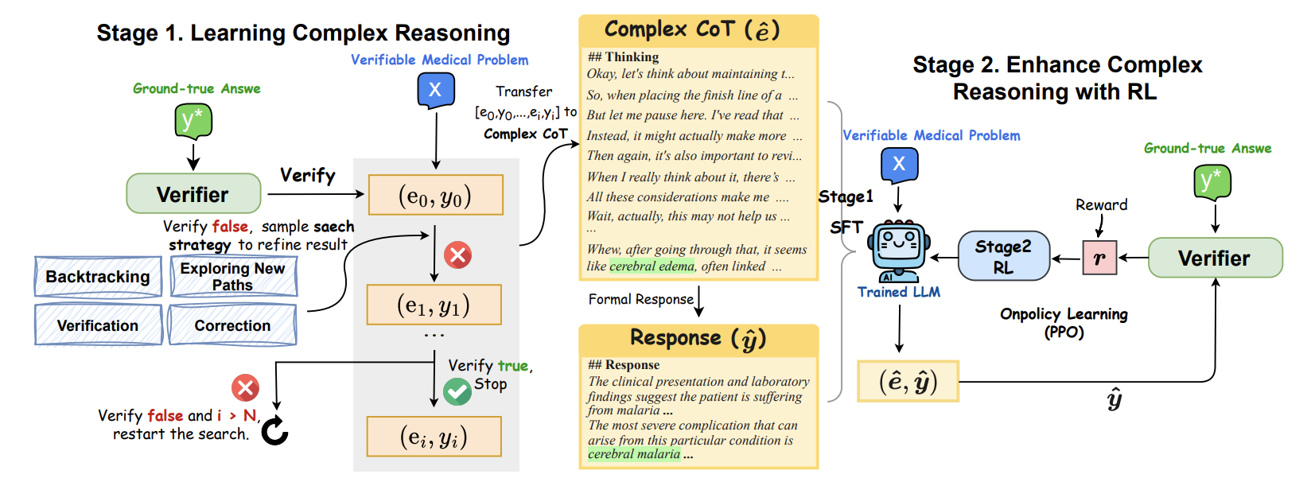
HuatuoGPT-o1
Junying Chen, Zhenyang Cai, Ke Ji, Xidong Wang, Wanlong Liu, Rongsheng Wang, Jianye Hou, Benyou Wang. HuatuoGPT-o1, Towards Medical Complex Reasoning with LLMs. Findings of ACL 2025.

Slide 33
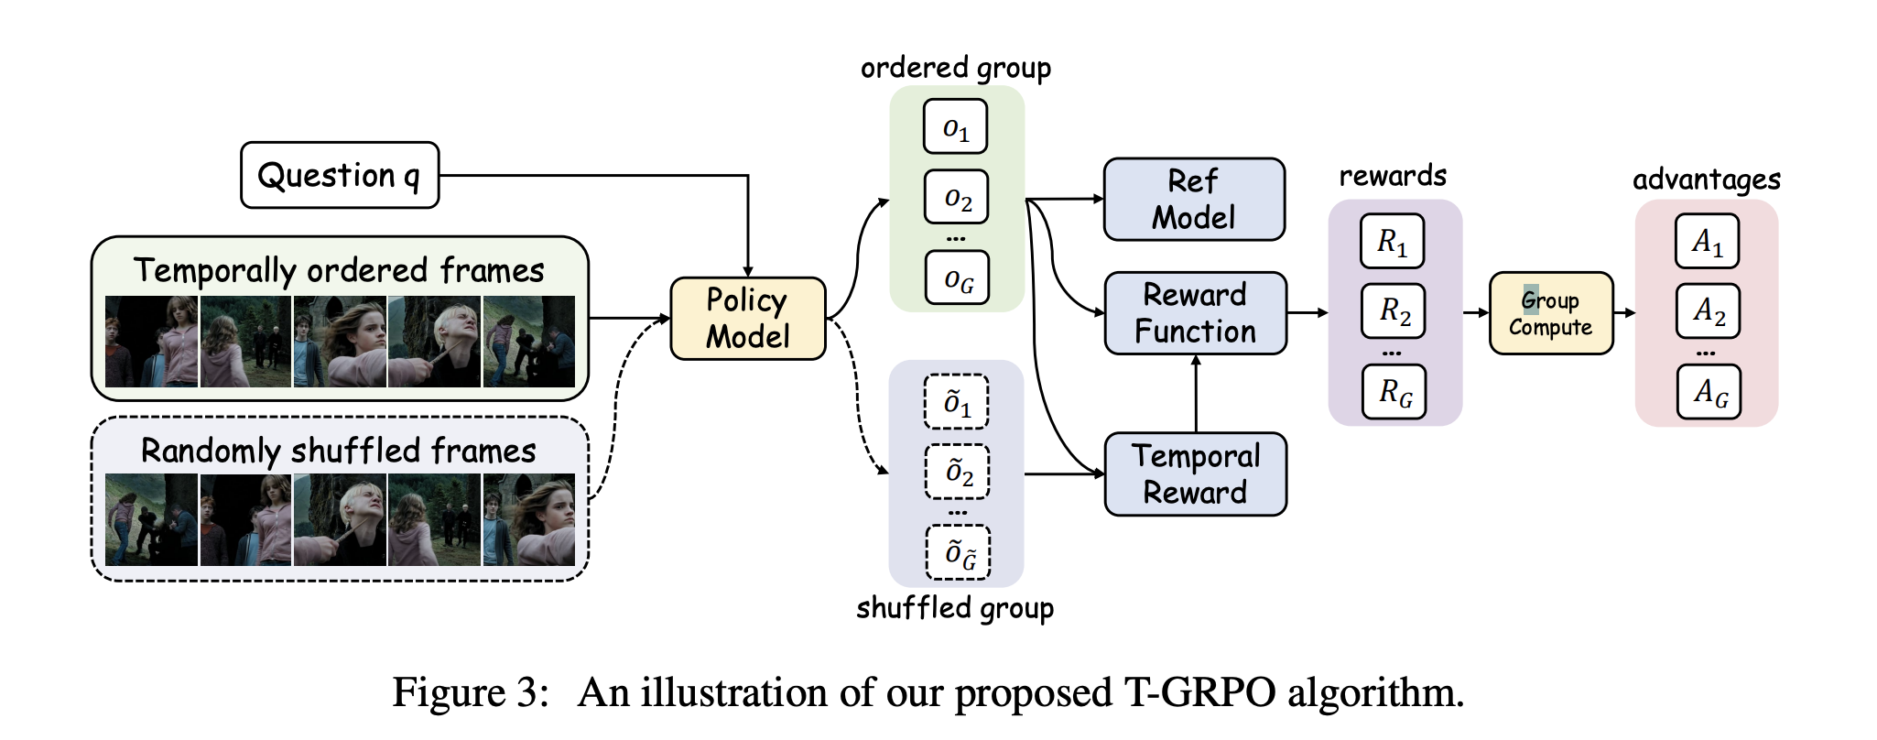
Video-R1
Kaituo Feng, Kaixiong Gong, Bohao Li, Zonghao Guo, Yibing Wang, Tianshuo Peng, Junfei Wu, Xiaoying Zhang, Benyou Wang, Xiangyu Yue. Video-R1: Reinforcing Video Reasoning in MLLMs. NeurIPS 2025.

Slide 34
More Applications

Slide 35
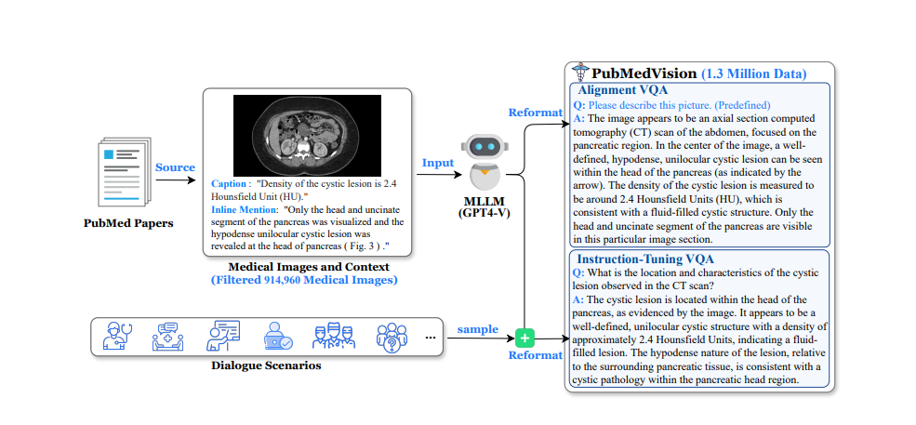
HuatuoGPT-vision: Injecting Multimodal Medical knowledge
Junying Chen, Chi Gui, Ruyi Ouyang, Anningzhe Gao, Shunian Chen, Guiming Hardy Chen, Xidong Wang, Ruifei Zhang, Zhenyang Cai, Ke Ji, Guangjun Yu, Xiang Wan, Benyou Wang.HuatuoGPT-Vision, Towards Injecting Medical Visual Knowledge into Multimodal LLMs at Scale. EMNLP 2024

Slide 36
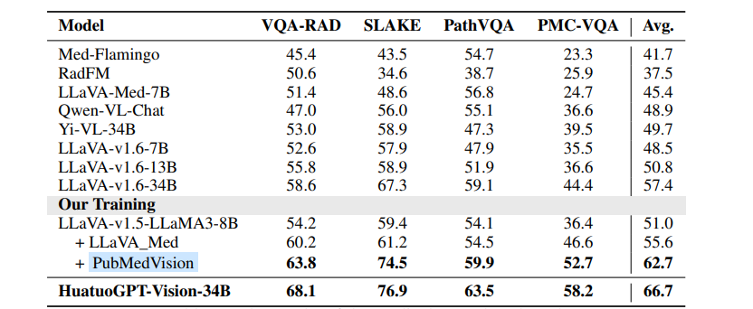
Junying Chen, Chi Gui, Ruyi Ouyang, Anningzhe Gao, Shunian Chen, Guiming Hardy Chen, Xidong Wang, Ruifei Zhang, Zhenyang Cai, Ke Ji, Guangjun Yu, Xiang Wan, Benyou Wang.HuatuoGPT-Vision, Towards Injecting Medical Visual Knowledge into Multimodal LLMs at Scale. EMNLP 2024

Slide 37
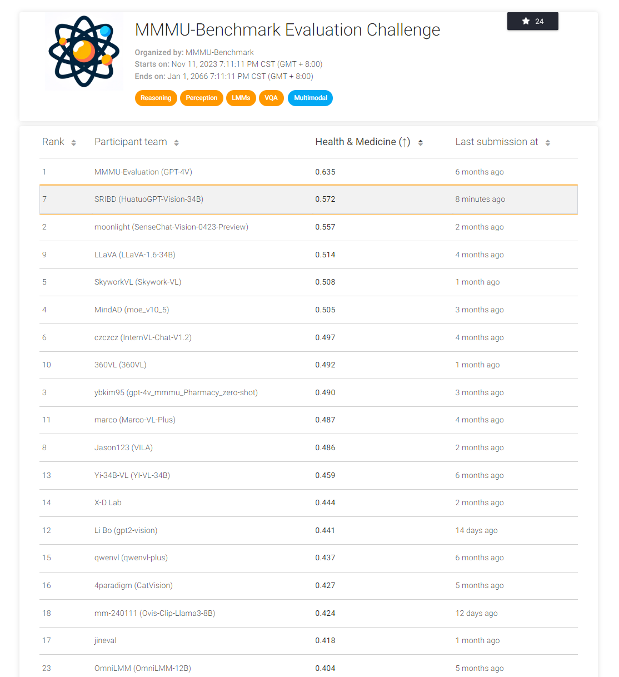
在huggingface 的单月下载量超过20万
https://eval.ai/web/challenges/challenge-page/2179/leaderboard/5377/Health%2520%2526%2520Medicine

Slide 38
The Future
Unified model
Agentic use for Multimodal LLMs (Mobile Agent)
Multimodal Reasoning
  involving visual search
Vision-language-action Models
Multimodal Environment and Agent Evolution
Multimodal LLMs in mobile/edge devices
Multimodal LLMs for low-resourced languages
Broader applications on Science, Engineering and Social Science
  solve specific problems

Slide 39
Thanks
wangbenyou@cuhk.edu.cn

