Slide 1

AReaL: Towards Scalable and Customizable Agentic RL
Jiaxuan Gao
Institute for Interdisciplinary Information Sciences
Tsinghua University

Slide 2
About Me
Name: 高嘉煊
Affiliation: 3rd year PhD student at IIIS, Tsinghua University
Supervisor: 吴翼
Research Focus:
  LLM Post-Training
  Agentic RL

Slide 3
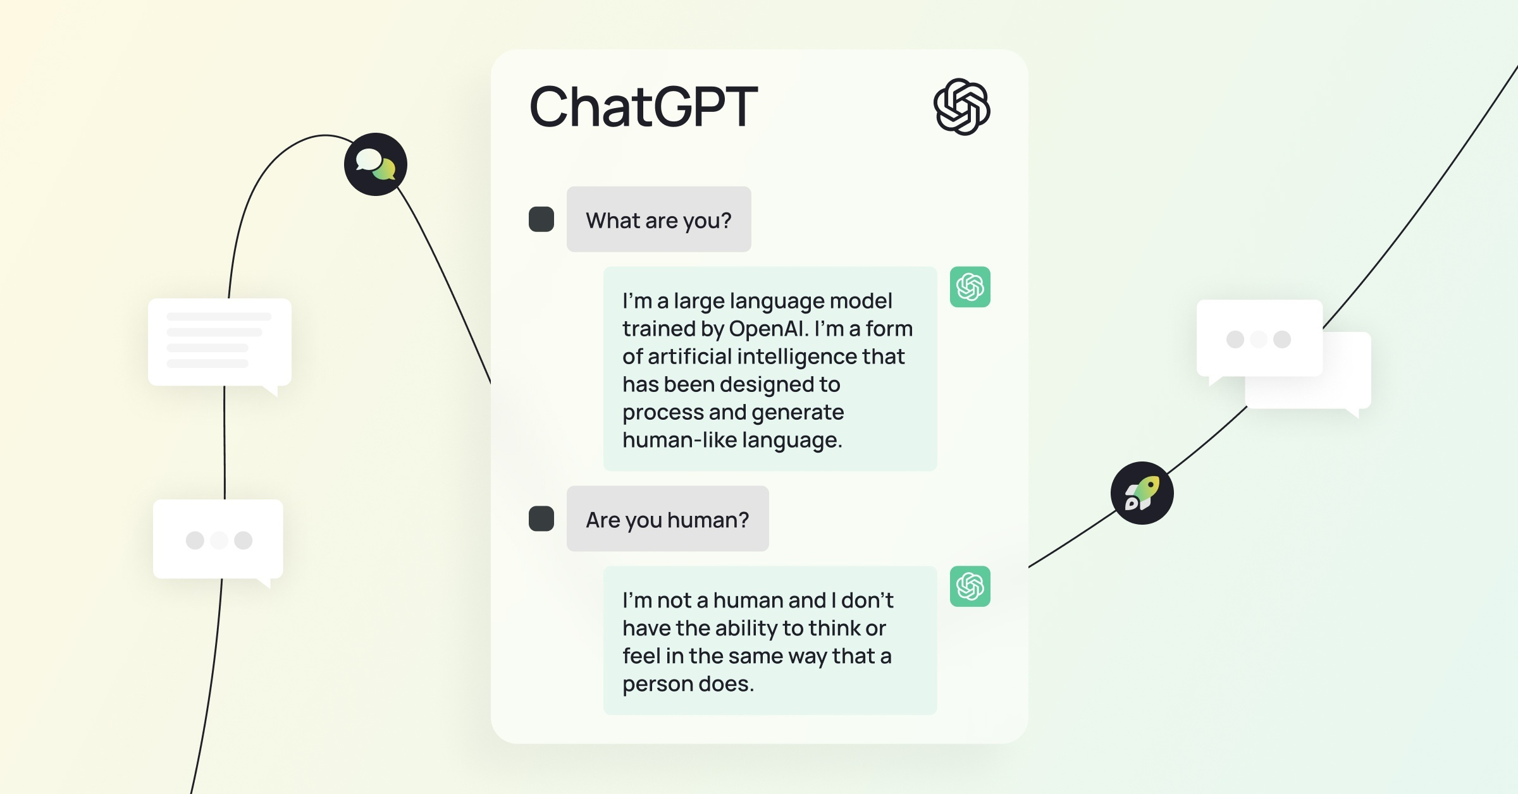
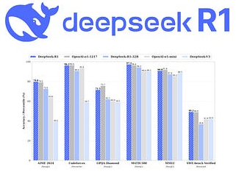
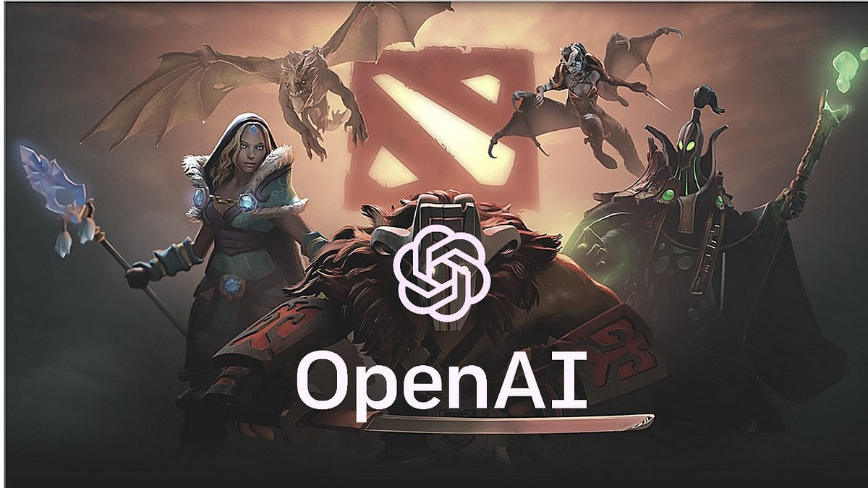
The RL Breakthroughs
OpenAI-o1, DeepSeek-R1
2024-2025
ChatGPT 2023
OpenAI Five 2019
?
PPO + Self-Play
~1B Params
256 GPUs and 128,000 CPU cores
10 months of training
GPT3 + RLHF
175B Params
10K GPUs
Weeks of Training
Long COT + RL Scaling
100B~1T MOE
2-10K GPUs
Months of Training

Slide 4
Content
Background: What’s Agentic RL?
Introduction to AReaL
Practical Agentic RL with AReaL

Slide 5
Content
Background: What’s Agentic RL?
Introduction to AReaL
Practical Agentic RL with AReaL

Slide 6
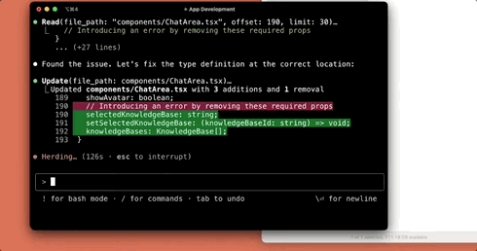
Task Specification: Agentic Workflow

Slide 7
Task Specification: Agentic Workflow
Multi-Tool Interaction
  Read, Update, Bash, …
Multi-Turn Interaction
  Back-and-forth communication with humans
Multi-Agent Interaction
  Use sub-agent to finish isolated tasks
Long-Context Reasoning/Planning
  Think long before making any action

Slide 8
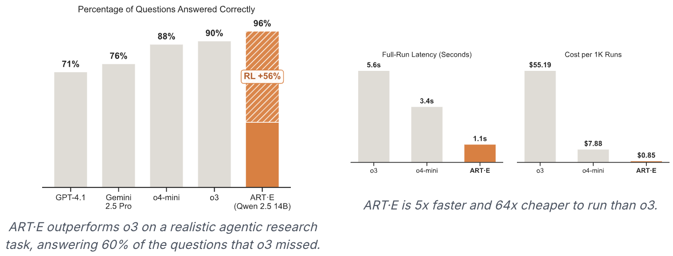
Why RL? An Email Searching Example
https://raw.githubusercontent.com/openpipe/art/main/assets/ART_E_graphs.png

Slide 9
Search Agent调用工具轮数对结果的影响
测试时，更多的轮数能取得更好的结果

Slide 10
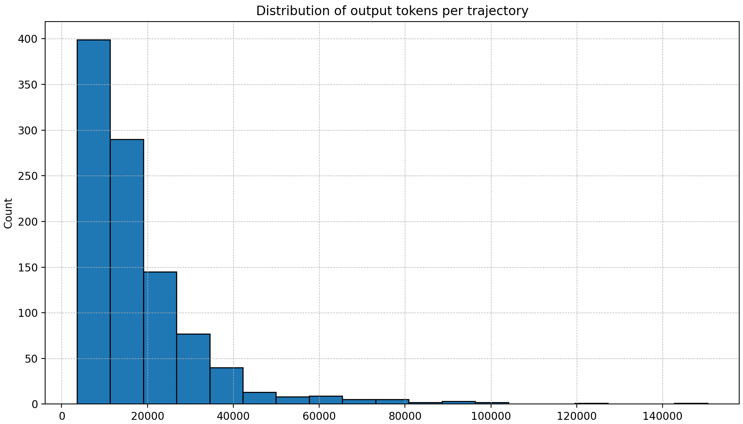

Challenge 1: Inference Device Under-Utilization
RL 训练中放松对轮数的限制：8 -> 128
2 hours
Prompt A
…
10mins
Prompt B
Done!
一个batch中出现了少数Prompt A ，大部分是Prompt B的情况
2 hours
…
GPU:
又可以摸鱼咯

Slide 11
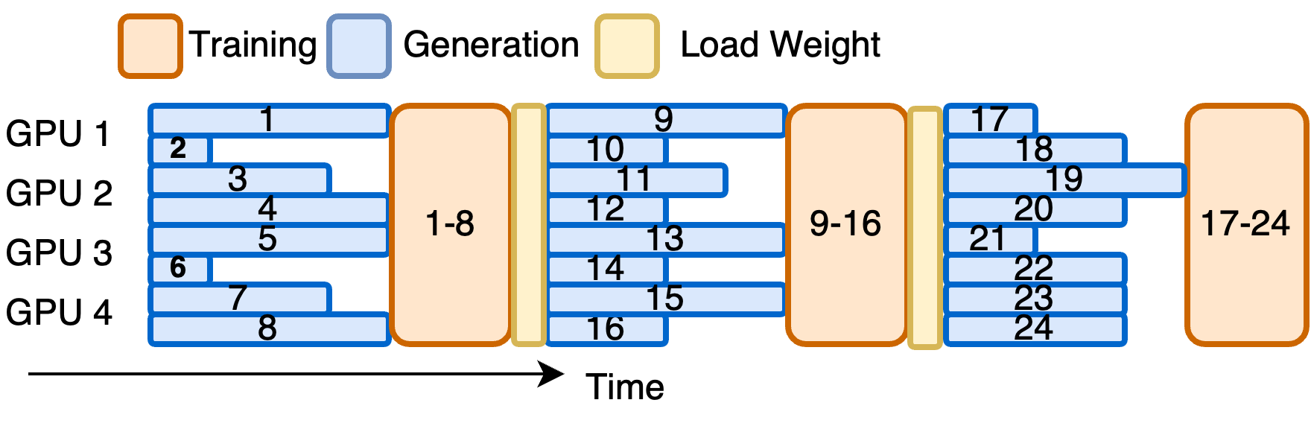




Challenge 1: Inference Device Under-Utilization
整 Batch 同步 Rollout
无法预测什么时候长 rollout 出现
Batch 内异步 Rollout
$θ_{1}$ Rollout
$θ_{2}$ Rollout
Training Step
Parameter Update
$$θ_{1}$$
$$θ_{2}$$
仍然存在空泡！
GPU1
GPU2
GPU3
GPU4
Rollout Batch 1
Train
Rollout Batch 2
Train
One-Step Time

Slide 12


Challenge 2: Hard to scale up
My Google Cloud
🤔
RL Experiment: 100 hours
The same RL Experiment: 50 hours?

Slide 13
Challenge 2: Hard to scale up
The change of decoding throughput with more GPUs
Compute Bound
Decoding
Throughput
Decreased Batch Size
per GPU
Memory Bound
full utilization
under-utilization
Critical GPU Count
(i.e., critical batch size per GPU)
# GPU

Slide 14
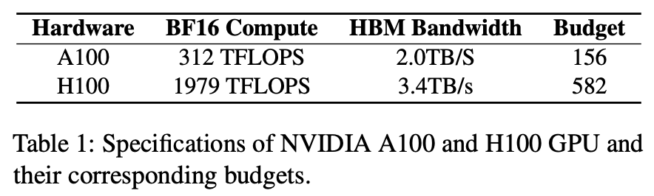
Challenge 2: Hard to scale up
Compute Bound
The critical batch size is determined by the hardware specification
Definition: Budget = Compute (TFLOPS)-to-Bandwidth (TB/S) ratio
Optimal number of tokens in a batch
Decoding
Throughput
Decreased Batch Size
per GPU
Memory Bound
full utilization
under-utilization
Critical GPU Count
(i.e., critical batch size per GPU)
# GPU

Slide 15





Our Solution: Fully Asynchronous Training
训练的同时推理引擎满负载工作
Inference Servers
$${ π}_{t}$$
$${ π}_{t+1}$$
推理中断+参数更新
一条数据的rollout流程
PPO Actor (FSDP Train Engine)
一个step训练完成后，同步参数到推理引擎
$${ π}_{t}$$
$${ π}_{t+1}$$
新的一个batch马上就准备好了，又可以开始训练
$${ π}_{t+1}$$
$${ π}_{t+2}$$
训练完成，新一轮数据无缝衔接
$${ π}_{t+2}$$

Slide 16
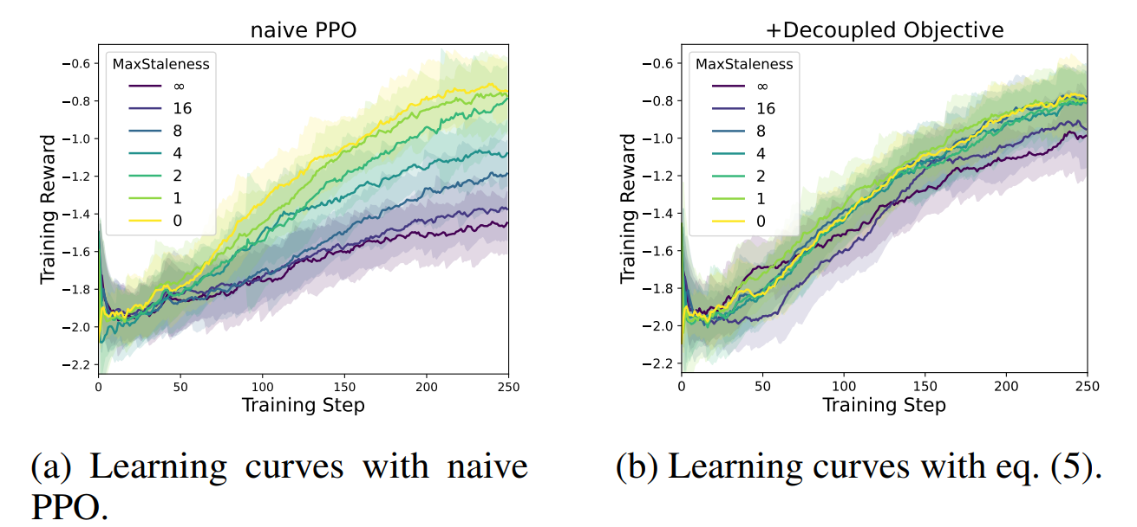
Algorithm-System Co-Design
Explicit staleness/Off-policyness control
Decoupled PPO Objective

Slide 17
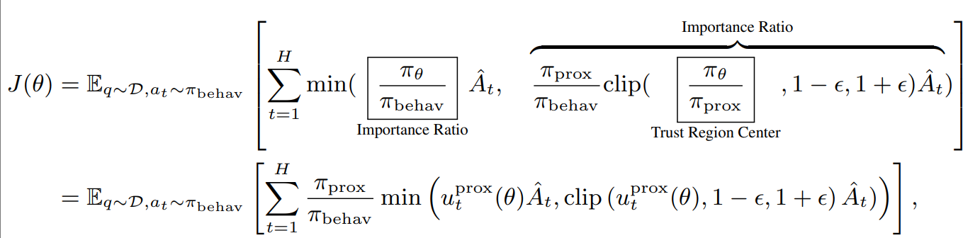
Solutions: Decoupled PPO Objective
Allows for rollout interruption
  Equivalent to sampling from a unified behavior policy
Better learning efficiency with more staled data
  The clipping center is changed to be around a proximal policy

Slide 18
Content
Background: What’s Agentic RL?
Introduction to AReaL
Practical Agentic RL with AReaL

Slide 19
What AReaL code looks like
# Run training.
for global_step in range(max_steps):
epoch = global_step // steps_per_epoch
step = global_step % steps_per_epoch
# Rollout: generate agentic trajectories
batch = rollout.prepare_batch(dataloader, workflow=workflow)
batch = batch.to(actor.device)
# Prepare training data
logp = actor.compute_logp(batch)
actor.compute_advantages(batch)
# Training
stats = actor.ppo_update(batch)
actor.step_lr_scheduler()
# Update weights to inference engine
actor.update_weights(weight_update_meta)
if __name__ == "__main__":
main_grpo(sys.argv[1:])
def main_grpo():
# Load config
config, _ = load_expr_config(sys.argv[1:], GRPOConfig)
config: GRPOConfig
# Create dataset and dataloaders
train_dataloader = StatefulDataLoader(
...
)
# Initialize train engine
actor = FSDPPPOActor(config=config.actor)
actor.create_process_group()
# Initialize inference engine
rollout = RemoteSGLangEngine(config.rollout)
# Initialize weight update method
weight_update_meta = WeightUpdateMeta.from_fsdp_xccl(...)
actor.connect_engine(rollout, weight_update_meta)
# Create Agent Workflow
workflow = RLVRWorkflow(
reward_fn=gsm8k_reward_fn,
gconfig=config.gconfig,
tokenizer=tokenizer,
enable_thinking=False,
)
class RLVRWorkflow:
async def arun_episode(self, engine: InferenceEngine, data):
client = ArealOpenAI(engine, self.tokenizer)
completions = await client.chat.completions.create(
messages=data["messages"], ...)
reward = await self.async_reward_fn(completions)
client.set_reward(completions.id, reward)
return client.export_completions()

Slide 20
Abstraction Level 1: Orchestration
Loading datasets
  Dataset processing
Initializing models
  Whether to use a reward/reference/critic model
Training loop
  Data loading logic
  Hybrid multiple training algorithms (e.g., one-step SFT + one-step RL)
  Whether to update weights and how
Agent
  Agentic workflow

Slide 21
Abstraction Level 2: Algorithm Implementation
Decouple backends with algorithm implementation
class PPOActor:
def __init__(self, config: PPOActorConfig, engine: TrainEngine):
self.config = config
self.engine = engine
@torch.no_grad()
def compute_logp(
self,
data: TensorDict,
temperature: Optional[float] = None,
) -> torch.Tensor | None:
self.engine.eval()
return self.engine.forward(input_=data, ...)
def ppo_update(self, data: TensorDict):
mb_inputs = split_padded_tensor_dict_into_mb_list(data)
for mb in mb_inputs.mbs:
train_stat = self.engine.train_batch(
mb,
loss_fn=...,
...
)
all_stats.append(train_stat)
return all_stats
class FSDPPPOActor(FSDPEngine):
def __init__(self, config: PPOActorConfig):
super().__init__(config)
self.actor = PPOActor(config, self)
@torch.no_grad()
def compute_logp(self, *args, **kwargs) -> torch.Tensor | None:
return self.actor.compute_logp(*args, **kwargs)
def ppo_update(self, *args, **kwargs) -> List[Dict[str, float]]:
return self.actor.ppo_update(*args, **kwargs)
class MegatronPPOActor(MegatronEngine):
def __init__(self, config: PPOActorConfig):
super().__init__(config)
self.actor = PPOActor(config, self)
...

Slide 22
Abstraction Level 3: Backends
Providing unified interfaces for:
  Training: FSDP, Megatron
class TrainEngine(abc.ABC):
def train_batch(
self,
input_: Dict,
loss_fn: Callable[[torch.Tensor, Dict], torch.Tensor],
loss_weight_fn: Callable[[Dict], float],
) -> Dict[str, float]:
raise NotImplementedError()
@torch.no_grad()
def forward(
self,
input_: Dict,
output_seqlens: List[int] | None = None,
post_hook: Callable | None = None,
aggregate_fn: Callable[[List[Any]], Any] = torch.cat,
) -> Any | None:
raise NotImplementedError()
def initialize(self, *args, **kwargs):
"""Initialize distributed training and load models."""
raise NotImplementedError()
def save(self, meta: SaveLoadMeta):
"""Save model weights and optimizer states for later use.
"""
raise NotImplementedError()
def load(self, meta: SaveLoadMeta):
"""Load model weights and optimizer states from a file.
"""
raise NotImplementedError()
def update_weights(self, meta: WeightUpdateMeta):
"""Update weights to the inference."""
raise NotImplementedError()

Slide 23
Abstraction Level 3: Backends
def submit(
self,
data: Dict[str, Any],
workflow: Optional["RolloutWorkflow"] = None,
workflow_builder: Optional[Callable] = None,
should_accept: Callable | None = None,
) -> None:
"""Submit a request and return immediately.
Should be used together with subsequent `wait`.
"""
raise NotImplementedError()
def wait(self, count: int, timeout: float | None = None)
"""Wait for a specified number of requests to complete.
Should be used together with preceding `submit`.
"""
raise NotImplementedError()
def prepare_batch(
self,
dataloader: StatefulDataLoader,
workflow: Optional["RolloutWorkflow"] = None,
workflow_builder: Optional[Callable] = None,
should_accept: Callable | None = None,
) -> Dict[str, Any]:
"""Asynchronously submit and wait a full batch.
raise NotImplementedError()
Providing unified interfaces for:
  Inference: SGLang/vLLM
class InferenceEngine(abc.ABC):
async def agenerate(self, req: ModelRequest) -> ModelResponse:
"""Asynchronously generate a response."""
raise NotImplementedError()
def init_weights_update_group(self, meta: WeightUpdateMeta):
"""Initialize the weight update process group.
"""
raise NotImplementedError()
def update_weights_from_distributed(
self, meta: WeightUpdateMeta, param_specs: List[ParamSpec]
) -> Future[None]:
"""Update weights with NCCL.
"""
raise NotImplementedError()
def update_weights_from_disk(self, meta: WeightUpdateMeta
"""Update weights with shared disk storage.
"""
raise NotImplementedError()

Slide 24
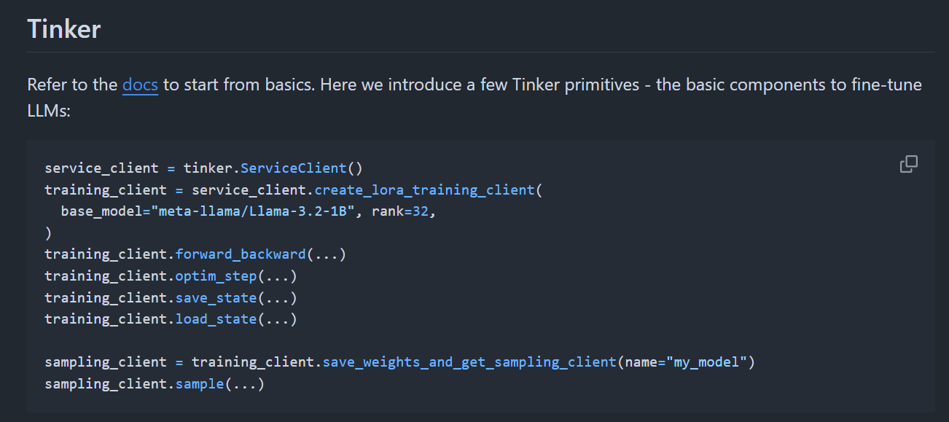
APIs of Tinker

Slide 25
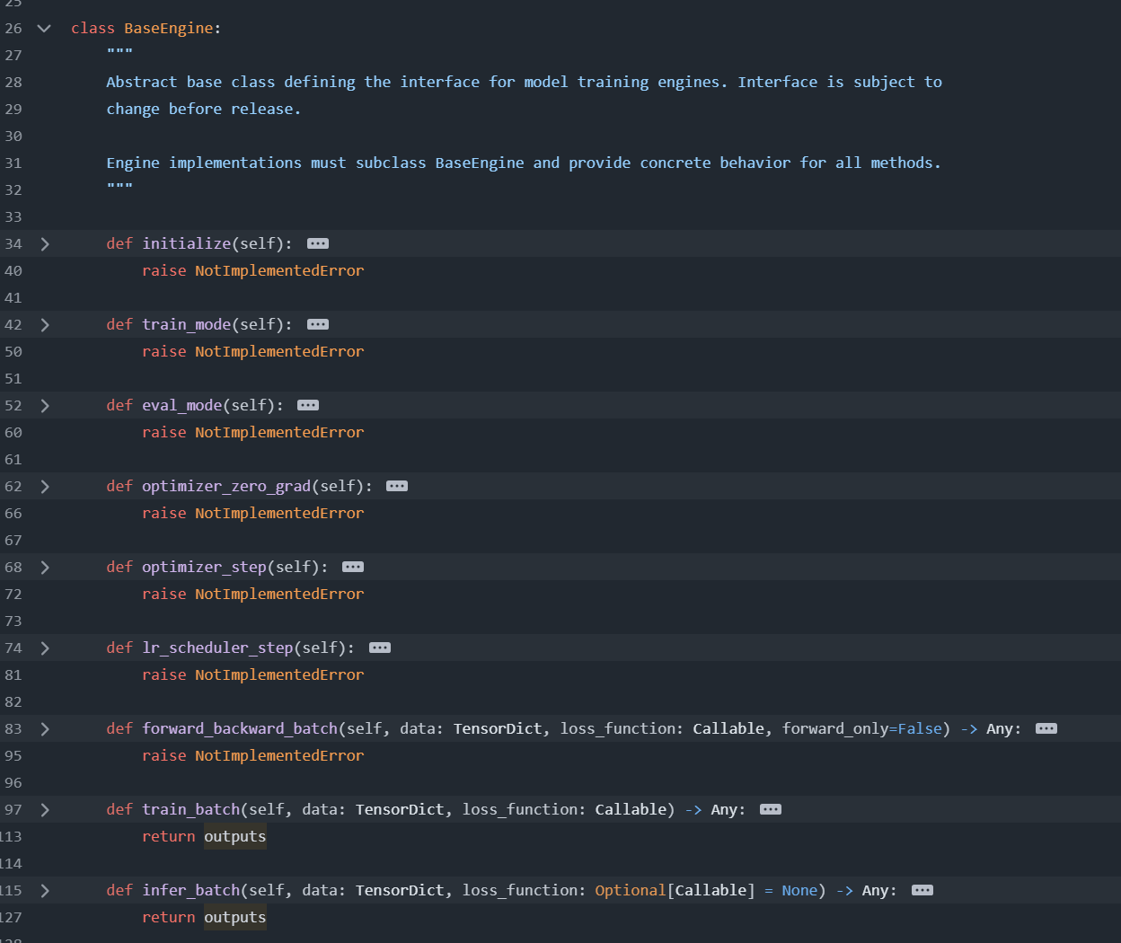
Model Engine APIs of verl v0.6.0 (2025.10.15)

Slide 26
Agent Abstraction: the RolloutWorkflow class
class InferenceEngine(abc.ABC):
async def agenerate(self, req: ModelRequest) -> ModelResponse:
"""Asynchronously generate a response."""
raise NotImplementedError()
def submit(
self,
data: Dict[str, Any],
workflow: RolloutWorkflow) -> None:
"""Asynchronously submit a request."""
raise NotImplementedError()
def wait(
self,
count: int,
timeout: float | None = None,
should_accept: Callable | None = None,
) -> TensorDict:
"""Wait for a specified number of requests to complete."""
raise NotImplementedError()
class RolloutWorkflow:
async def arun_episode(
self, engine: "InferenceEngine", data: Dict[str, Any]
) -> Union[TensorDict, None]:
raise NotImplementedError()
RolloutWorkflow
  Inputs a (single, not batched) prompt
  Outputs the trajectory used for training
Seamless workflow execution
  The `submit` API
  Natively asynchronous
Allows arbitrary agent implementation
  Use `engine.agenerate` for completion
  Arbitrary tool use inside the workflow

Slide 27
What AReaL code looks like
# Run training.
for global_step in range(max_steps):
epoch = global_step // steps_per_epoch
step = global_step % steps_per_epoch
# Rollout: generate agentic trajectories
batch = rollout.prepare_batch(dataloader, workflow=workflow)
batch = batch.to(actor.device)
# Prepare training data
logp = actor.compute_logp(batch)
actor.compute_advantages(batch)
# Training
stats = actor.ppo_update(batch)
actor.step_lr_scheduler()
# Update weights to inference engine
actor.update_weights(weight_update_meta)
if __name__ == "__main__":
main_grpo(sys.argv[1:])
def main_grpo():
# Load config
config, _ = load_expr_config(sys.argv[1:], GRPOConfig)
config: GRPOConfig
# Create dataset and dataloaders
train_dataloader = StatefulDataLoader(
...
)
# Initialize train engine
actor = FSDPPPOActor(config=config.actor)
actor.create_process_group()
# Initialize inference engine
rollout = RemoteSGLangEngine(config.rollout)
# Initialize weight update method
weight_update_meta = WeightUpdateMeta.from_fsdp_xccl(...)
actor.connect_engine(rollout, weight_update_meta)
# Create Agent Workflow
workflow = RLVRWorkflow(
reward_fn=gsm8k_reward_fn,
gconfig=config.gconfig,
tokenizer=tokenizer,
enable_thinking=False,
)
class RLVRWorkflow:
async def arun_episode(self, engine: InferenceEngine, data):
client = ArealOpenAI(engine, self.tokenizer)
completions = await client.chat.completions.create(
messages=data["messages"], ...)
reward = await self.async_reward_fn(completions)
client.set_reward(completions.id, reward)
return client.export_completions()

Slide 28
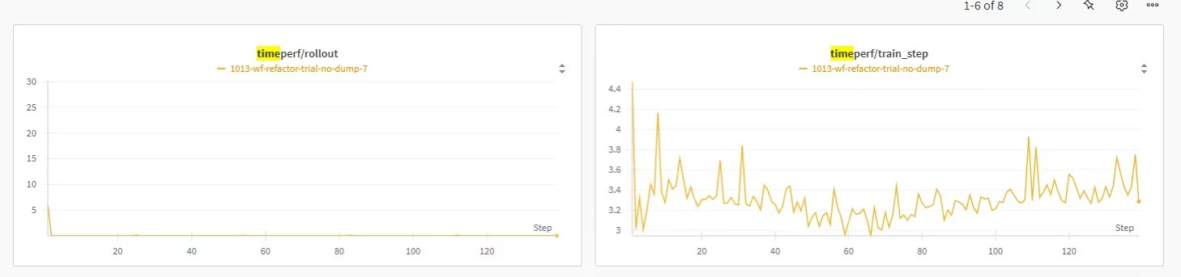
What’s unique for AReaL?
Letting you write asynchronous RL with synchronous patterns
  The previous example runs async RL with partial rollouts
  To use sync RL, set a parameter `max_head_offpolicyness` to 0

Slide 29
What’s unique for AReaL?
Pluggable
  Core modules can be used independently
  Can be used anywhere in your own project (e.g., Tau2-bench)
from areal.engine.sglang_remote import RemoteSGLangEngine
import os
dataloader = ...
engine = RemoteSGLangEngine(...)
# SGLang server addresses in your own company
os.environ['AREAL_LLM_SERVER_ADDRS'] = 'xxx,xxx'
engine.initialize(None, None)
# Use a customized workflow to generate
# agentic trajectories asynchronously
results = engine.prepare_batch(dataloader, workflow)

Slide 30
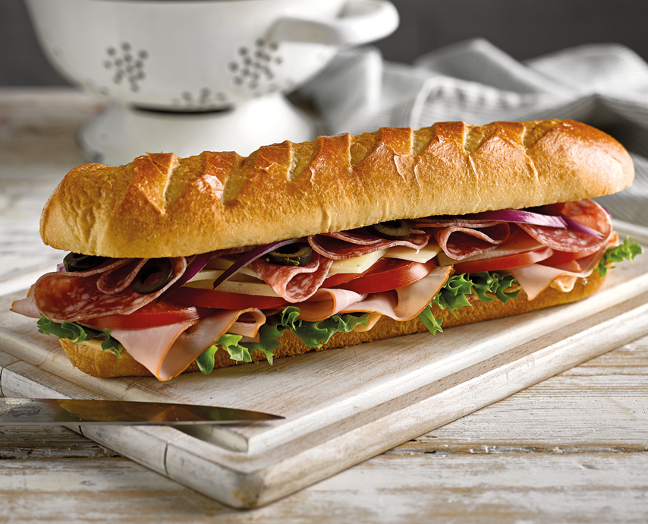
What’s unique for AReaL?
Transparency: a bad example
Code provided by the framework
  Distributed launcher
  Batched rollout execution
  Dataflow
  Backend integration
User Code
  Algorithm orchestration
  Concrete agentic workflow

Slide 31

What’s unique for AReaL?
Transparency: AReaL
LightWeight
On the top of a single file, users can implement
  Any agent
  Any orchestration code
While applications share the same AReaL train/inference engines for efficient asynchronous execution

Slide 32
Content
Background: What’s Agentic RL?
Introduction to AReaL
Practical Agentic RL with AReaL

Slide 33
Agent Abstraction: the RolloutWorkflow class
class InferenceEngine(abc.ABC):
async def agenerate(self, req: ModelRequest) -> ModelResponse:
"""Asynchronously generate a response."""
raise NotImplementedError()
def submit(
self,
data: Dict[str, Any],
workflow: RolloutWorkflow) -> None:
"""Asynchronously submit a request."""
raise NotImplementedError()
def wait(
self,
count: int,
timeout: float | None = None,
should_accept: Callable | None = None,
) -> TensorDict:
"""Wait for a specified number of requests to complete."""
raise NotImplementedError()
class RolloutWorkflow:
async def arun_episode(
self, engine: "InferenceEngine", data: Dict[str, Any]
) -> Union[TensorDict, None]:
raise NotImplementedError()
RolloutWorkflow
  Inputs a (single, not batched) prompt
  Outputs the trajectory used for training
Seamless workflow execution
  The `submit` API
  Natively asynchronous
Allows arbitrary agent implementation
  Use `engine.agenerate` for completion
  Arbitrary tool use inside the workflow

Slide 34
AReaL’s Workflow Supports
Multi-Tool Interaction
  By external tools: rllm, terminal, MCP servers, …
Multi-Turn Interaction
  By simple for-loops
Multi-Agent Interaction
  By sub-agent orchestration & multiple inference servers
Long-Context Reasoning/Planning
  Natively

Slide 35
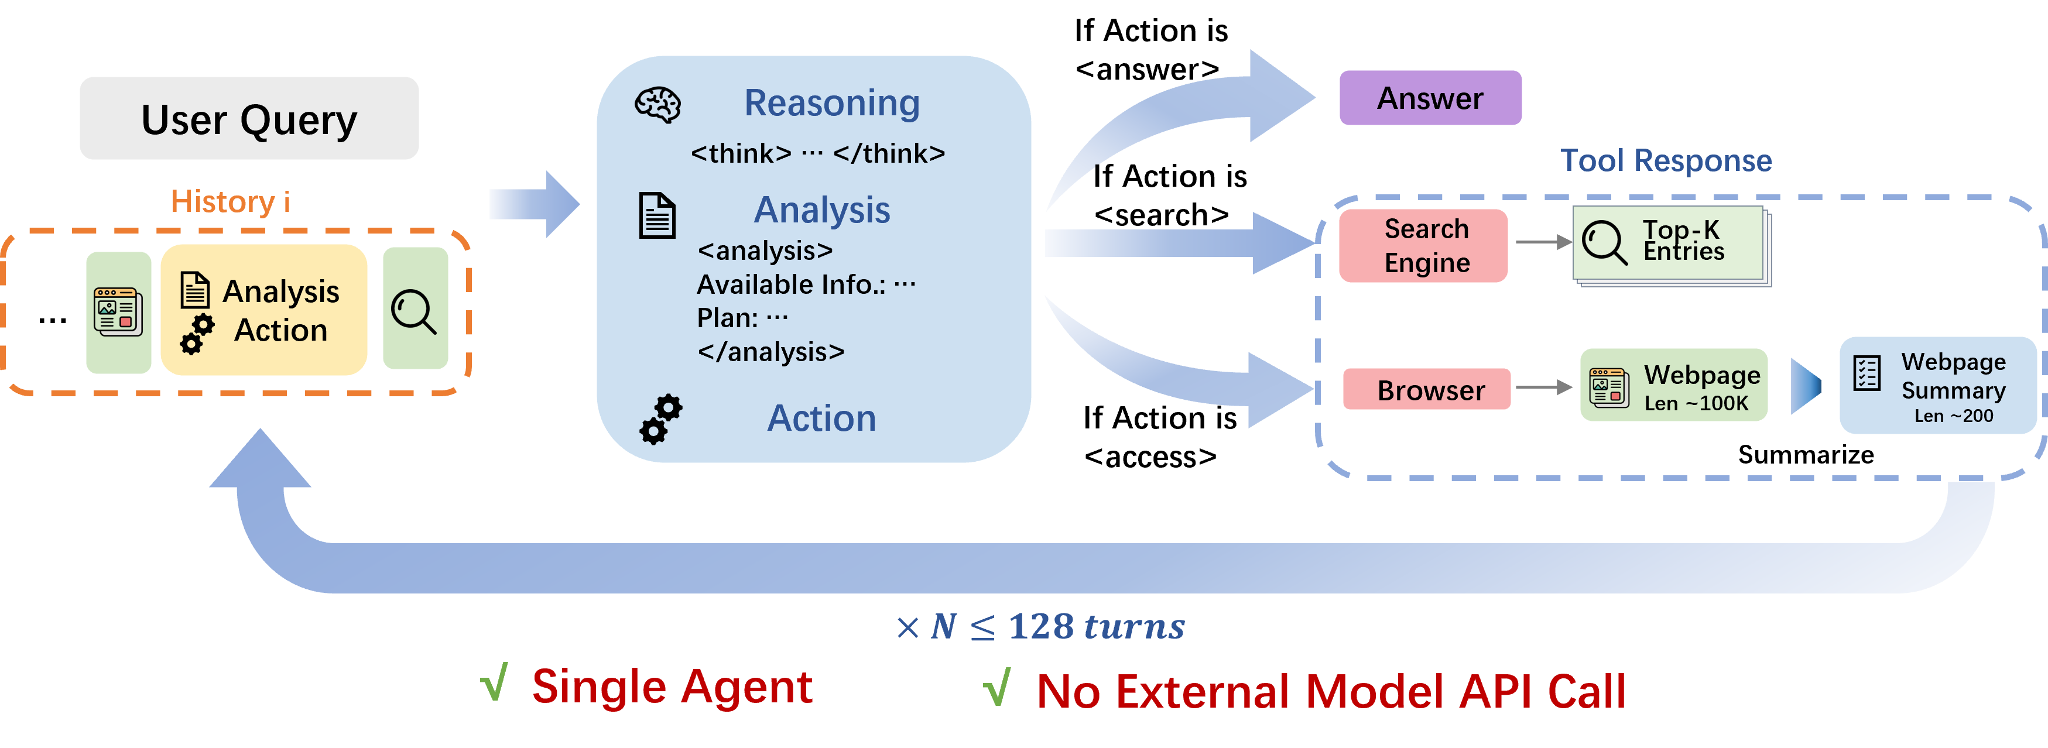
Project based on AReaL: ASearcher

Slide 36
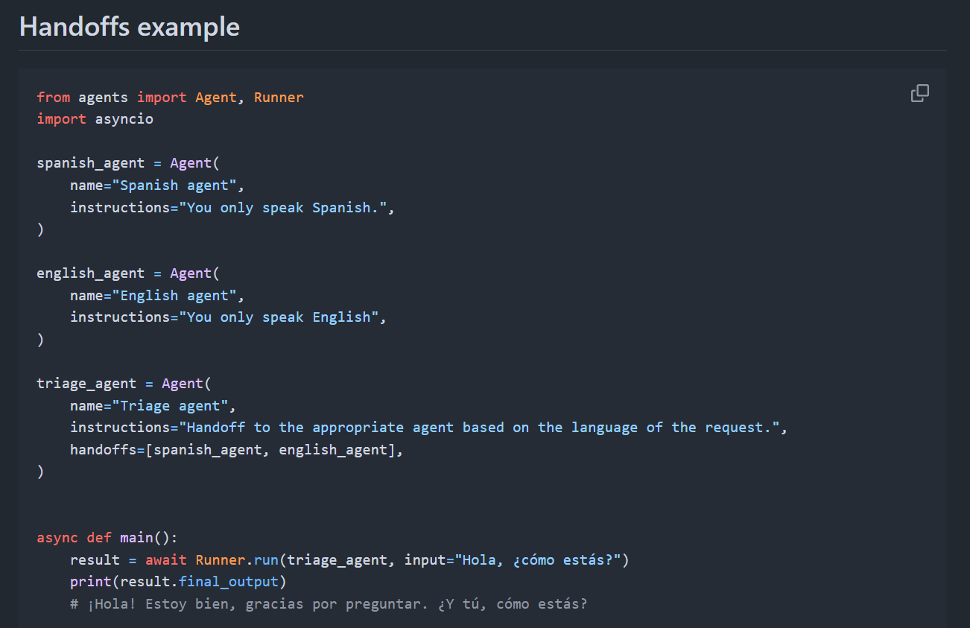
OpenAI Agents SDK as a Protocol

Slide 37
AReaL v0.4.0 Examples: ASearcher
class ASearcherWorkflow(RolloutWorkflow):
def __init__(self, ...):
...
self.agent = ASearcherAgent(...)
async def arun_episode(self, engine, data):
# Initialize and Prepare the prompt
prompt = SEARCH_ACCESS_PROMPT_TEMPLATE.format(question=data["question"])
clients = [ArealOpenAI(engine=engine, tokenizer=self.tokenizer) for _ in range(self.n_trajs)]
# Collect trajectories
await asyncio.gather(
*[
self.agent.run_agent(
data=data,
prompt=prompt,
client=clients[i],
)
for i in range(self.n_trajs)
]
)
# Export completions with rewards
for client in clients:
client.apply_reward_discount(turn_discount=0.9)
return client.export_completions(style="individual")

Slide 38
AReaL v0.4.0 Examples: ASearcher
class ASearcherAgent:
async def run_agent(self, data, valid_inst, qid, prompt, client: ArealOpenAI):
base_run_config = RunConfig(
model_provider=OpenAIProvider(openai_client=client, use_responses=False),
tracing_disabled=True,
)
# Create search agent with appropriate tools
openai_agent = OpenAIAgent(name="ASearcher")
agent = SearchAgent(prompt)
async with AReaLOpenAIClientContext(base_run_config):
while agent.num_turns < self.max_turns and not agent.is_finished:
# The agent prepares the prompt and sampling params for LLM generation
prompt = agent.prepare_llm_query()
extra_args = {"max_completion_tokens": self.max_tokens_per_turn}
run_config = RunConfig(
model_settings=ModelSettings(extra_args=extra_args)
)
resp = await OpenAIRunner.run(
openai_agent, input=prompt, run_config=run_config
)
# agent extracts tool callings from the llm response
tool_calls = agent.consume_llm_response(resp, resp.final_output)

Slide 39
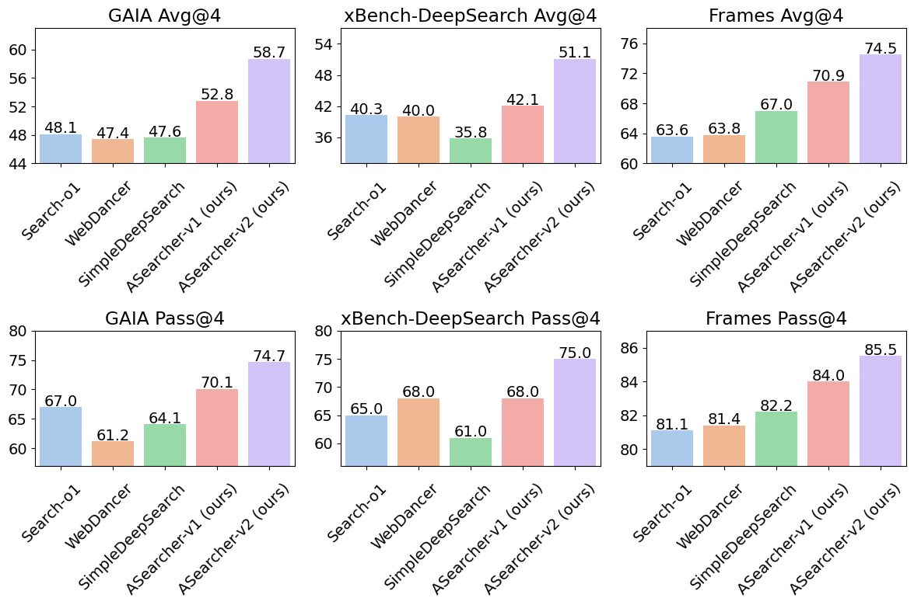
ASearcher
~16k GPU hours (H800) based on QwQ 32B

Slide 40
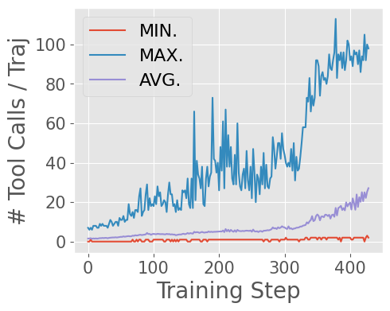
Unlocking Long-Horizon Agentic Search
Stage 1
Stage 2
Maximum: 100+ tool calls / traj
After RL: 20+ tool calls / traj
Init: <5 tool calls / traj
# of tool calls scales as training processes

Slide 41
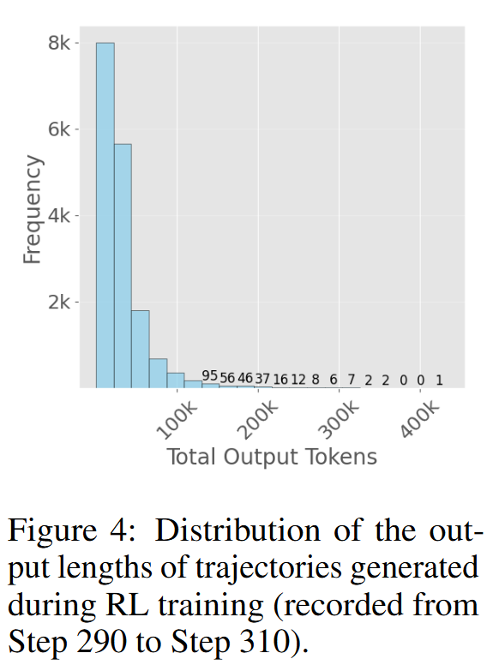
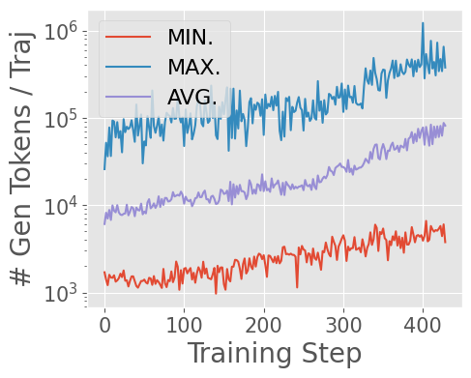
Trajectory Length
High Variance
Long Tail

Slide 42
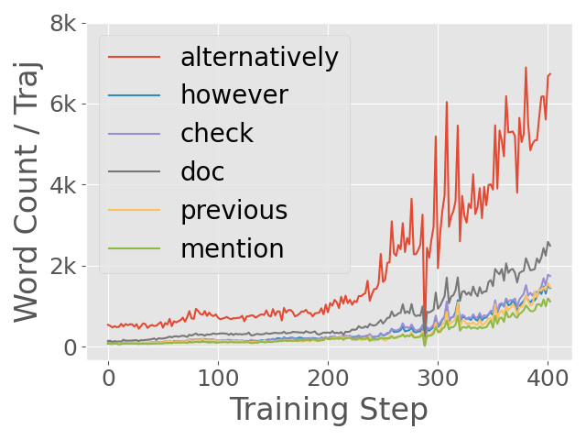
Emergent Behaviors
Stage 1
Stage 2
alternatively, however --> Reflection
mention, previous, doc --> Referencing external information

Slide 43
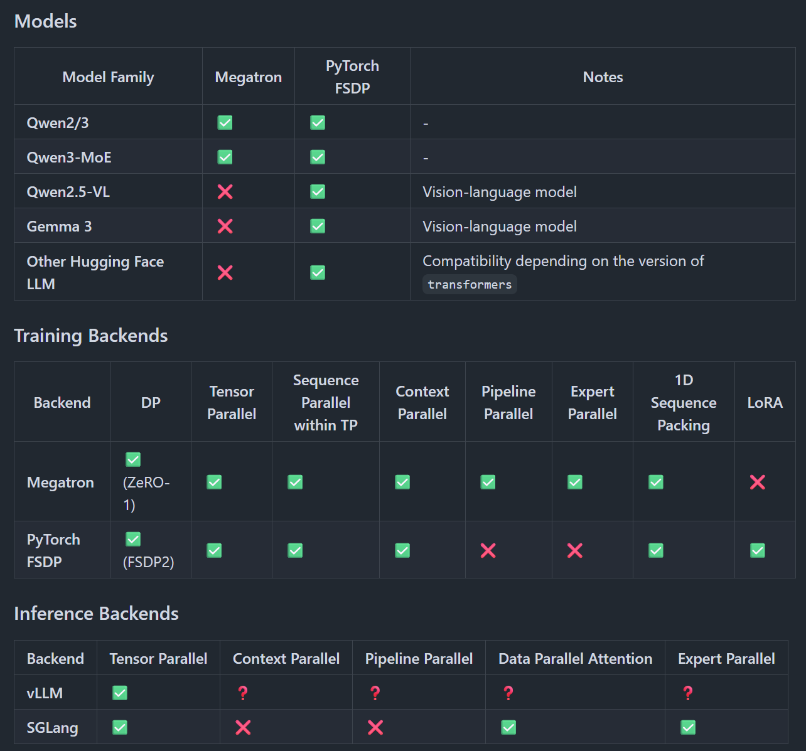
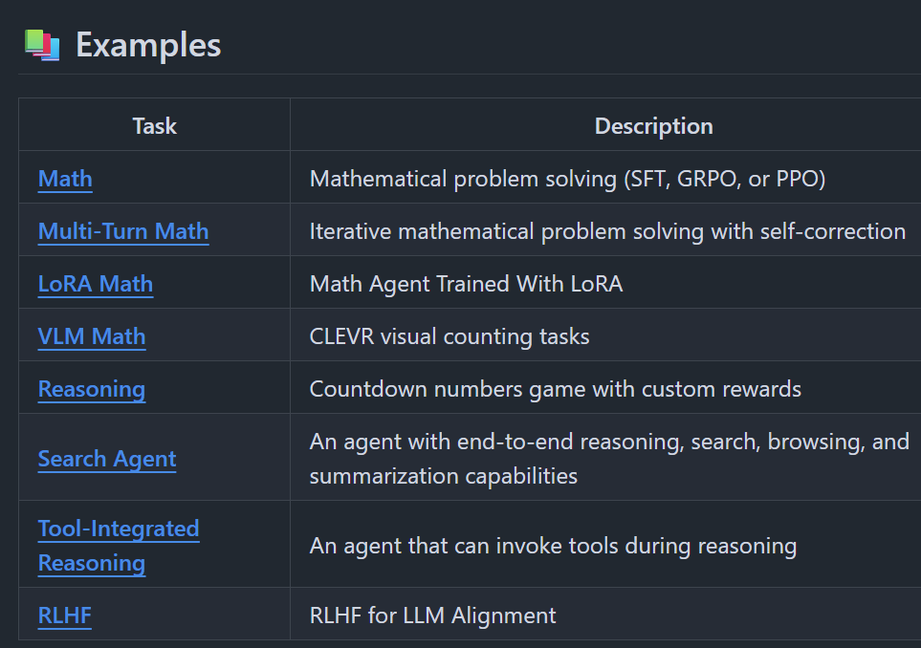
Supported Features
vLLM/SGLang/FSDP/Megatron
VLM: Qwen2-VL, Gemma-3
LoRA

Slide 44

Q&A
AReaL微信群
fuwth17@gmail.com
2025 Q3 Roadmap: https://github.com/inclusionAI/AReaL/issues/257
Paper link: https://arxiv.org/pdf/2505.24298
Code: https://github.com/inclusionAI/AReaL

